Slide 1
Year 3
English
Thursday 4th February
by Miss Taylor

Slide 2
We have created a setting for our story and written a character description.
We are now going to think about how to organise our story.
Paragraphs are used to organise ideas in the correct sequence of events.

Slide 3
L.O. Organise paragraphs around a theme.
Success Criteria
Organise ideas in a correct sequence.
Plan ideas for each paragraph.

Slide 4
Why do we use paragraphs?
Group ideas together.
Make the text easier to read.
Paragraphs
Show how an author has changed
the time, place or argument.
Organise what is being explained.

Slide 5
What is a paragraph?
A paragraph is a group of sentences within a piece of writing which is written about the same idea or topic.
Miss A Line
Between
Each
Paragraph

Slide 6
Sorting ideas into paragraphs.
All of these sentences are about castles. We are going to group the sentences together that are about the same idea / information.

Slide 7
Sorting ideas into paragraphs.
These are the sentences grouped into 3 paragraphs.
Each paragraph is giving you different information/ideas about castles.

Slide 8
In the next few slides there are 3 pieces of work,
choose the one that you feel is the
appropriate level for you.

Slide 9
Work 1
Thursday 4th February
L.O. Organise paragraphs around a theme.
Sorting into paragraphs
Read the passage below and re-write using paragraphs.
Paragraph 1 – What Miss Muffet is doing
Paragraph 2 – what came beside her
Paragraph 3 – what Miss Muffet did
Little Miss Muffet
Sat on a tuffet,
Eating her curds and whey.
There came a great spider,
Which sat down beside her,
And frightened Miss Muffet away!
Can you write another paragraph about where Miss Muffet went?
Use the ideas below, or think of your own.
Miss Muffet went to the shop To have a drink of pop.
Little Miss Muffet went inside Sat and cried.

Slide 10
Work 2
Thursday 4th February
L.O. Organise paragraphs around a theme.
Sorting into paragraphs
Read the passage below and re-write using paragraphs.
Paragraph 1 – describing Jack’s movements.
Paragraph 2 – Introducing Luca
Paragraph 3 – what had happened earlier.
Paragraph 4 – Jack shouts “speed up – we’re nearly there!”
Jack strode up an overgrown path away from the park as though relishing a mission through the jungle, dodging the occasional stinging nettle with an effortless skip or jump. “Come on, Luca. This is going to be epic!” Dipping his head and swiping away leaves like some intrepid explorer, he manoeuvred under a tree branch which hung over the narrow track. Luca dawdled behind. Only a few minutes earlier, he had been perfectly happy practising his limited gymnastics moves upside down on the monkey bars. Now, he was torn between making the effort to keep up with his friend and deliberately getting left behind. “Speed up – we’re nearly there!” Jack called eagerly over his shoulder.
Can you write another paragraph about what happens next?

Slide 11
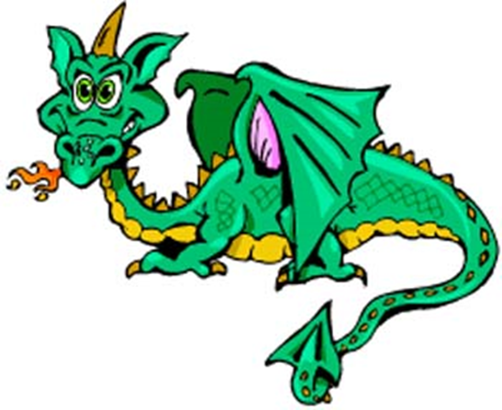
Work 3
Thursday 4th February
L.O. Organise paragraphs around a theme.
Sorting into paragraphs
Read the passage below and re-write using paragraphs.
Paragraph 1 – describing the character.
Paragraph 2 – what it eats.
Paragraph 3 – where it lives.
Paragraph 4 – it’s breed and what it can do.
The Welsh Green dragon has skin which is a blend of different greens to allow it to camouflage itself with the lush green grass of its homeland. Its eyes are blazing green and its claws are razor sharp. The tail of a Welsh Green is covered in dangerous spikes which it whips about crazily to defend itself. This breed of dragon likes to prey on sheep and cattle. It wouldn’t eat a human unless it was provoked. It will also feed on creatures found in the water and enjoys munching on birds’ eggs. You will find the Welsh Green in mountainous areas which are rocky and cold. It doesn’t like company so tends to nest in remote areas so it’s not bothered. Its nest will be somewhere sheltered and is usually made of twigs, leaves and bones and padded with sheep wool. It is the largest breed of dragon and has the longest fire breathing range of all the dragons. Incredibly, it can shoot balls of fire from its eyes. It has amazing hearing and can hear a heart beating from over 10 miles away!
Can you write another paragraph about the dragon?

Slide 12
Remote Learning Tracking
Please click on the link below.
https://forms.office.com/Pages/ResponsePage.aspx?id=eCY4lN73r0G0KV1rDWITzRhTQ2IZqpBOsW8cFVoooF9UNVlMS1dCVkdaM0k0WlhFTE9WVFBTWEg1Ti4u

