Slide 1
Year 6 Challenge 1.
2.3.2021.
If you are a challenge 1 person, your tasks linked to your learning in maths today have been set on Purple Mash

Slide 2
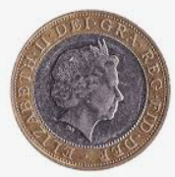
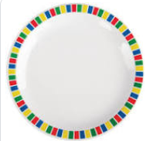
Word of the week: circular
The word circular means shaped like a circle.
Can you explain what circular means to someone else?
Can you use circular in a sentence?
Today’s challenge: Find 5 circular objects.

Slide 3
2.3.2021
L.O. Sort 2D shapes
Identify the different properties of 2D shapes
Count the different properties of 2D shapes
Sort 2D shapes according to their properties

Slide 4
1) Which shape is a triangle?
2) Which shape is a square?
3) How many sides does a square have?
4) How many circles do you see?

Slide 5
1) Which shape is a triangle?
2) Which shape is a square?
3) How many sides does a square have?
4) How many circles do you see?
4
3

Slide 6
Sorting rules:
What is the same?
What is different?

Slide 7
Sorting rules - Colour

Slide 8
Sorting rules - shape
Have a think
Circles
Squares

Slide 9
Sorting rules - shape
Have a think
Triangles
Rectangles

Slide 10
Sorting rule –
Number of vertices
Have a think
Fewest
Most

Slide 11
Vertices
Have a think
Odd
Even

Slide 13
Remote learning tracking
https://forms.office.com/Pages/ResponsePage.aspx?id=eCY4lN73r0G0KV1rDWITzRhTQ2IZqpBOsW8cFVoooF9UNVlMS1dCVkdaM0k0WlhFTE9WVFBTWEg1Ti4u

