Slide 1
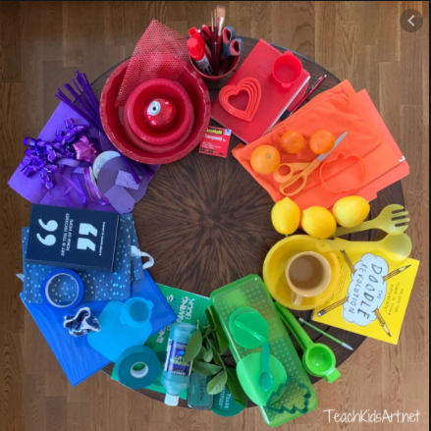
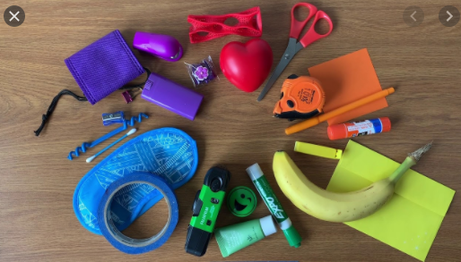
ART
Colour wheels

Slide 3
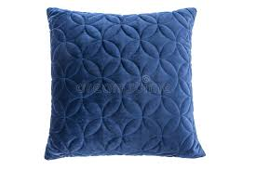
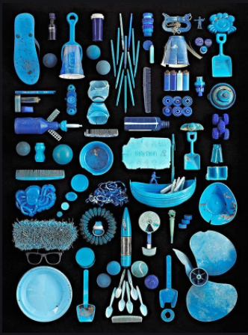
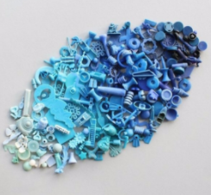
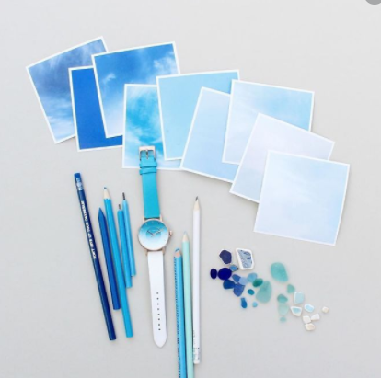
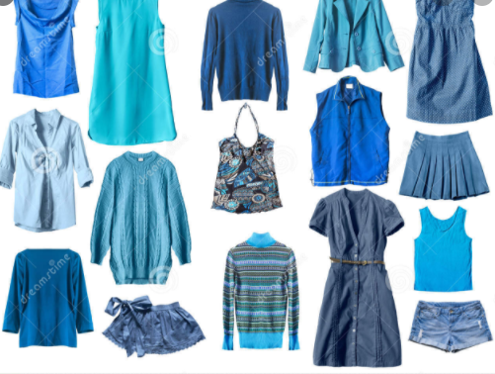

Slide 4
TASK
Use different colours of blue
Use different types of pens, pencils, paints, chalks AT THE same time
Completely fill a piece of paper using the different types of blues and materials. Colour in different directions to look like waves and ripples.
Cut the paper into 3 strips to make a river…The River Thames!
Stick the 3 pieces together and draw on boats with people in them escaping the Great fire of London.

