Slide 1
Y1 English Friday 5th March

Slide 2
Objectives:
To write an apology letter
To understand a character’s feelings.

Slide 3
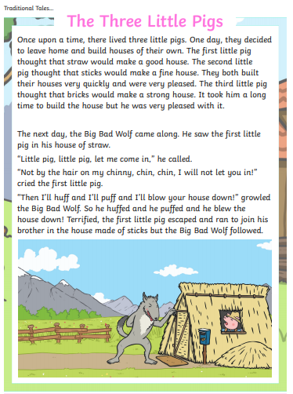
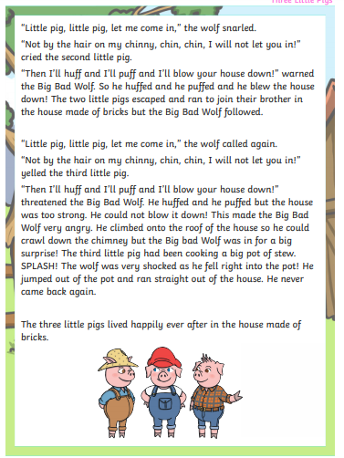

Slide 4
What should the Wolf say to let the Little Pigs know that he is sorry?

Slide 5
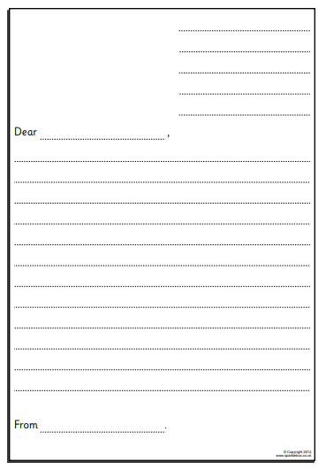
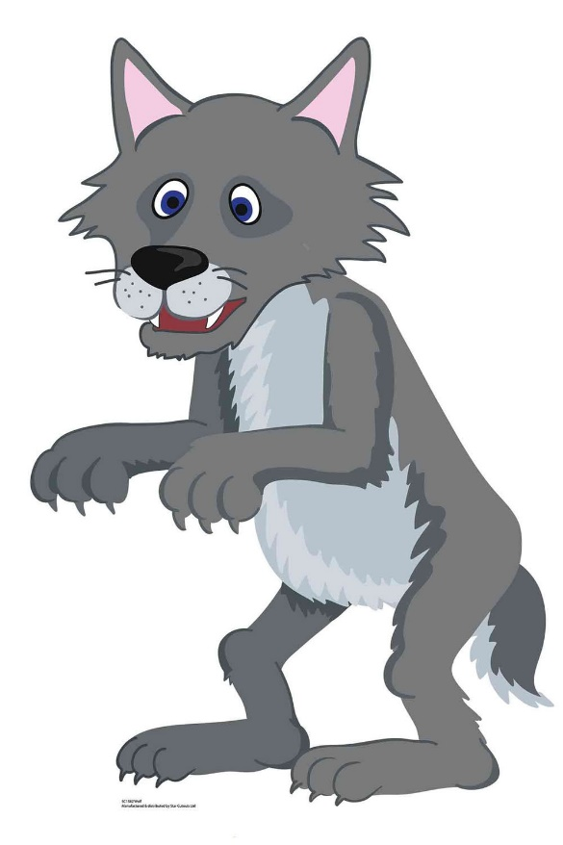
Write a letter from the Wolf to The Three Pigs to apologise for all the things he has done wrong.

Slide 6
Please follow the link below and fill in the online form to show that you have completed the lesson.
https://forms.office.com/Pages/ResponsePage.aspx?id=eCY4lN73r0G0KV1rDWITzRhTQ2IZqpBOsW8cFVoooF9UNVlMS1dCVkdaM0k0WlhFTE9WVFBTWEg1Ti4u

