Slide 1
Poetry
Remember to push on the little speaker button to hear what I have to say.

Slide 2
What are we learning today?
I can spot the different senses in the poem.
I can write sentences describing what the dog can hear and touch

Slide 3
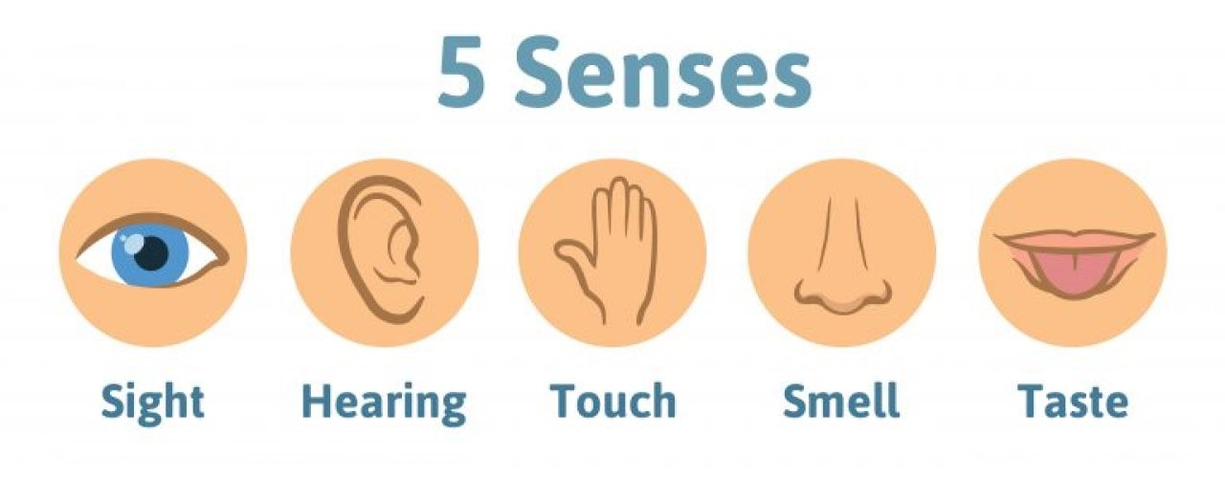
What are the five senses?

Slide 4
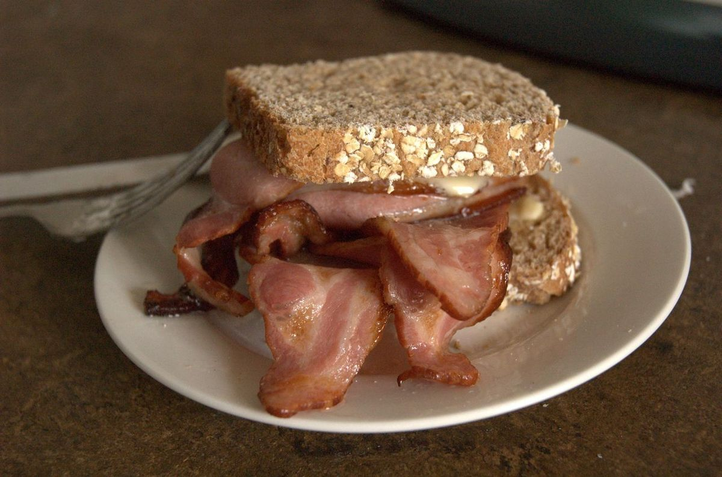
MINi task
Look around your home and carefully see things you can see, touch, taste, hear and smell.
Draw then and label them on a piece of paper.

Slide 5
Poetry Time
Here is a poem about what a dog experienced in the great fire of London.
Can you spot some of the five senses?

Slide 6
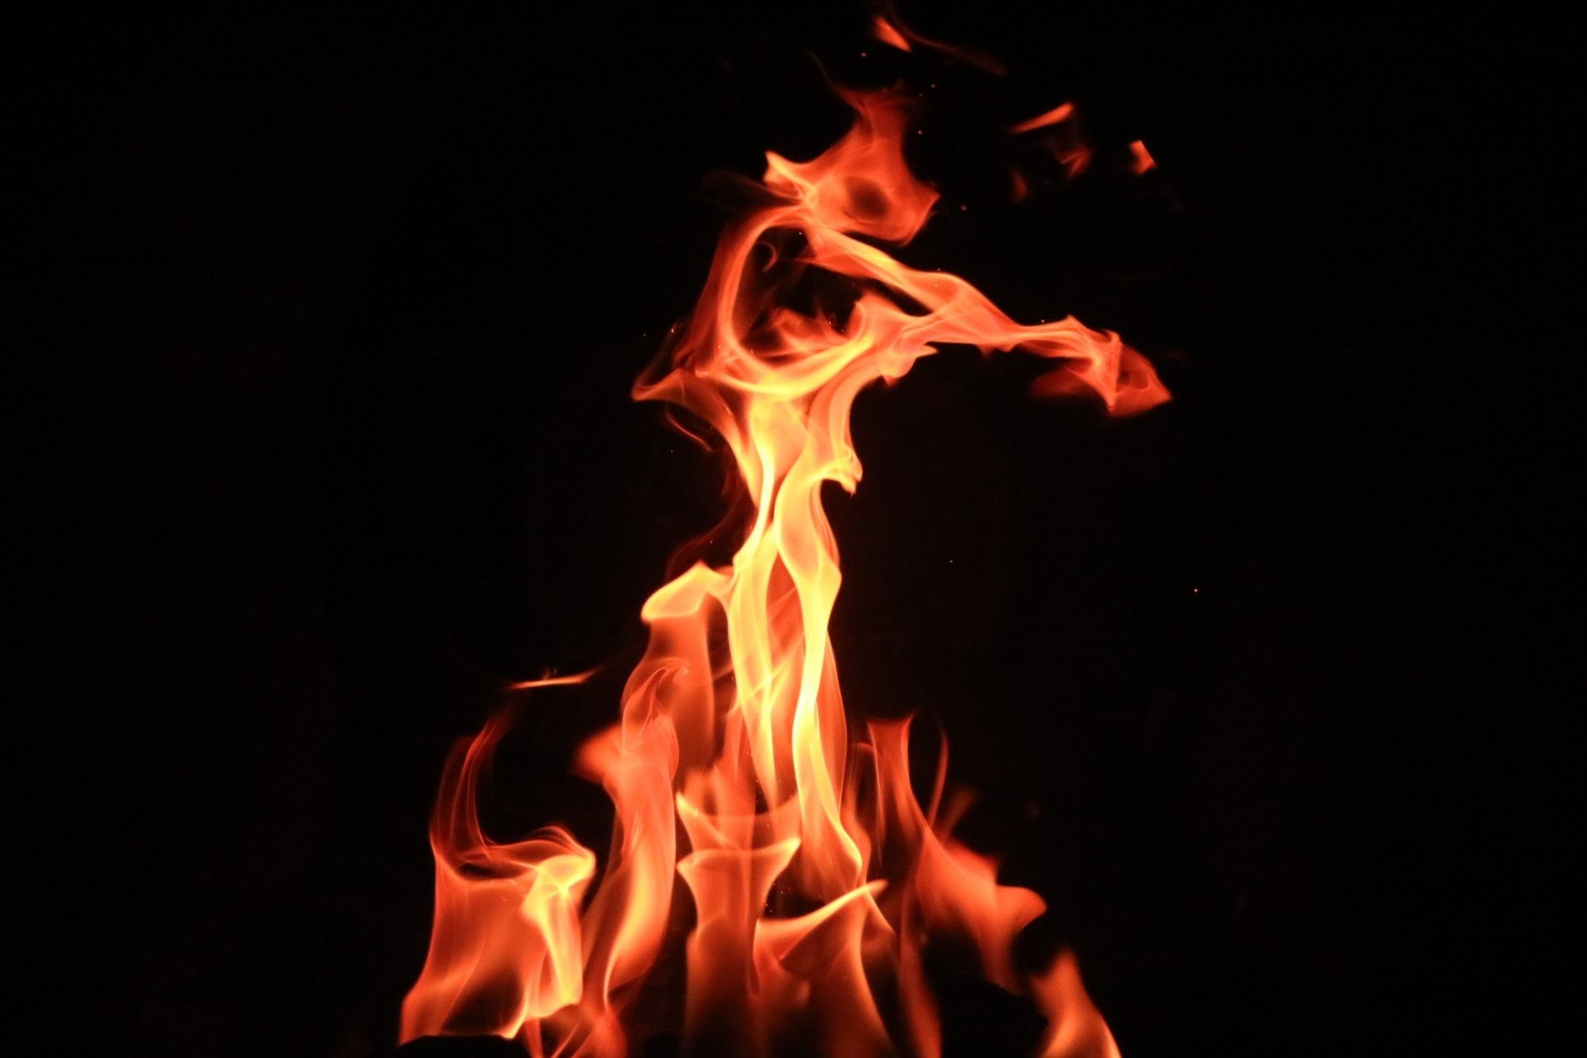
Dog in the Great fire of London
By Ms Panteli
‘Hi there,
Dog in the Great Fire of London,
How do you feel?’
Like nothing I have ever felt before.
‘Yes, but can you taste anything there?’
Ashes so hot and bitter
They bite my tongue.
That’s great dog,
Now what do you smell?

Slide 7
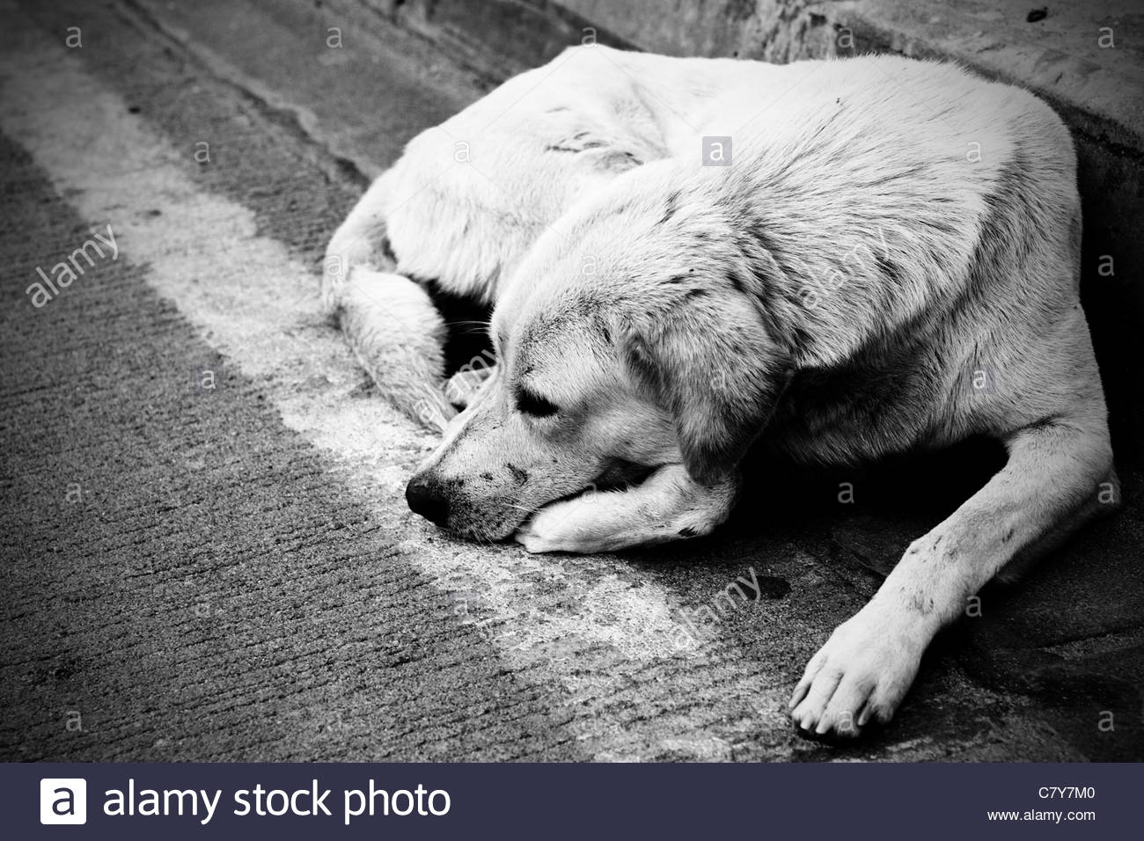
Fear of the gigantic flames towering above me.
‘OK, OK, so what can you see?’
Long dead trees,
Broken houses in empty streets,
Things,
Shadows.
‘So what are you going to do next?
Sit and howl for help.

Slide 8
Which senses did you spot?

Slide 9
Writing task

Slide 10
What makes good writing?
What makes good writing?
Think about what we are going to write.
Say it three times
Start with a capital letter. C
Sound out each word
Full stop .
Finger spaces
Check it out!

Slide 11
The dog can hear….

Slide 12
Great work!

