Slide 1
Poetry
Remember to push on the little speaker button to hear what I have to say.

Slide 2
What did we learn about yesterday?
Read aloud your favourite poem.
Say why you have enjoyed this poem.

Slide 3
What are we learning today?
Write a verse of a poem.

Slide 4
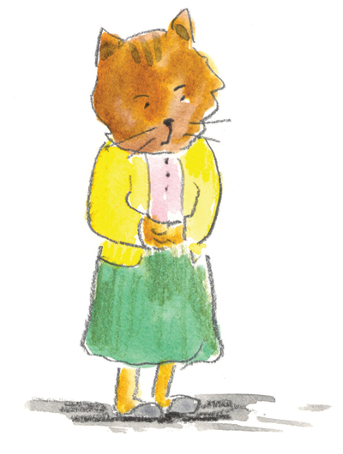
Poetry Time
Singing of my boys,
Roaring of cars.
The buzz of Alfred.
The smiles of my class,
Scraping of chairs,
Crunching of apples.
Scents of the lunch hall,
The tinkling of forks,
Slurping of drinks,
Pitter-patter of feet.
The ticking of the clock,
Bags rustling on shoulders,
The hum of parent’s voices,
Eyes twinkling with affection.
Another Sensational Day
By Ms Panteli
The snores of children,
The ringing of the alarm,
Splash of the tap.
Bubbling of the kettle
The crunch of cereal,

Slide 5
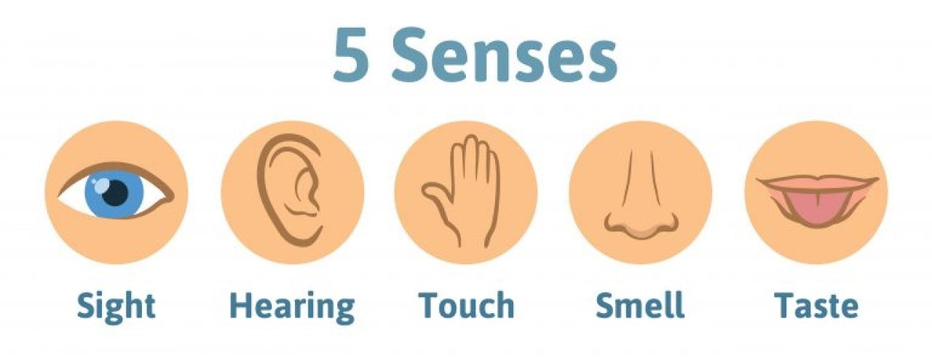
Task 1
Read through the poem again and see if you can spot the five senses.

Slide 6
Poetry Time
singing of my boys,
roaring of cars.
The buzz of Alfred,
The smiles of my class,
Scraping of chairs,
Crunching of apples.
Scents of the lunch hall,
The tinkling of forks,
Slurping of drinks,
Pitter patter of feet.
The ticking of the clock,
Bags rustling on shoulders,
The hum of parent’s voices,
Eyes twinkling with affection.
Another Sensational Day
By Ms Panteli
The snores of children,
The ringing of the alarm,
Splash of the tap.
Bubbling of the kettle,
The crunch of cereal,

Slide 7
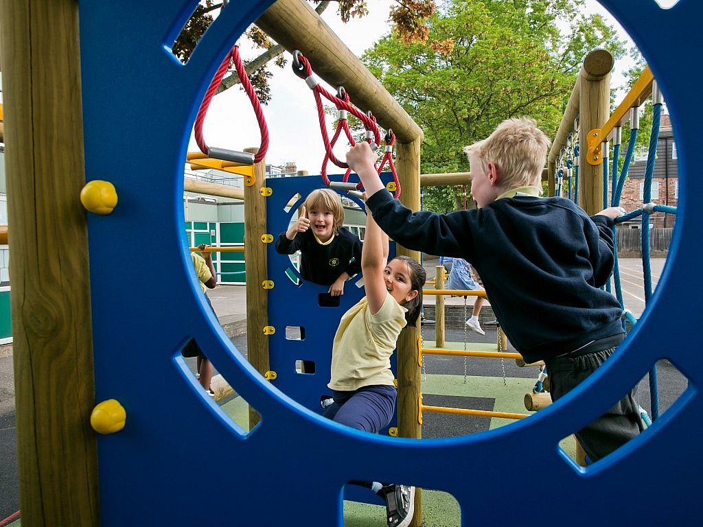
Task 2:
Read through the poem again and see if you can spot the different times of the day

Slide 8
Poetry Time
singing of my boys,
roaring of cars.
The buzz of Alfred,
The smiles of my class,
Scraping of chairs,
Crunching of apples.
Scents of the lunch hall,
The tinkling of forks,
Slurping of drinks,
Pitter patter of feet.
The ticking of the clock,
Bags rustling on shoulders,
The hum of parent’s voices,
Eyes twinkling with affection.
Another Sensational Day
By Ms Panteli
The snores of children,
The ringing of the alarm,
Splash of the tap.
Bubbling of the kettle,
The crunch of cereal,

Slide 9
Writing task
Today you are going to be writing your own bit of the poem.
Choose a time of the day and see if you can describe the different things that happen.
For example:
During breakfast you might hear crunching cereal, the bubbling of the kettle or a honk of the alarm.

Slide 10
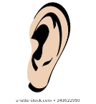
What makes good writing?
What makes good writing?
Think about what we are going to write.
Say it three times
Start with a capital letter. C
Sound out each word
Full stop .
Finger spaces
Check it out!

Slide 11
Your task
The poem is set out into verses with four lines each.
Now use your ideas to create your own verse.

Slide 12
Verse example
Honk of the alarm waking me up
Crunching cereal
Roar of the engine
Scraping ice from the frozen window screen

Slide 13
Success Criteria
Capital letters
Finger spaces
Four lines
Full stop

Slide 14
Great work

