Slide 1
Year 2 Science
Week 3
Microhabitats

Slide 2
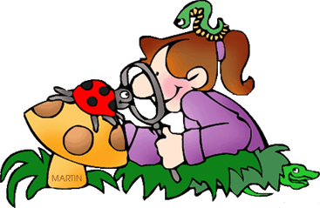
Tuesday 19th January 2021 L.O: Investigate the preferred habitat of mini beasts.

Slide 3
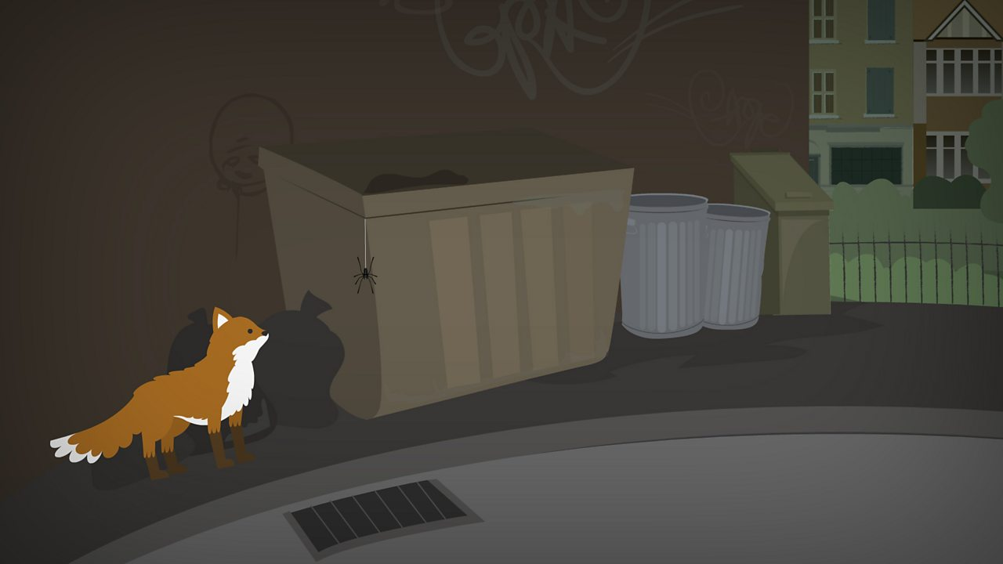
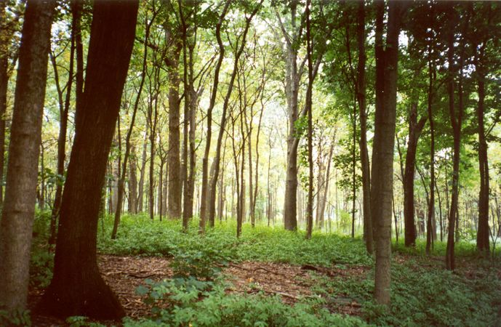
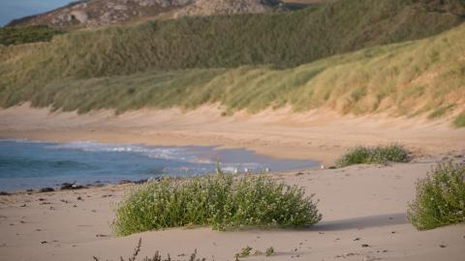
Habitats
Last week, we learnt about different habitats. Can you remember what these were?
Urban
Woodland
Coastal

Slide 4
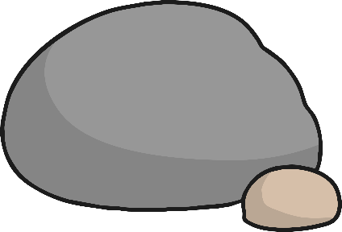
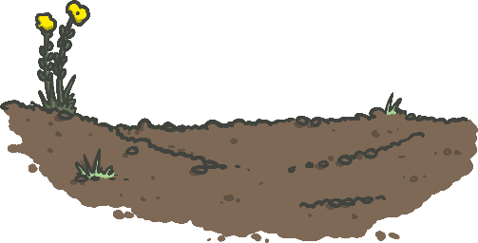
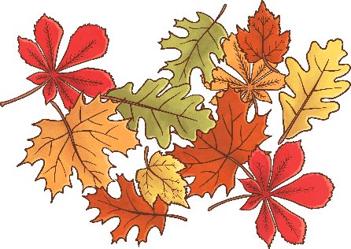
Microhabitats
Microhabitats are tiny habitats within a big habitat. Here are some images of microhabitats that you may have seen.
Under stones
In grass
In soil or mud
Under leaves that have fallen off trees
On plants
Inside rotting wood

Slide 5
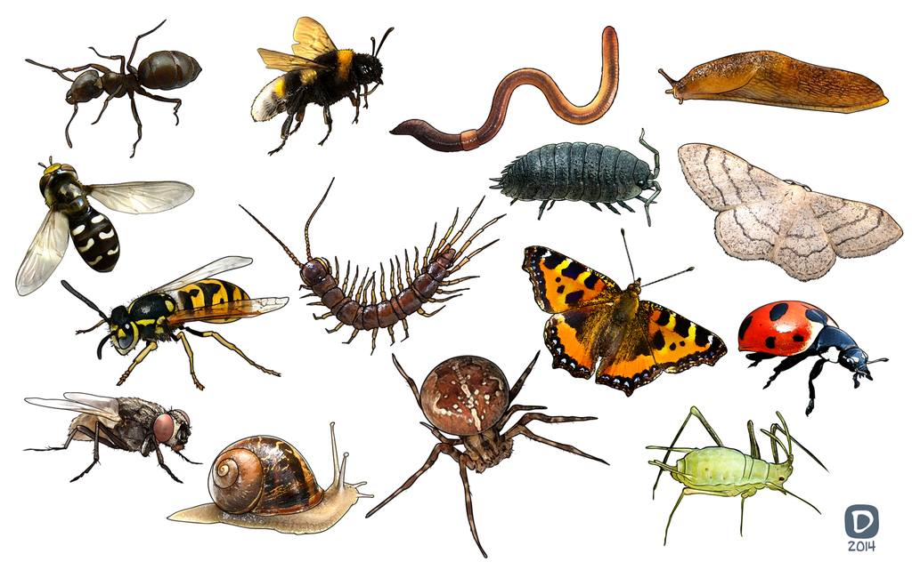
Mini beasts
Mini beasts are tiny creatures that live in microhabitats. The microhabitats are small so that they can provide a safe place for mini beasts to live and survive.
Can you name any of the mini beasts in the image?

Slide 6
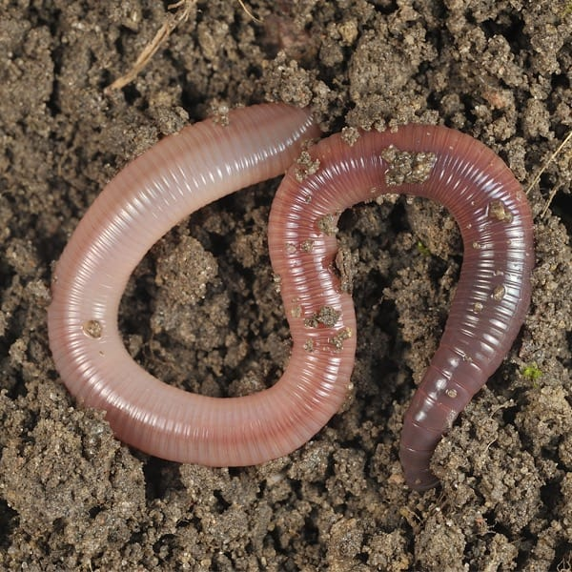
Worms
Worms like to live in micro habitats that contain soil, such as around plants.
In order to survive, the soil needs to be moist. This is why you will mostly see worms when it has been raining.
Worms eat the dead leaves that have dropped onto the floor.
Worms dig holes in the soil so that the water and air can get into it and keep it healthy for them to live in.

Slide 7
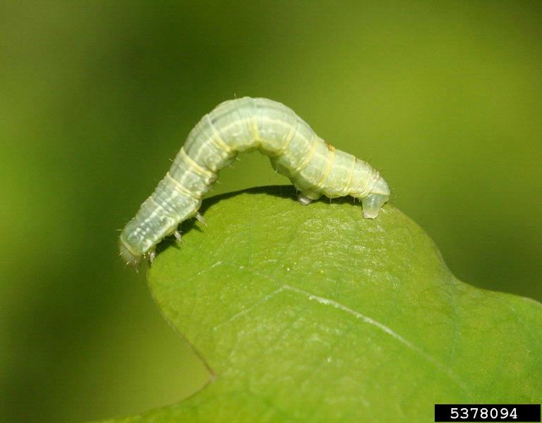
Caterpillars
Caterpillars like to live on the top of leaves or underneath them.
They like to live on leaves because this means that they are camouflaged. Camouflaged means that other animals cannot see them because they are the same colour as their habitat and they won’t get eaten.
Caterpillars grow a cocoon which they keep safe in until they turn into a butterfly.

Slide 8
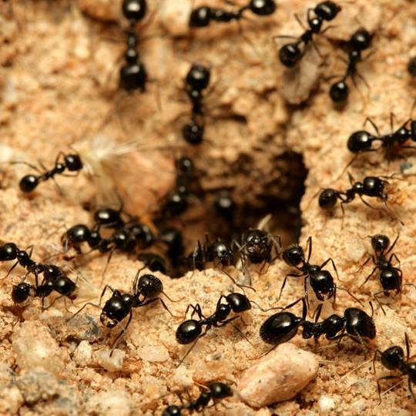
Ants
Ants live underground and they often live in big families. You will not very often see an ant on its own because they usually come out and walk in lines.
Ants live underground because there are lots of other insects that they can eat under there. They are also protected under the ground.
Ants also live underground because they don’t have ears. They can hear insects that are coming to eat them through the vibrations on the ground above them.

Slide 9
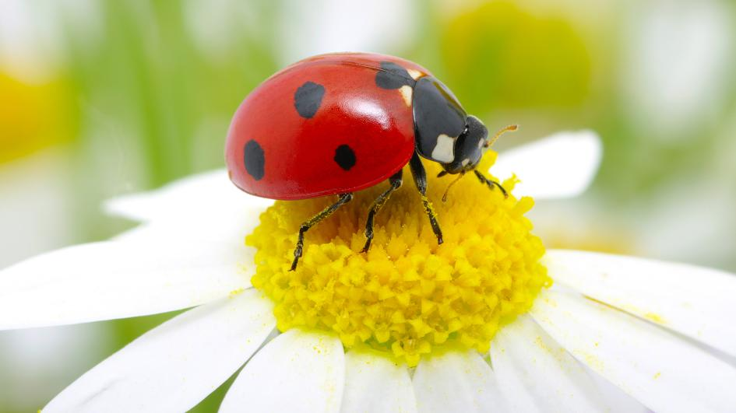
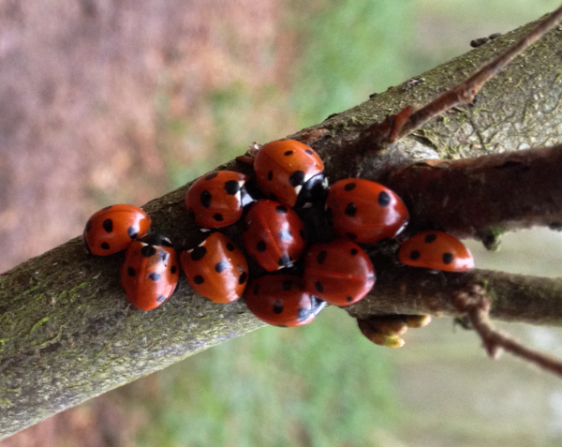
Ladybirds
In the summer, ladybirds live on flowers and in shrubs. These are like hedges.
However, in the winter, they hide in tree stumps, under rocks and under fallen leaves because it is cold and the want to feel protected.
In the winter, ladybirds huddle together like you can see in the image so that they can stay warm. They hibernate, this means sleep until it is spring and summer again.

Slide 10
Activity
Draw a poster about the different microhabitats that you have learnt about in today’s lesson. Label what insects you may find there.
Look in your garden or local area if you go on a walk.
Can you find any microhabitats and see any mini beasts that you didn’t know lived there?

