Slide 1
L.O: notice forces need contact between 2 objects.
Types of forces

Slide 3
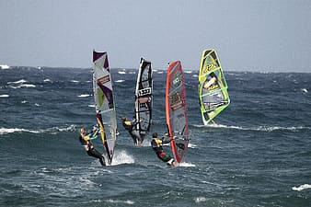
L.O: notice forces need contact between 2 objects.
Look at the picture opposite.
Which forces can you see?
Use the clues to help you.
Notes:
🍐 This is a Pear Deck Text Slide
🍐 To edit the type of question, go back to the "Ask Students a Question" in the Pear Deck sidebar.

Slide 4
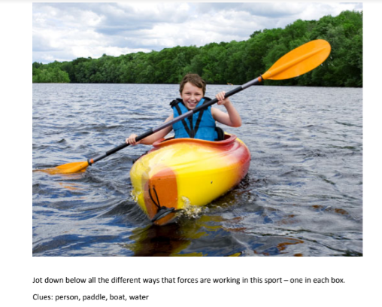
L.O: notice forces need contact between 2 objects.
Look at the picture opposite.
Which forces can you see?
Use the clues to help you
Notes:
🍐 This is a Pear Deck Text Slide
🍐 To edit the type of question, go back to the "Ask Students a Question" in the Pear Deck sidebar.

Slide 6
Notes:
🍐 This is a Pear Deck Drawing Slide
🍐 To edit the type of question, go back to the "Ask Students a Question" in the Pear Deck sidebar.

Slide 7
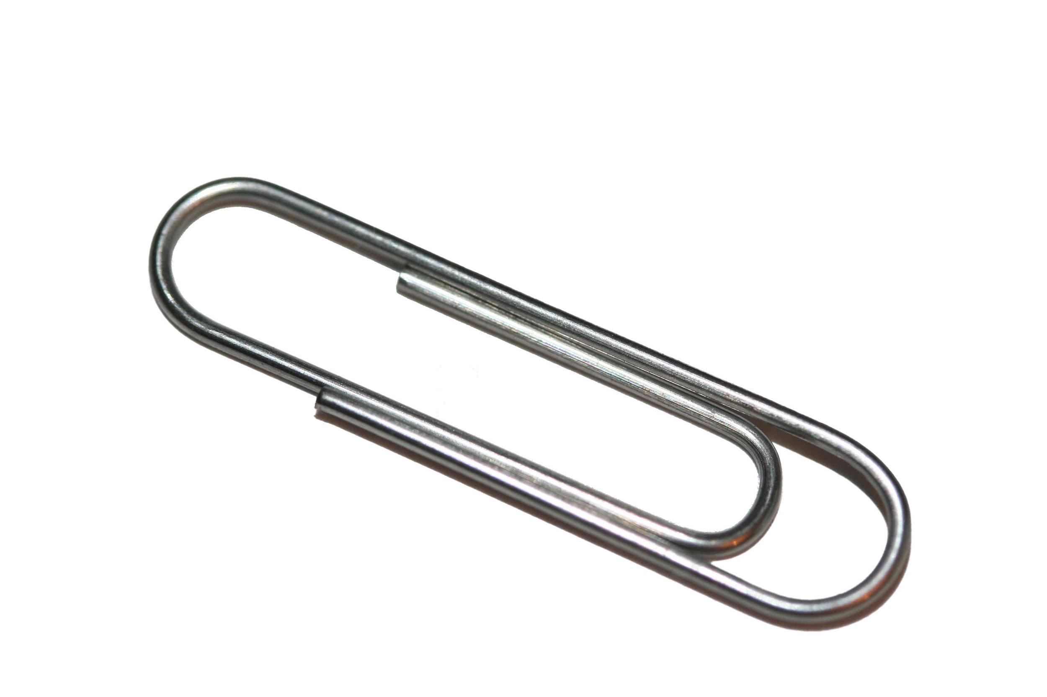
L.O: notice forces need contact between 2 objects.
Here is a paperclip and a piece of card.Put the paperclip on top of the card.
How can you make the paperclip move without touching it?

Slide 8
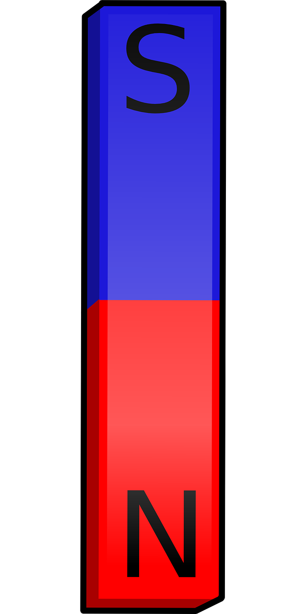
L.O: notice forces need contact between 2 objects.
What if you were to tilt the card? Gravity will make it slide downhill.
Can you think of any other ways we can move it without contact?
What if we were to use a magnet?
Let’s investigate.

Slide 9
L.O: notice forces need contact between 2 objects.
L.O: notice forces need contact between 2 objects.
What do I think will happen with a paperclip and a magnet?
Our scientific investigation:
Our question: ( What do we want to test).
What we are going to do:
What we found out:

Slide 10
L.O: notice forces need contact between 2 objects.
Record your results on your sheet.

Slide 11
L.O: notice forces need contact between 2 objects.
Now we can share our findings from when you used the magnet.
What happened?
What have we learnt?
That magnets ( like gravity) can act without contact.

