Slide 1
Non-Chronological
Reports
13.01.21

Slide 2
LO: Use appropriate features to write a non-chronological report.
Success Criteria:
Use sub-headings to sort the information.
Write in the present tense.
Write in the third person.
Use paragraphs.
Finish with a summary.

Slide 3
Structure
Opening Statement – Introduce the information
Who are you writing about?
What is it or what is it used for?
Where is it found?
When is it found?
Description of topic or situation including some or all of its:
Qualities – Birds have feathers.
Parts and their functions – The beak is…
Habits or behaviours or uses – They build nests out of twigs and sticks.

Slide 4
The Report
Use headings and sub headings.
Use simple clear titles.
Tempt the reader using questions. Make them think.
Write using short sentences, it makes it clear and gives more emphasis on the point.
Use diagrams and captions to help explain leading lines or interesting facts.

Slide 5
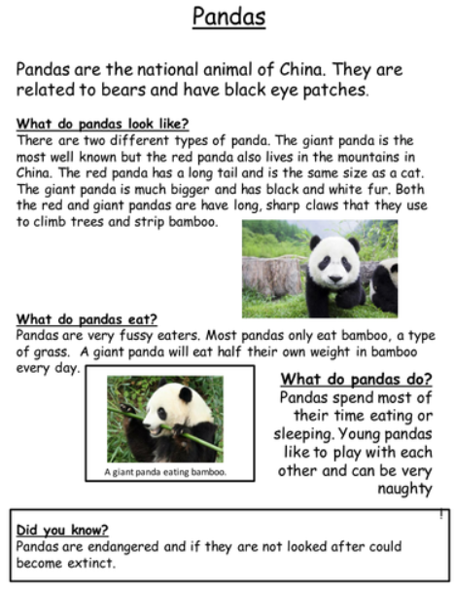
An example of a
non-chronological report.

Slide 6
Your Turn…
Use your plan from yesterday to write your non-chronological report on fireworks.
Mild – use sub-headings to sort the information.
Medium – include paragraphs and diagrams.
Spicy – include questions, paragraphs and diagrams.

