Slide 1
Science – Properties and Changes of Materials Lesson 1
Monday 1st March 2021

Slide 2
LO: Compare and group together everyday materials on the basis of their properties.
Success Criteria:
Generate vocabulary to describe properties of materials.
List antonyms.
Label properties.
Define key vocabulary.
Investigate properties of materials.
Compare and group materials using a Venn Diagram.

Slide 3
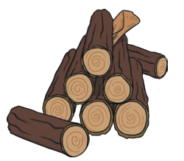
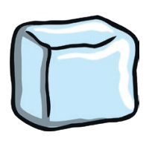
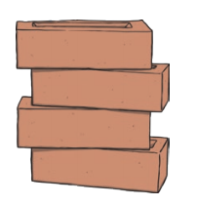
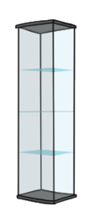
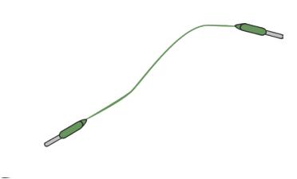
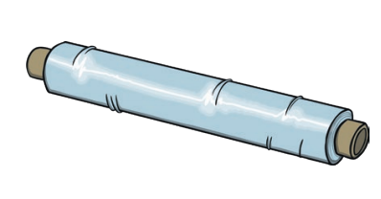
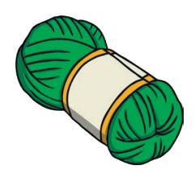
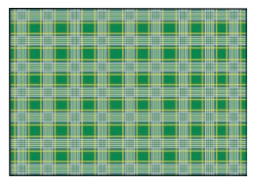
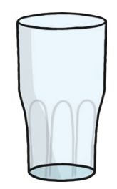
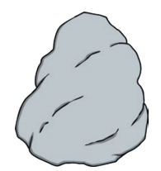
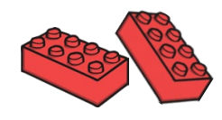
waterproof
Properties

Slide 4
Antonyms (Opposites)
Shiny
Stretchy
Bouncy
Hard
Rough
Flexible
Waterproof
Absorbent
Opaque
Magnetic
Electrical Conductor
Thermal Conductor
Strong

Slide 5
Antonyms (Opposites)
Shiny
Stretchy
Bouncy
Hard
Rough
Flexible
Waterproof
Absorbent
Opaque
Magnetic
Electrical Conductor
Thermal Conductor
Strong
Dull
Not stretchy
Not bouncy
Soft
Smooth
Rigid
Not waterproof
Not absorbent
Transparent/ translucent
Non magnetic
Electrical insulator
Thermal insulator
Fragile

Slide 6
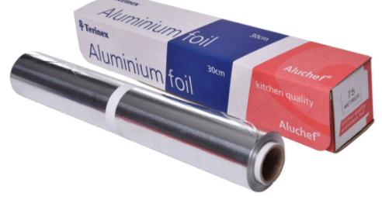
Starter Task
Not stretchy
Shiny
Non magnetic
Opaque
Flexible
Not absorbent

Slide 7
Vocabulary Check
Hard
Soft
Soluble
Insoluble
Transparent
Opaque
Translucent
Electrical Conductor
Thermal Conductor
Magnetic
Non magnetic
Solid, firm and rigid, not easily broke, scratched or pierced.
A material that can easily change shape.
When it is put in water it ‘disappears.’ It has dissolved and the resulting liquid is called a solution.
When it is put in water it stays as a solid.
Light completely passes through it and you can clearly see through it.
Can not be seen through and does not allow light to pass through it.
Some light passes through it but the light is scattered, so you can’t see clearly through it.
Electric charges can pass through without difficulty.
Materials that allow heat to pas through them easily.
A material that will be attracted to a magnet.
A material that will not be attracted to a magnet.

Slide 8
Your Task
 | Hard/ Soft | Soluble/ Insoluble | Transparent/ Opaque/ Translucent | Electrical Conductor | Thermal Conductor | Magnetic/ Non magnetic

Slide 9
Your Task
 | Hard/ Soft | Soluble/ Insoluble | Transparent/ Opaque/ Translucent | Electrical Conductor | Thermal Conductor | Magnetic/ Non magnetic
Aluminium Foil | Soft | Insoluble | Opaque | Yes | Yes | Non Magnetic
https://coolscienceexperimentshq.com/conducting-heat/

Slide 10
Your Task - Support
 | Hard/ Soft | Soluble/ Insoluble | Transparent/ Opaque/ Translucent
Aluminium Foil | Soft | Insoluble | Opaque

Slide 11
Challenge
Choose one word from our properties list e.g. magnetic.
Plan and carry out a fair test investigation to find out more about this property (use materials you’ve already collected during this lesson).
Then, compare and group together materials according to your results.

Slide 12
Plenary

Slide 13
Plenary - ANSWERS

Slide 14
Remote Learning Tracking
Please click on the link below to let us know that you have accessed the lesson.
https://forms.office.com/Pages/ResponsePage.aspx?id=eCY4lN73r0G0KV1rDWITzRhTQ2IZqpBOsW8cFVoooF9UNVlMS1dCVkdaM0k0WlhFTE9WVFBTWEg1Ti4u

