Slide 1
Geography
Tuesday 19th January 2021

Slide 2
LO: Identify and know the main physical geographical features of the Maya Highlands.
Success Criteria:
Identify key geographical features from an atlas.
Mark on a map, using a key.

Slide 3
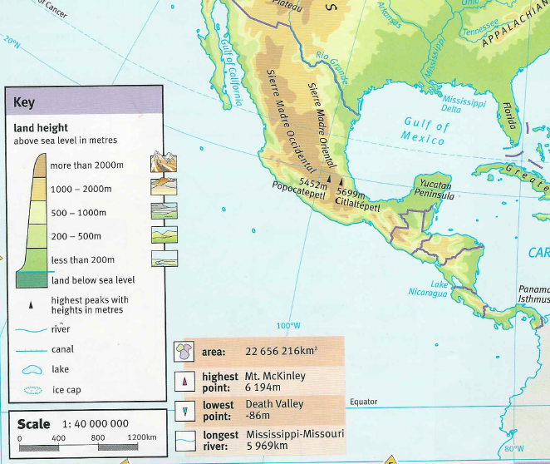
Maya Highlands

Slide 4
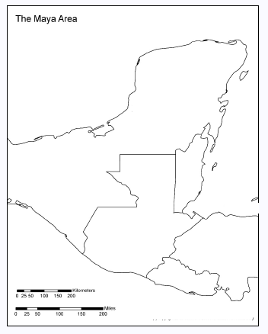

Slide 5
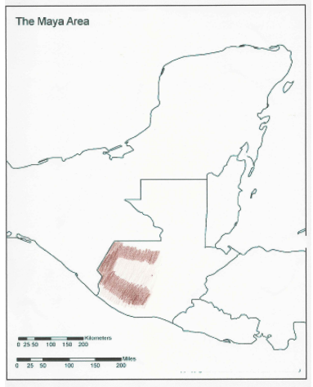

Slide 6
Using GoogleMaps, locate these features and mark on your map:
Tajumulco Volcano
Cuchumatanes Range
Chuacús and Chamá Sierras
Caribbean Sea
El Chaval
Lake Atitlan
Pacific Ocean

Slide 7
Maya Highlands (more info)

Slide 8
Summary
Where are the Highlands?
Sierras
Water
Climate / Weather
Trade
Animals
Which Maya city is the closest to the Highland region?

Slide 9
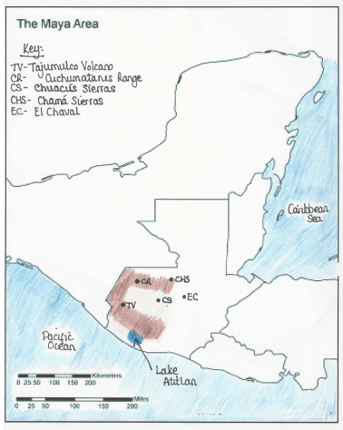
Answers

