Slide 1
Friday 8th January 2020
Add fractions with the same denominator.

Slide 2
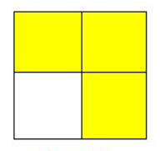
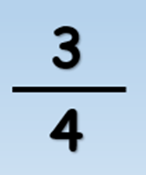
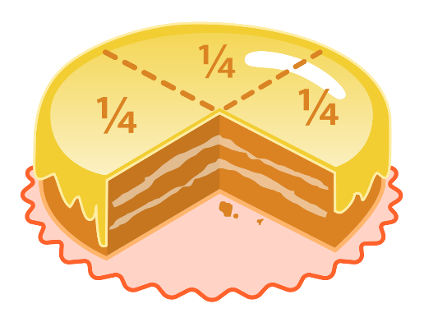
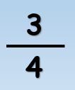
Let’s Revise!
Numerator
3
3
4
4
Denominator
3
3
4
4

Slide 3
1
3
1 + 3
4
+
=
=
5
5
5
5
One fifth
Three one fifths
1
3
1 + 3
4
+
=
=
5
5
5
5
One fifth
Three one fifths

Slide 4
Recap
How do you add fractions when the denominator is the same?
S.C:
Identify the numerator and denominator
Calculate with the numerators
Keep the denominator the same

Slide 5
Your Turn
1
1
+
=
4
4
+
=

Slide 6
1
1
1 + 1
2
+
=
=
4
4
4
4
One quarter
One quarter
Two one quarters
+
=

Slide 7
Your Turn
3
2
+
=
5
5

Slide 8
3
2
3 + 2
5
+
=
1
5
5
5
=
5
=
Three one fifths
Two one fifths
Five one fifths
One whole

Slide 9
Your Turn
One mouse travels 5/8 of a metre.
The other mouse travels 2/8 of a metre.
How far do they travel altogether?

Slide 10
How far do they travel altogether?
5
2
5 + 2
7
+
=
=
8
8
8
8

Slide 11
Your Turn
2
4
3
+
+
=
11
11
11

Slide 12
2
4
3
2 + 4 + 3
9
+
+
=
=
11
11
11
11
11
Two one elevenths
Four one elevenths
Three one elevenths
Nine one elevenths

Slide 13
Your Turn
1
5
+
=
7
7
4
1
+
=
7

Slide 14
4
5
1
+
=
7
7
7
3
4
1
+
=
7
7

Slide 15
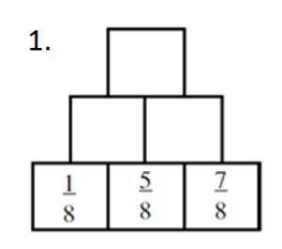
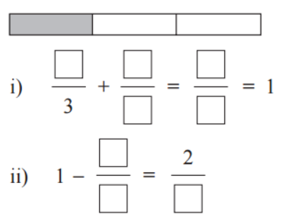
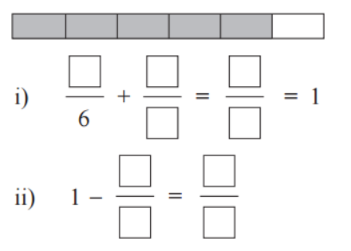
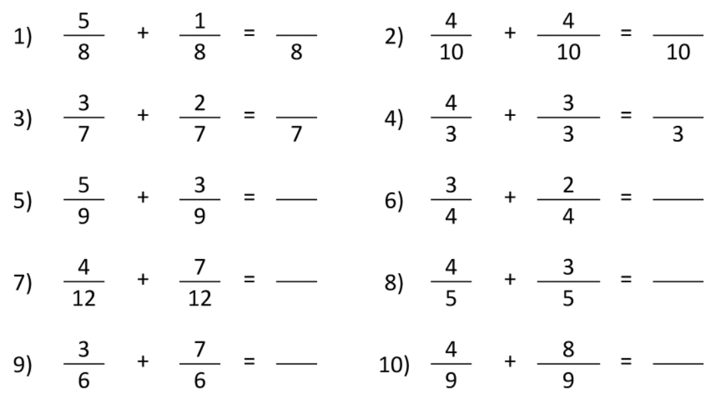
Challenge One Challenge Three
Challenge Two

Slide 16
Plenary
7
+
=
9
This is the answer. What could the question be?

Slide 17
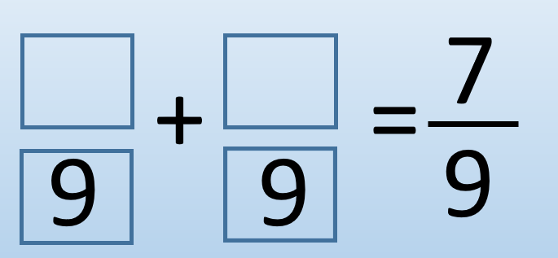
Plenary
2
5
1
6
3
4
This is the answer. What could the question be?

Slide 18
Challenge One Challenge Three
Challenge Two
Answers
2
3
6
9
18
8
7
10
5
8
6
8
12
8
6
8
1
5
1
6
2
3
3
3
5
7
6
1
3
5
1
8
9
5
4
3
6
6
11
12
7
5
10
6
12
9

