Slide 1
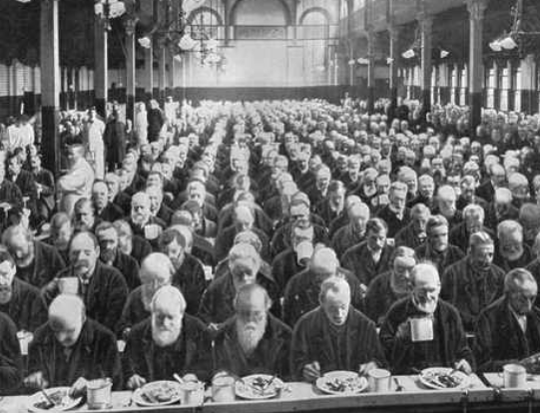
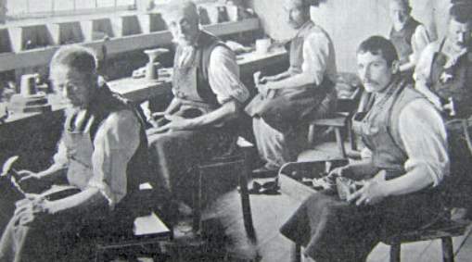
L.O. Use technical language
Identify technical language within a text.
Ensure technical language used is linked to the topic.
Explain what the technical language means.
Today we are going to be writing a non chronological report about the work houses in Victorian times.

Slide 2
Technical language is vocabulary specific to the topic.
For example if you were writing about car engines, you would use the following technical language: piston, cam belt, spark plugs, battery, and alternator.
Click on the link below to watch a video about what life was like in the Victorian workhouse. While watching, make notes on what the workhouse was like and also make a note of the technical language.
If there is any language you don’t understand, you could use a dictionary but make sure you are looking at the word in context.
https://www.youtube.com/watch?v=YcpqCdIXmHE

Slide 4
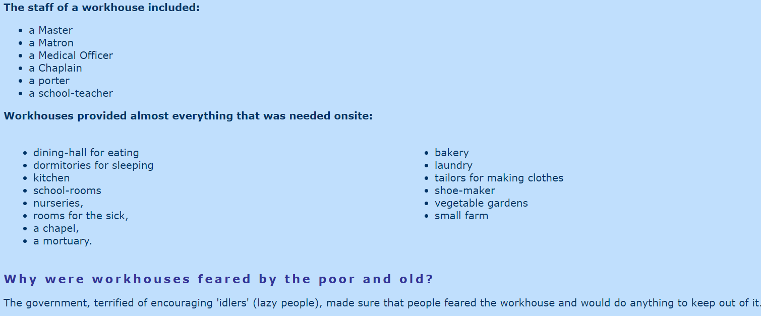

Slide 5
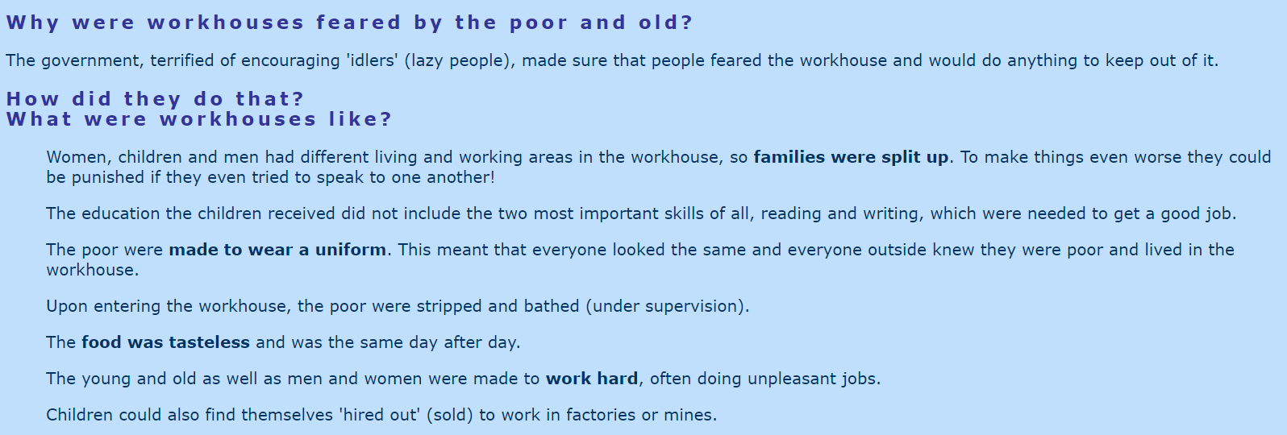

Slide 6
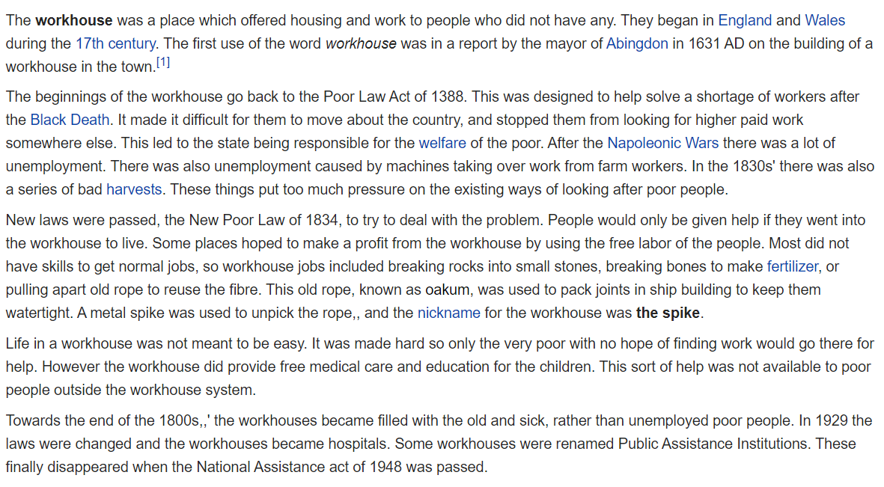

Slide 7
The following link will take you to a website about workhouses that you can do your own research from.
https://www.historic-uk.com/HistoryUK/HistoryofBritain/Victorian-Workhouse/

Slide 8
The features of a non-chronological report include some of the following:
An eye-catching heading in a large font
An introductory paragraph
Text split up into paragraphs and each paragraph on a different aspect of the subject
Sub-headings for each paragraph
Pictures of the subject
Captions under each picture to explain what is in the picture
Diagrams with labels
Lists of facts in bullet points
Boxes containing interesting individual facts to grab the attention of the reader
Technical vocabulary in bold, possibly with a glossary at the end

Slide 9
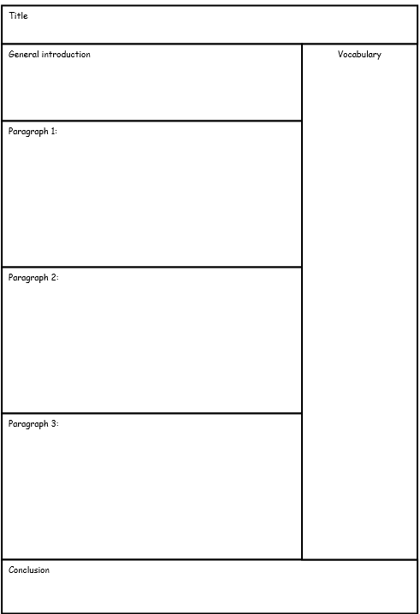

Slide 10
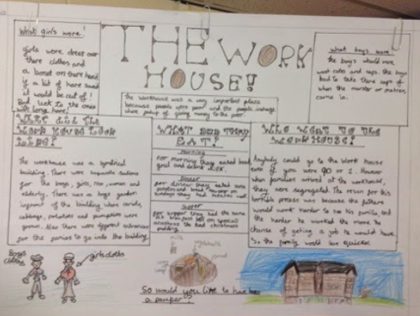

Slide 11
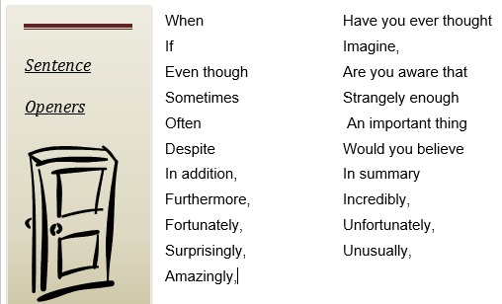

Slide 12
