Slide 1
L.O. Use past tense consistently
Explain that we use past tense when we recount things that have happened in the past.
Identify verbs in sentences.
Identify the past tense of verbs.
Convert present tense verbs into past tense.

Slide 2
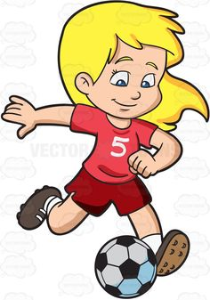
I usually play football.
Yesterday I played football.

Slide 3
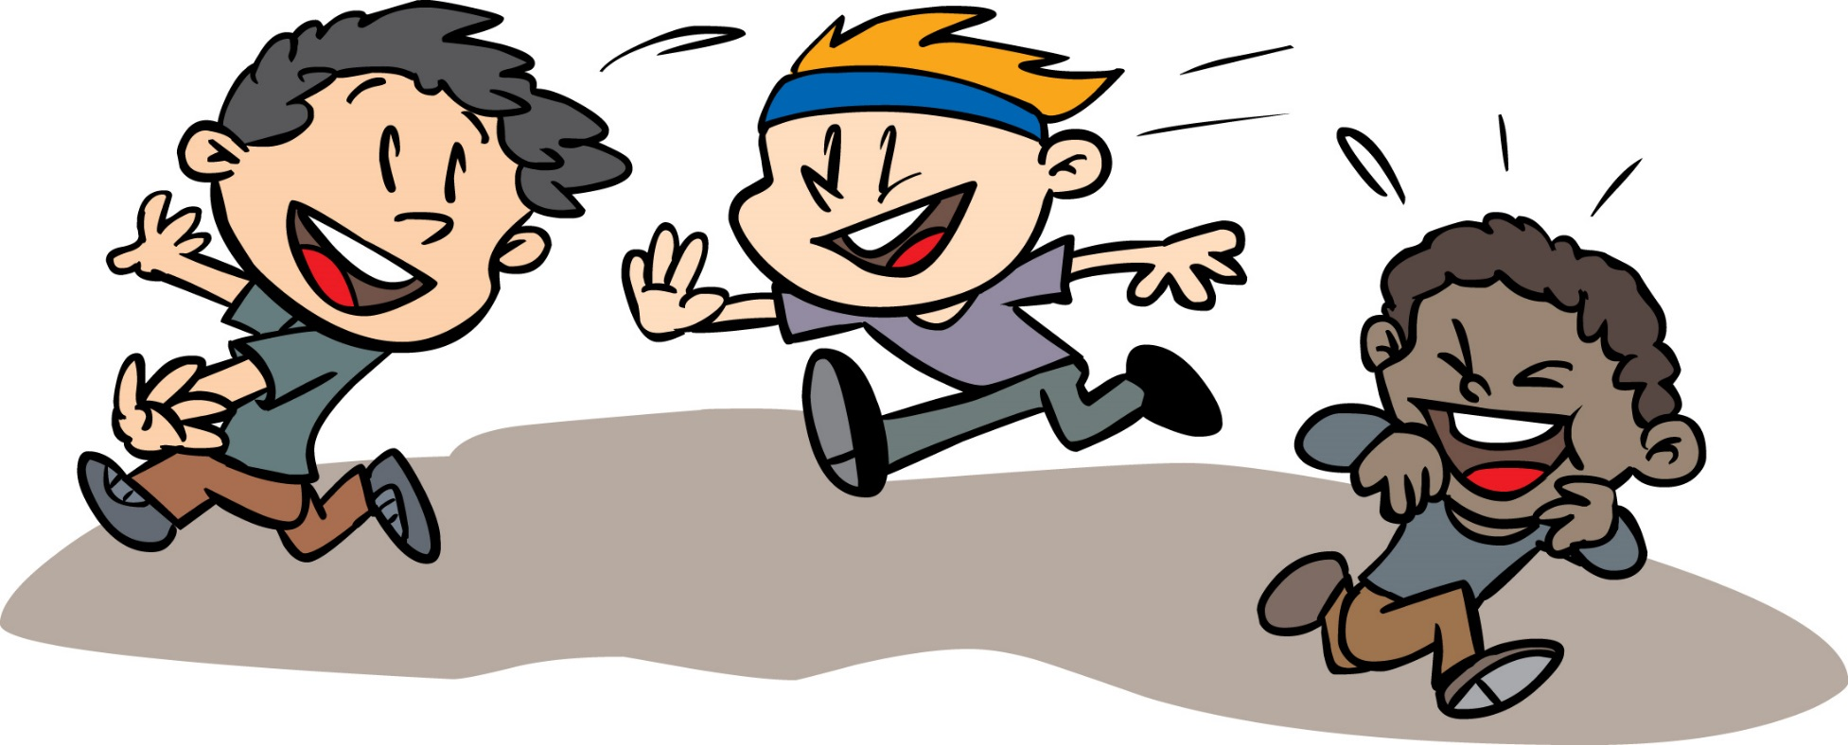
Sometimes I run around playing tag.
This morning I ran around playing tag.

Slide 4
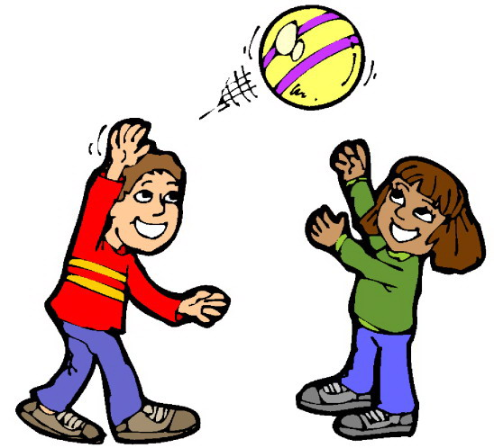
I throw the ball to my friend and she catches it
I threw the ball to my friend and she caught it.

Slide 5
Regular verbs (add –ed in past tense)
play
laugh
need
look
ask
call
played
laughed
needed
looked
asked
called

Slide 6
Irregular verbs (they break the rules! You just have to learn them)
go
say
make
take
think
is
went
said
made
took
thought
was

Slide 7
Now try these:
It is sunny
We have Assembly today
We go swimming
I think P.E. is fun
My dad helps me with my homework
We need to tidy up the cloakroom
It was sunny
We had Assembly today
We went swimming
I thought P.E. was fun
My dad helped me with my homework
We needed to tidy up the cloakroom

Slide 8
Today we are going to look at the lives of poor Victorian children who didn’t live in the workhouses. You are going to write a diary entry as a poor Victorian child using past tense. Why would we use past tense?

Slide 9
Click on the link below to watch a film about child labour in Victorian times.
www.youtube.com/watch?v=q94mPWu0Ej8

Slide 14
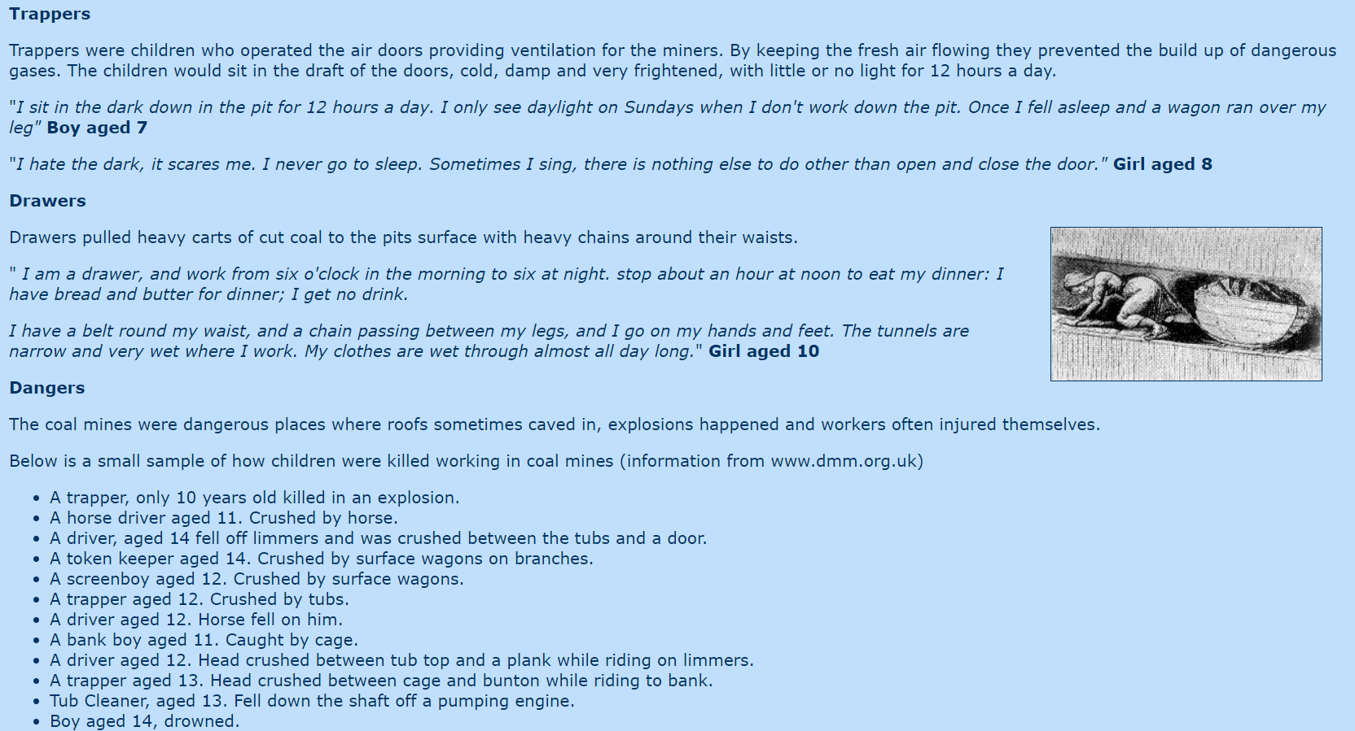

Slide 15
Joe Holt, like many climbing boys, came from a large family. He was sold to William Hope for a few guineas and never saw his family again. His world was bounded by Perkins Rents and the rough plaster walls of the fifteen chimneys he climbed each week.
Dear diary,
I’ve had such a long day. At 6.00 a.m., Mr Hope bellowed to me to wake up. The first thing I felt was pain. I put my hands up to my face and felt around my eyes. I could feel they were inflamed and sore where my filthy hands had rubbed coal deep into my skin. My knees and elbows throbbed from grazes which, irritated by soot and ash, have never healed.
Shortly after waking up, I was lucky enough to get a slice of bread and a mug of tea.
My first call of the day was at 6.45 a.m. It was at 20 Dartmouth Street. Tom Honnett was with me. He is one of Mr Hope’s older boys who carries the soot bags. We were let into the house by a yawning servant and lead into a bleak room, lit by a single candle. We examined the chimney and Tom said, because it was a ‘nine-incher’, I would have to go in ‘on the slant’. I went into the flue and put one hand by my side, pressing my palm against the wall, while putting my other hand above my head with my palm on the opposing wall. I kept my body rigid and shimmied up to the top in 12 minutes.
When I started as an apprentice, I wore pads on my arms and legs until the skin toughened. Soon the pads took up too much room; without them my skin was soon torn again. Once, half-way up a chimney, I lost my nerve and refused to move; but the sweep who was with me drove pins into my feet until I scrambled, screaming and choking, to the top. Even then, I knew I had got off lightly; I have heard of sweeps who lit fires under their boys to make them climb more quickly.

