Slide 1
12.01.2021
L.O: Convert fractions to percentages.
S.C: Recall what percent means.
Recognise relationship between fractions and percentages.
Use knowledge of fractions to convert to percentages.

Slide 2
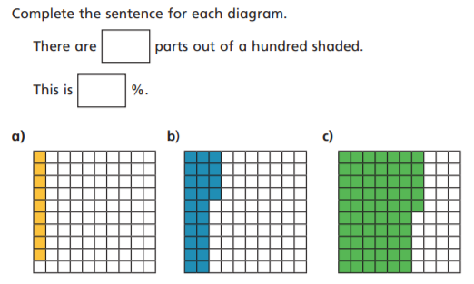
Percentages
Percent (%) means out of 100.

Slide 3
a) There are 9 parts out of 100 shaded.
This is 9%.
b) There are 24 parts out of 100 shaded.
This is 24 %.
C) There are 65 parts out of 100 shaded.
This is 65 %

Slide 4
Can you write the fraction to go with each bar model?

Slide 5
30
30/100 3/10
70
70/100 7/10

Slide 6
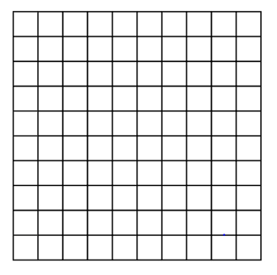
Use the 100 square to help you workout the percentages.
Remember:
1/100 = 1%
10/100=1/10=10%

Slide 7
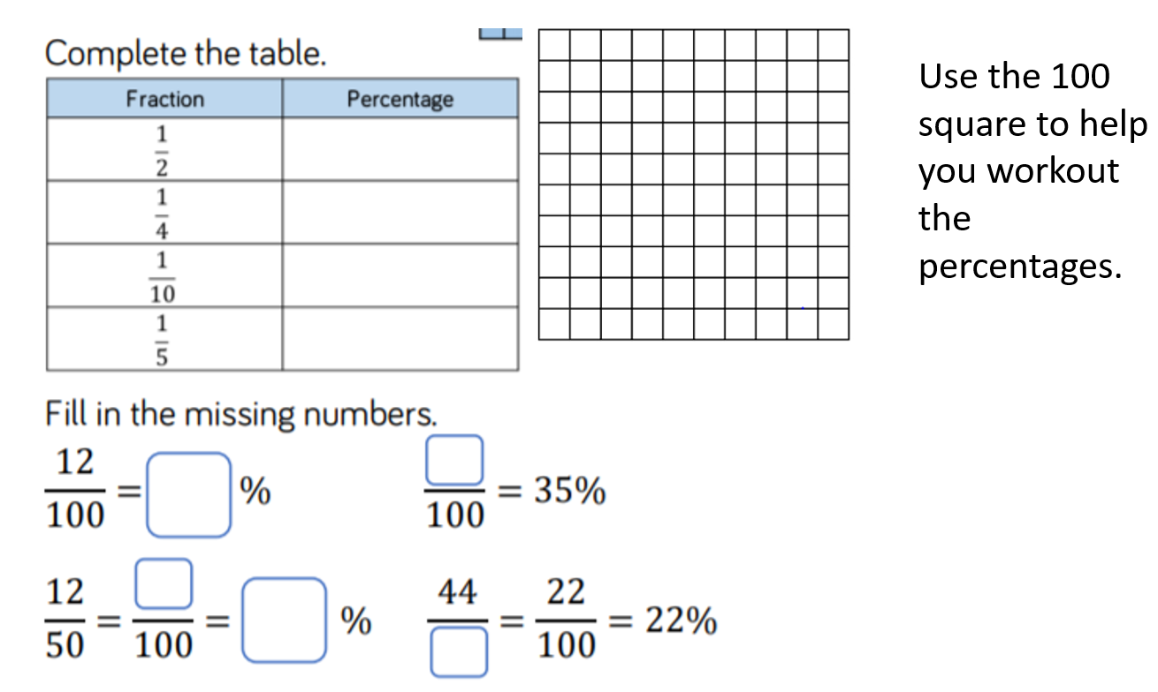
50%
25%
10%
20%
35
12
24
24
200

Slide 8
Rehearsal questions

Slide 9
40
65
50
70

Slide 10
Challenge 1

Slide 11
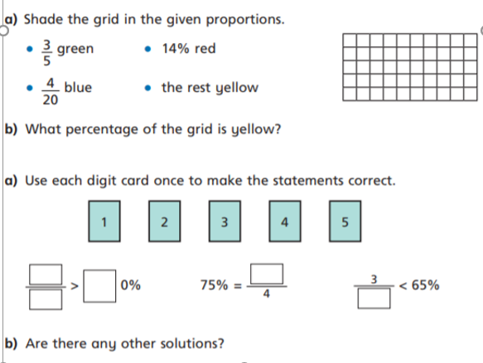
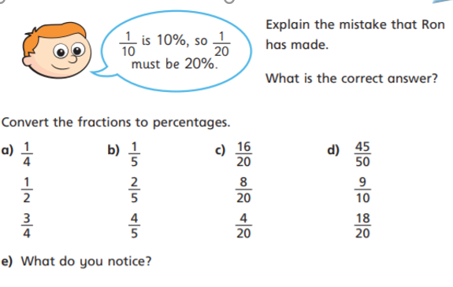
Challenge 2
1.
4.
5.
2.
3.

Slide 12
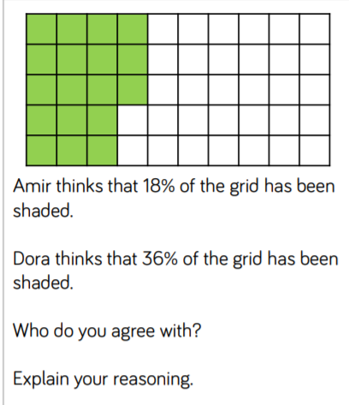
Additional challenges
Create your own questions based on the question above for your friend or a member of your family to answer.

Slide 13
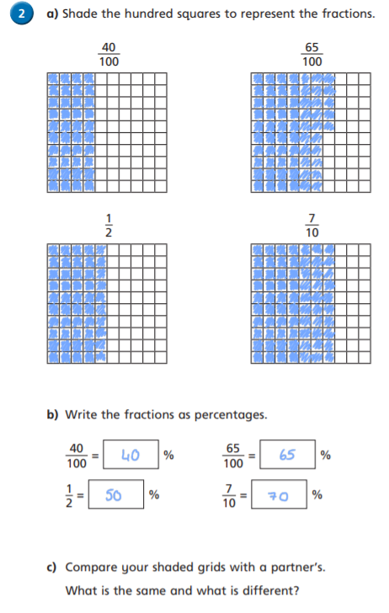
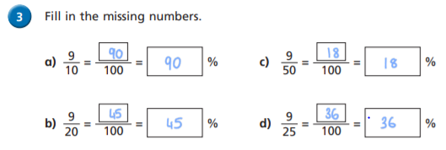
Answers-Challenge 1

Slide 14
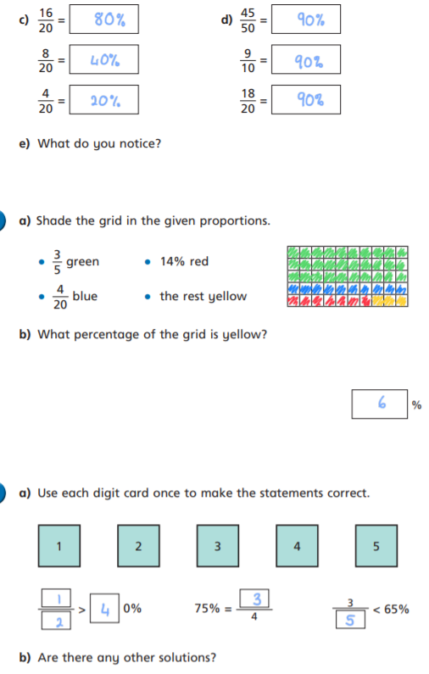
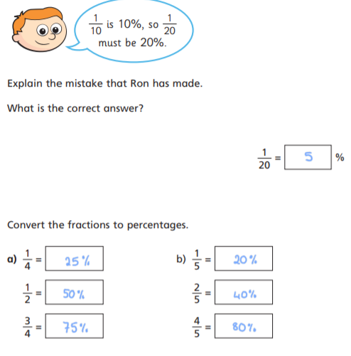
Answers-Challenge 2
1.
4.
2.
5.
3.

Slide 15
Remember to complete your daily 8 and practise your times tables on TTRS. Can you make the top 10 this week?

