Slide 1
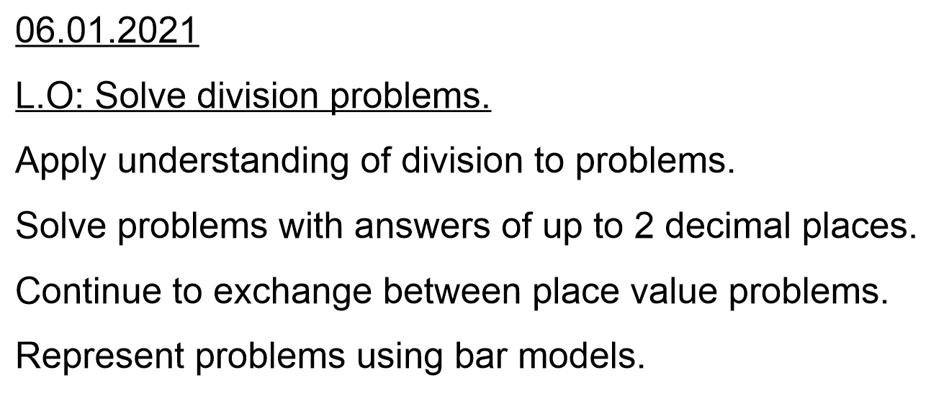

Slide 2
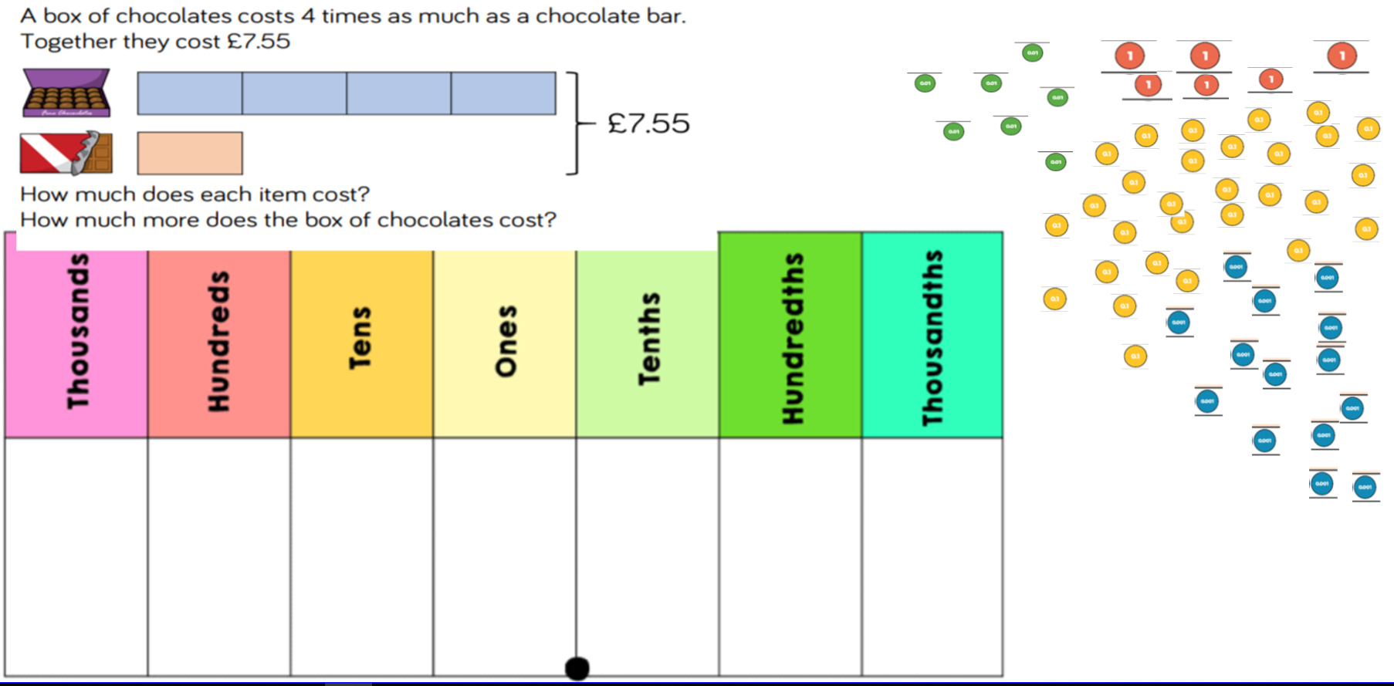

Slide 3
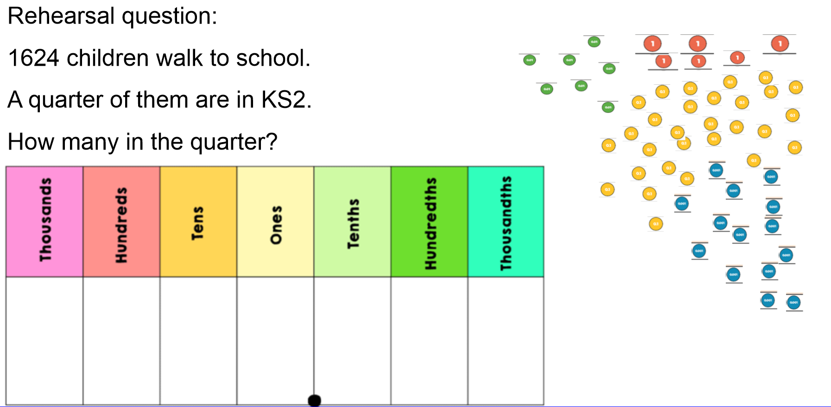

Slide 4
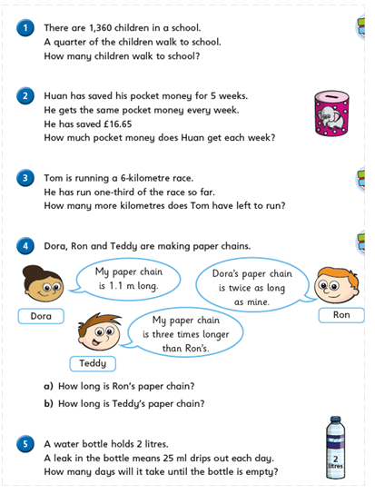
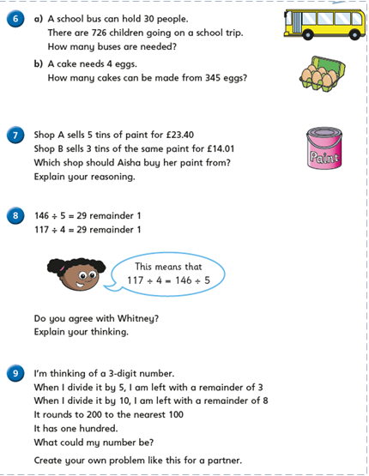

Slide 5
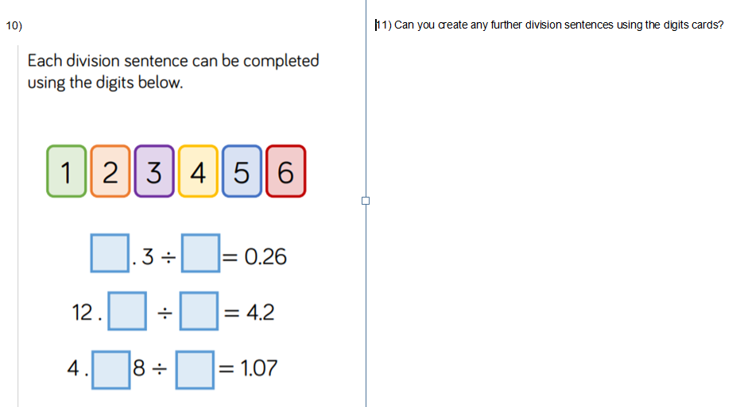

Slide 6
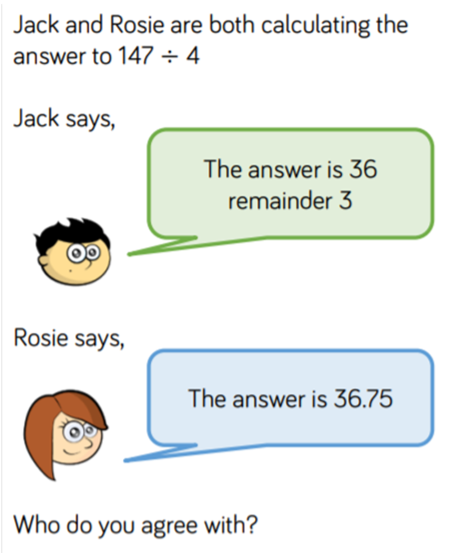

Slide 7
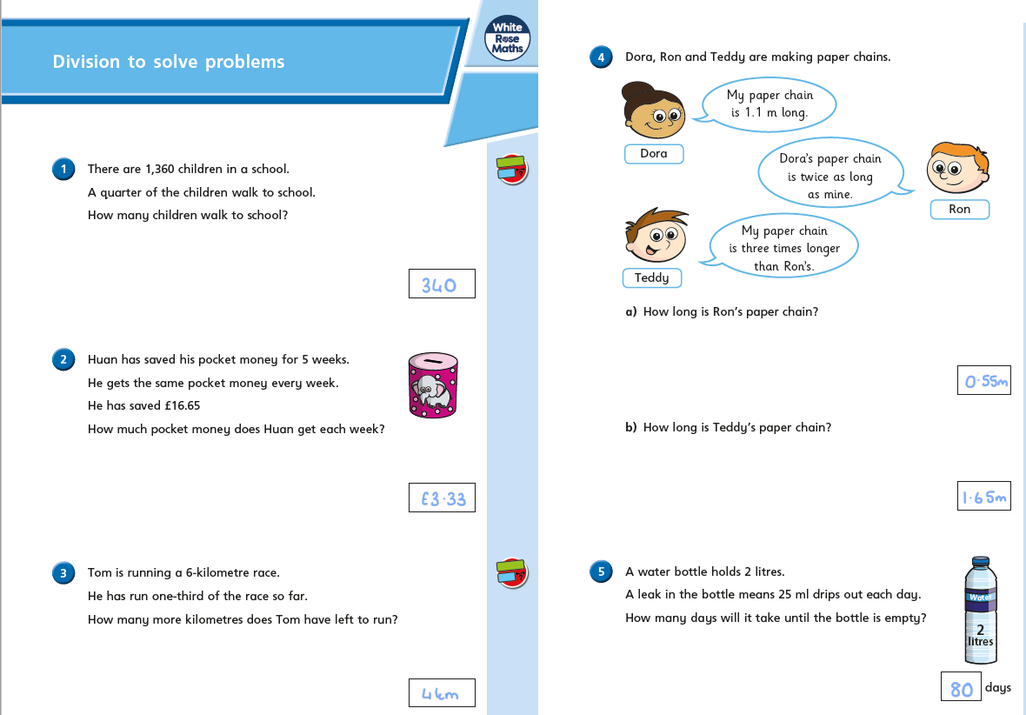

Slide 8
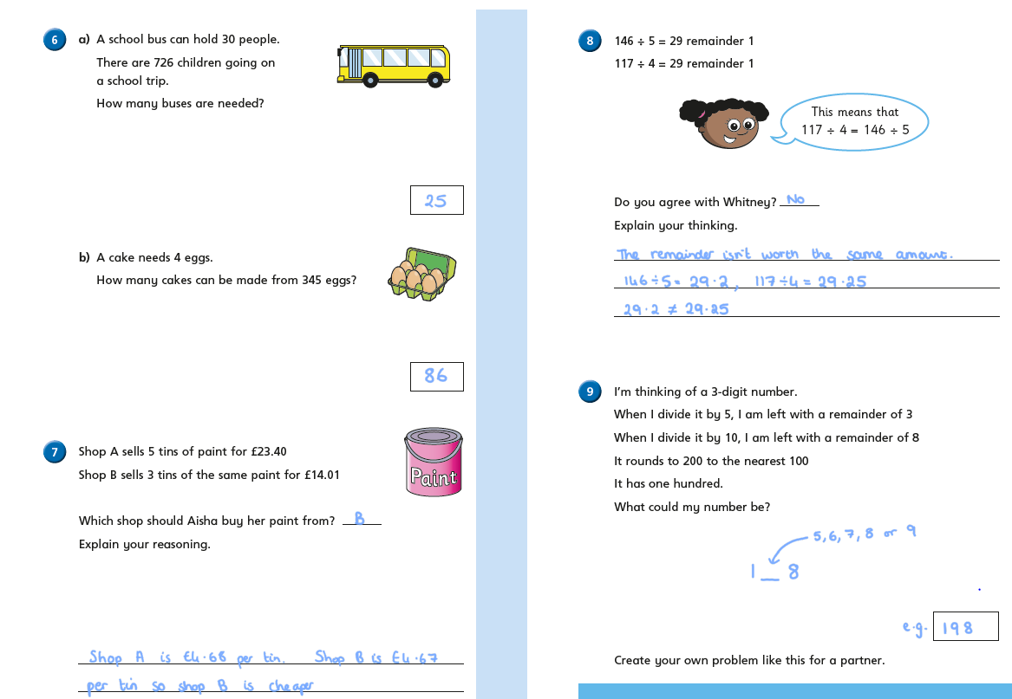
10.
Plenary answer:
They are both correct.
Rosie has divided her remainder of 3 by 4 to get 0.75 whereas Jack has recorded his as a remainder.

Slide 9
Remember to complete your Daily 8 and battle you friends on Times Tables Rock Stars.

