Slide 1
Year 6 Maths
15.01.2021

Slide 2
15.01.2021
L.O: Use the four operations.
S.C: Use taught mental and formal methods to calculate answers.

Slide 3
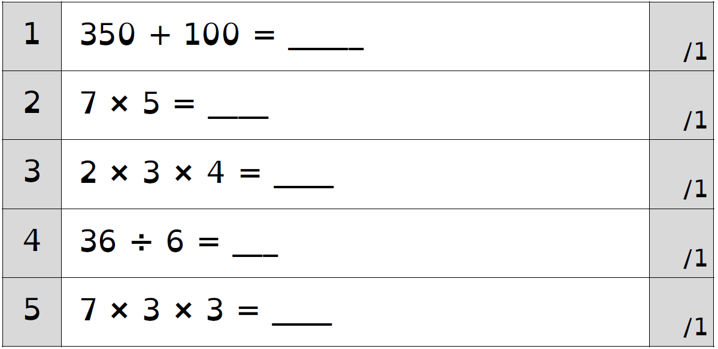
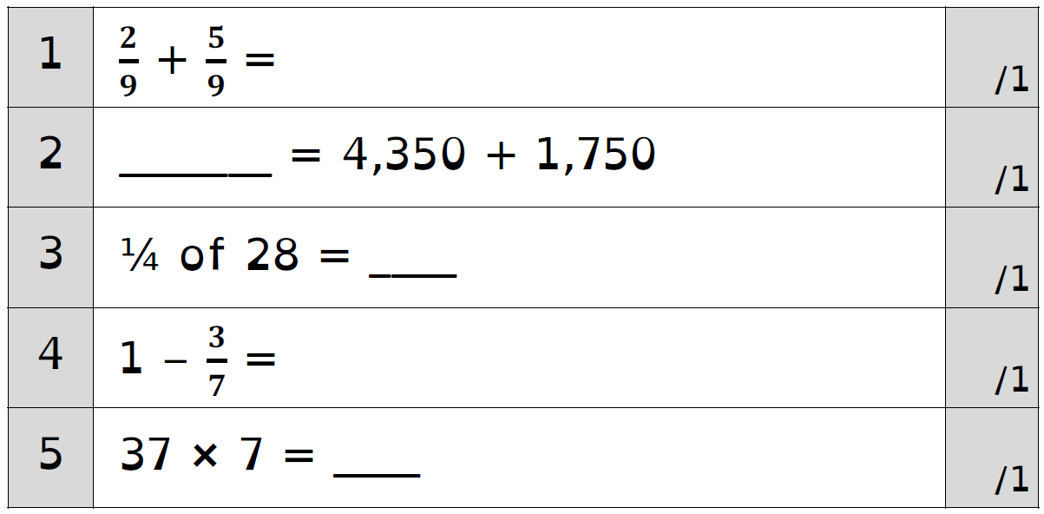
Challenge 1

Slide 4
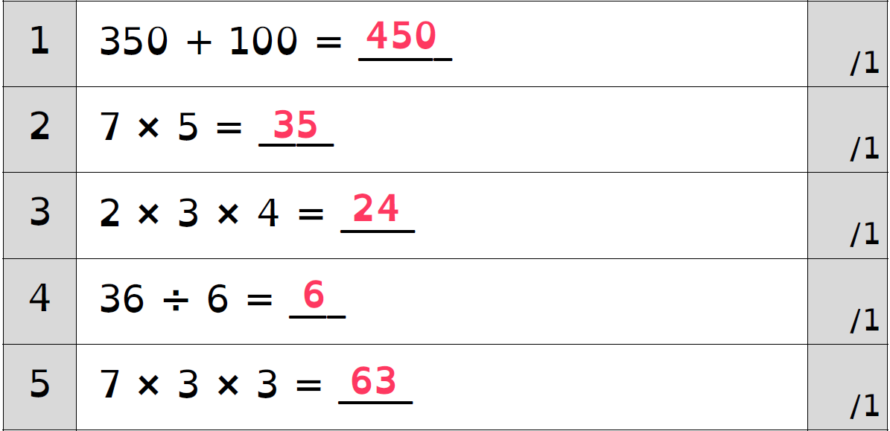
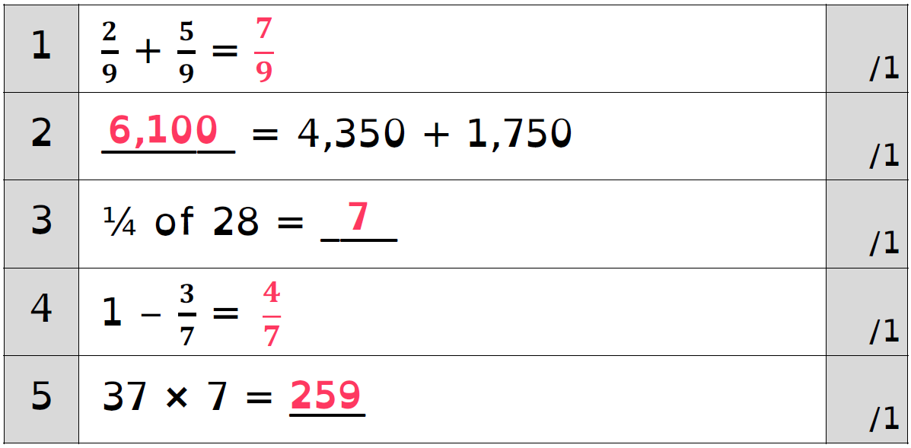
Challenge 1 answers

Slide 5
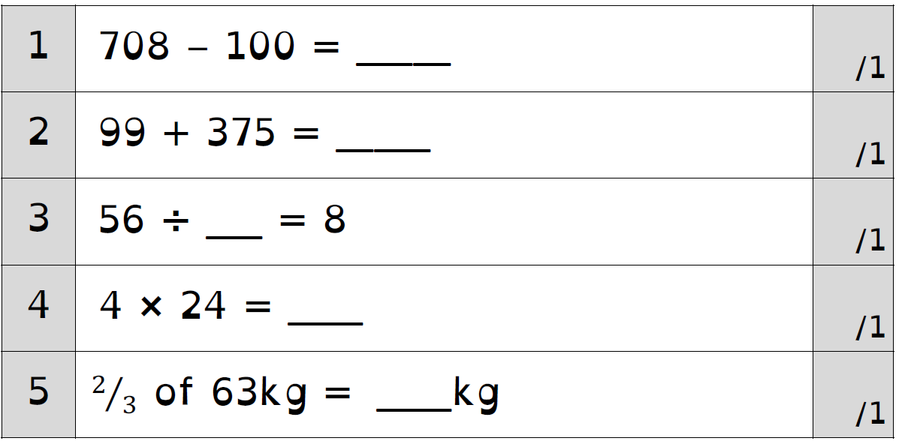
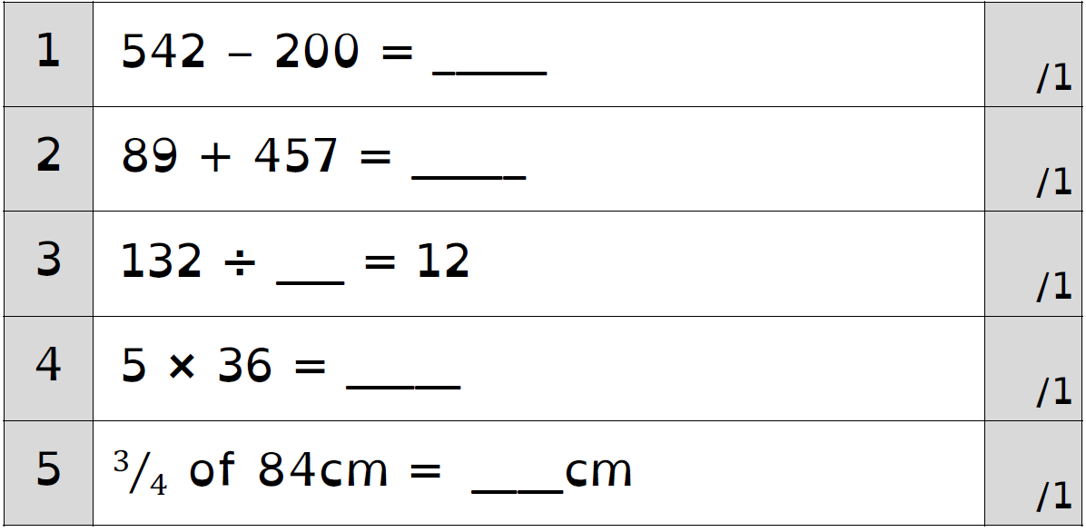
Challenge 2

Slide 6
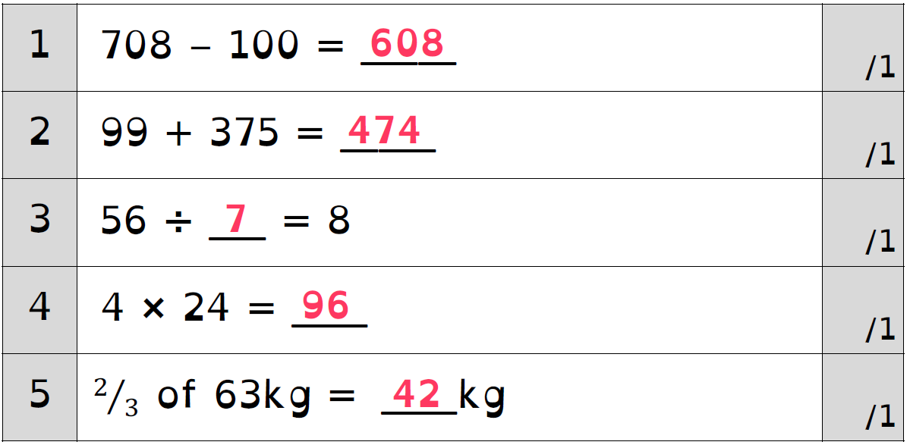
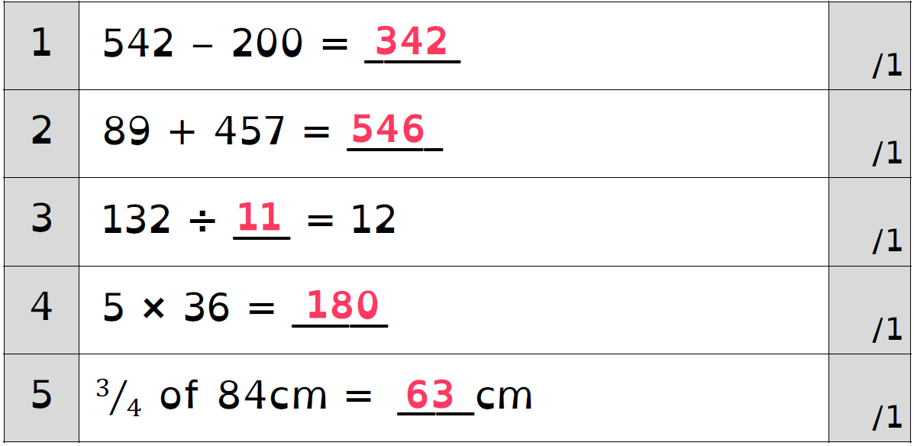
Challenge 2 answers

Slide 7
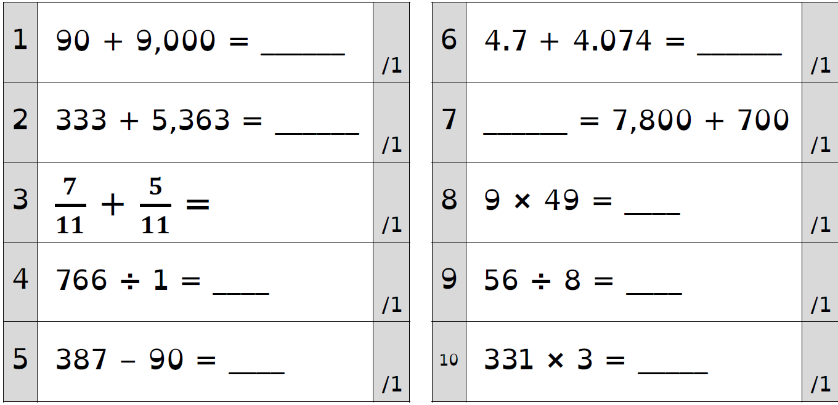
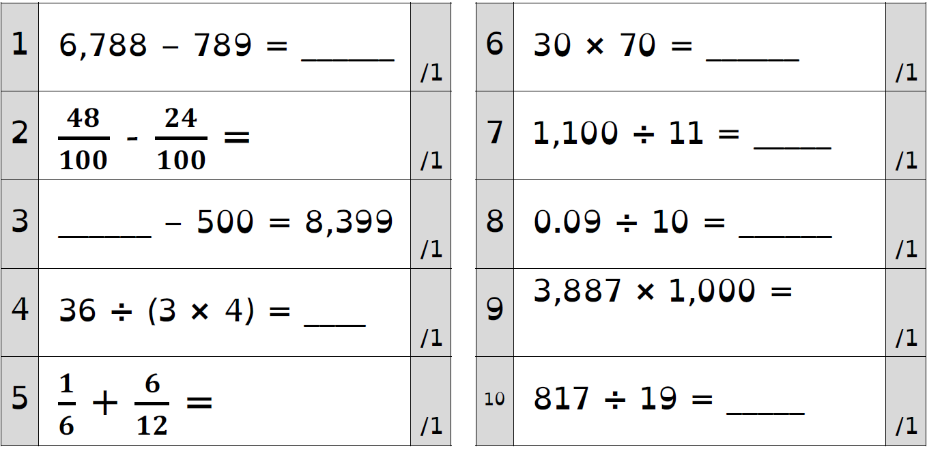
Challenge 3

Slide 8
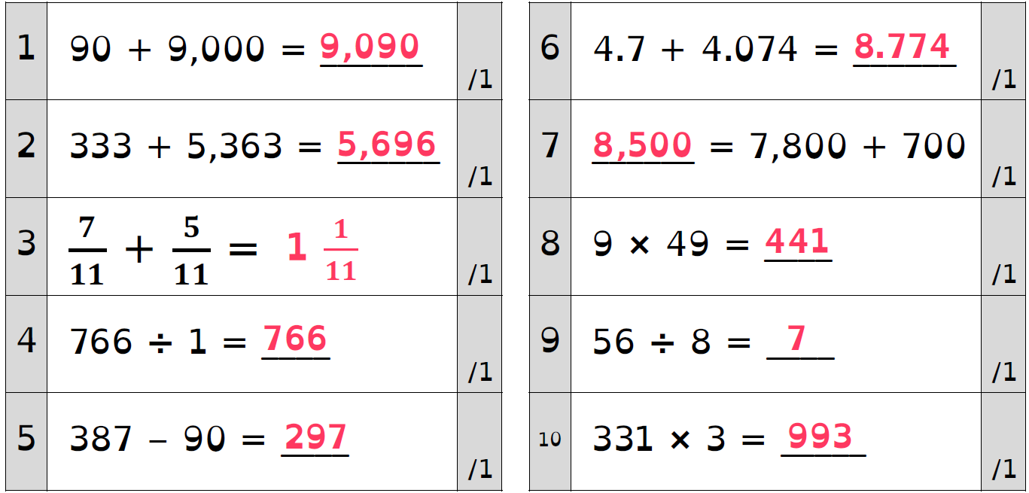
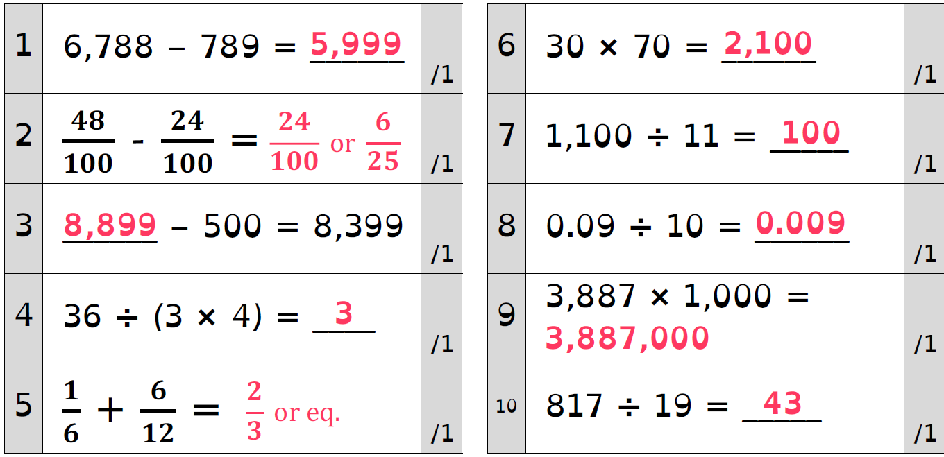
Challenge 3 answers

Slide 9
Remember to complete your Daily 8 and battle you friends on Times Tables Rock Stars.

