Slide 1
PSHE Lesson 1-Rights and Responsibilities.
L.O: Understand the basic rights of children and who is responsible for ensuring they are achieved.
S.C:
State some of the rights in the United Nations Convention on the rights of the Child.
State some reasons why these rights are important.
Explain who is responsible for achieving these rights.
Explain the different roles people can play in protecting the rights of children.

Slide 2
In November 1989, officials from governments of many countries met together to sign a children’s charter (a list of things they believed all children should have and things they shouldn’t have to have or feel). This is the United Nations Convention on the Rights of the child.
On the next two slides there is a summary of all of the rights for you to read through. As you read, think about some reasons why these rights are important.

Slide 3
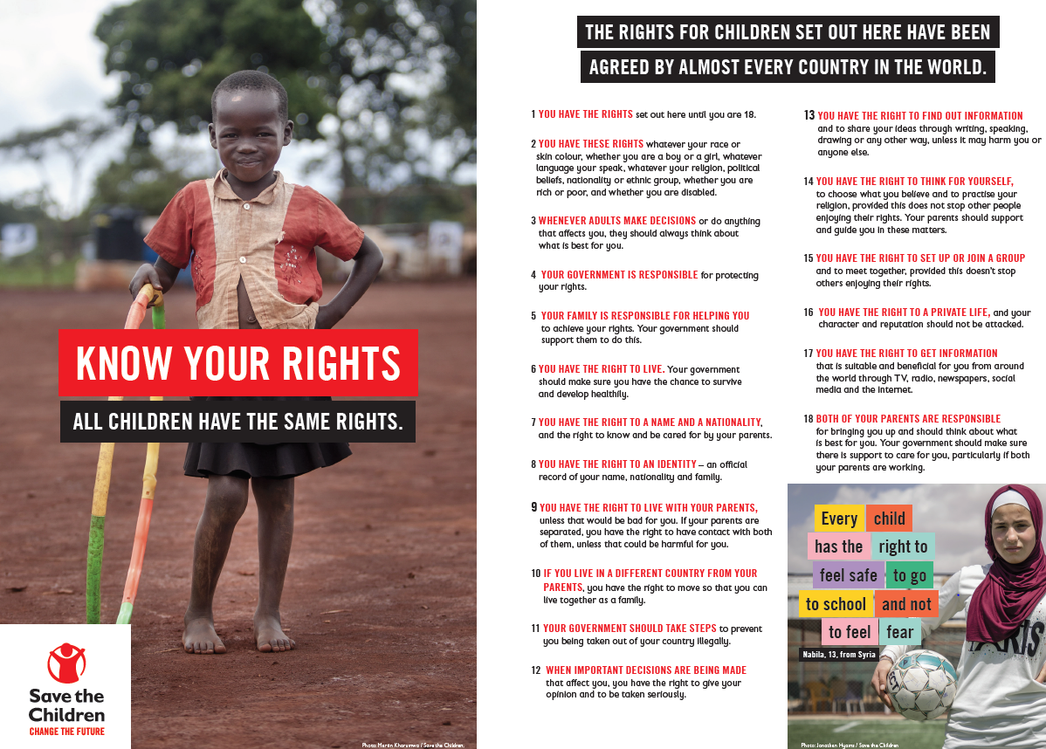

Slide 4
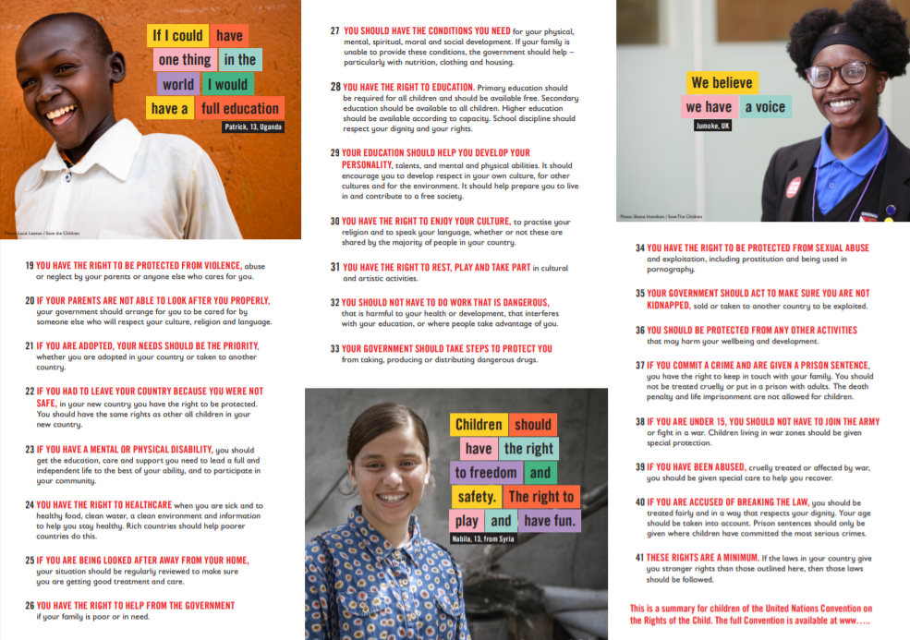

Slide 5
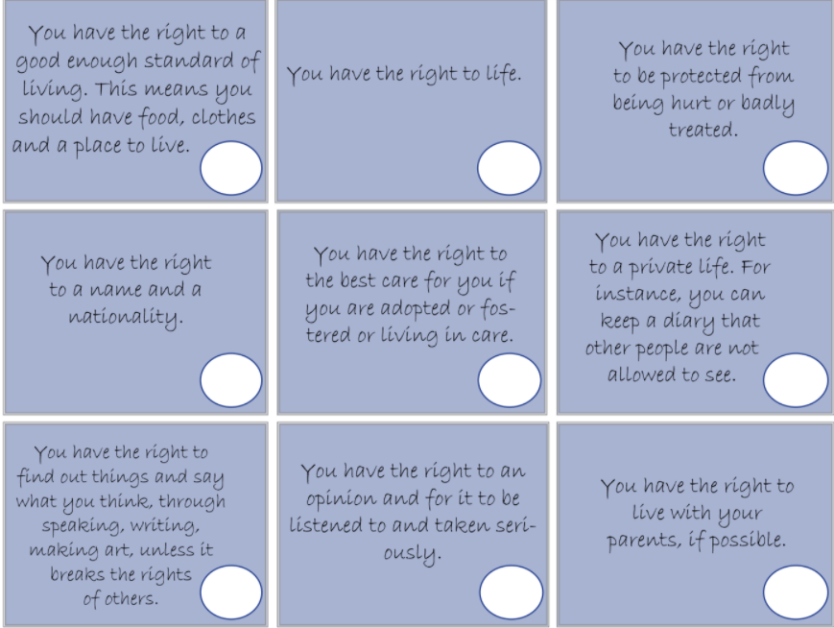
On this slide and the next we have a summary of some of the rights included in the charter. Read through the rights. Which rights do you have access to? Was it all of them or most of them? Why is this?
Now take on the role of a homeless child. Read through the rights again. Which rights would the child not have access to and why?
Repeat this taking on the role of a child that lives in a poor country. Which rights would the child not have access to and why?

Slide 6
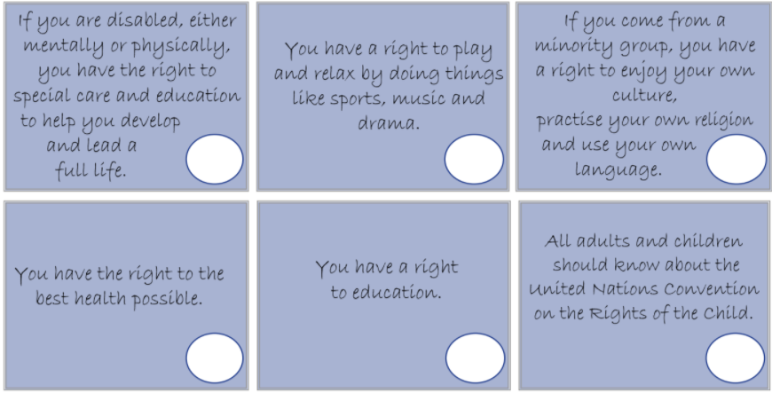

Slide 7
Now that you have thought about all of the rights, I would like to you to choose one right at a time. Write about how you could protect that right, how your family/local community could protect that right and how the government could protect that right.
Write about as many as you would like to. Keep in mind who's responsibility is it to achieve and protect the rights of a child?
My example:
The right to health - I have helped our school to encourage everyone to bring in healthy snacks for break times. My parents/carers cook me healthy meals and take me to football training. The government has also funded some sports clubs in the local area.
Extension:
Write about what you could do to protect the rights of children. This could be writing to someone in the government, campaigning for equal rights, running a club at school or another idea you have.
Theme link:
Research the rights of children during the Victorian era. What rights did Victorian children have? Think especially about poor children like Oliver Twist. We will be learning more in the coming weeks.

