Slide 1
Wednesday 10th February English
Wings!

Slide 2
Click on the link and listen to the story.
https://www.youtube.com/watch?v=XZnUlohpKKA

Slide 3
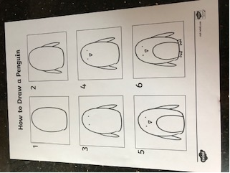
Today’s Writing Challenge!
The main character of the story is a penguin. Today you are going to draw a penguin and then label his body parts.

Slide 4
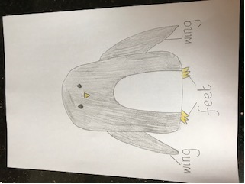
Today’s Writing Challenge!
Use the words below to label the parts of the penguin. Try and sound out the words by yourself and write them carefully by the penguin part.
eyes
wing
beak
tummy
feet
head

Slide 5
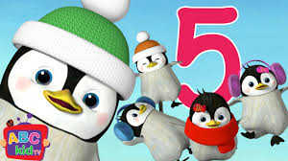
Performance!
Now you have finished your English for today, why not practise performing either the poem or song you have chosen. The links are below.
You might decide you want to learn them both!
I have included another rhyme just in case you don’t like the song or dance we have had so far.
The rhyme is called ‘5 little Penguins!’ click on the link below to listen to the rhyme.
https://www.youtube.com/watch?v=cdMQOo0Ugtg

Slide 6
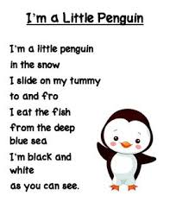
Performance!
Now you have finished your English for today, why not practise performing either the poem or song you have chosen. The links are below.
You might decide you want to learn them both!
The rhyme is called ‘I’m a little Penguin!’ click on the link below to listen to the rhyme I have also included the words just in case!
https://www.youtube.com/watch?v=qZwIZ1TsveA

Slide 7
Performance!
This dance is one of my favourites!!!
Enjoy dancing like a penguin!!
https://www.youtube.com/watch?v=uf0uKmKwnKs

Slide 8
Remote Learning Tracking
Once you have completed the PowerPoint please fill in the simple questionnaire below to let us know it’s complete.
https://forms.office.com/Pages/ResponsePage.aspx?id=eCY4lN73r0G0KV1rDWITzRhTQ2IZqpBOsW8cFVoooF9UNVlMS1dCVkdaM0k0WlhFTE9WVFBTWEg1Ti4u
Thank you.

