Slide 1
Thursday 11th February English
Wings!

Slide 2
Click on the link and listen to the story.
https://www.youtube.com/watch?v=XZnUlohpKKA

Slide 3
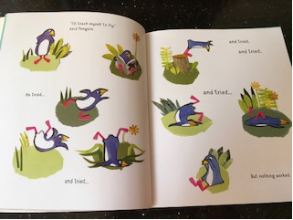
Today’s Writing Challenge!
Poor penguin! All he wanted to do was fly. His friends tried to help him by tying him up with string, but that didn’t work! Your job today, is to decide how you would help penguin fly. Draw a picture of what you would use and then write a sentence to go with it.
For example you might use balloons. Your sentence could be:
I will use balloons to help penguin.

Slide 4
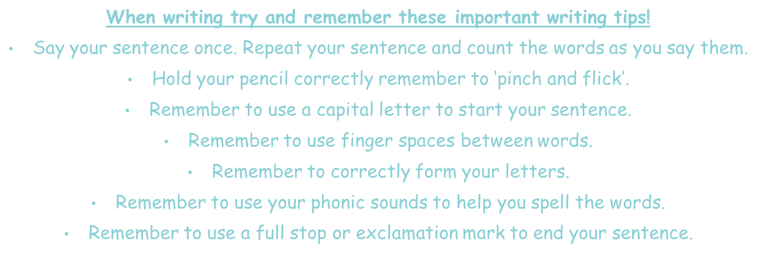
Tips for writing!

Slide 5
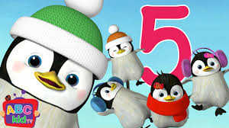
Performance!
Now you have finished your English for today, why not practise performing either the poem or song you have chosen. The links are below.
You might decide you want to learn them both!
I have included another rhyme just in case you don’t like the song or dance we have had so far.
The rhyme is called ‘5 little Penguins!’ click on the link below to listen to the rhyme.
https://www.youtube.com/watch?v=cdMQOo0Ugtg

Slide 6
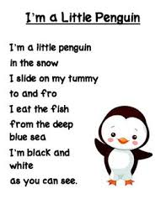
Performance!
Now you have finished your English for today, why not practise performing either the poem or song you have chosen. The links are below.
You might decide you want to learn them both!
The rhyme is called ‘I’m a little Penguin!’ click on the link below to listen to the rhyme I have also included the words just in case!
https://www.youtube.com/watch?v=qZwIZ1TsveA

Slide 7
Performance!
This dance is one of my favourites!!!
Enjoy dancing like a penguin!!
https://www.youtube.com/watch?v=uf0uKmKwnKs

Slide 8
Remote Learning Tracking
Once you have completed the PowerPoint please fill in the simple questionnaire below to let us know it’s complete.
https://forms.office.com/Pages/ResponsePage.aspx?id=eCY4lN73r0G0KV1rDWITzRhTQ2IZqpBOsW8cFVoooF9UNVlMS1dCVkdaM0k0WlhFTE9WVFBTWEg1Ti4u
Thank you.

