Slide 1
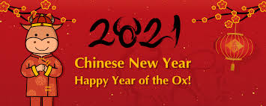
Friday 12th February English

Slide 2
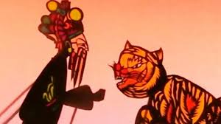
It’s Chinese New Year today and it is the year of the Ox
I thought for today’s English lesson we can find out all about Chinese New Year and why and how it is celebrated. Click on the link below to listen how the animals were placed on the Chinese calendar.
https://www.youtube.com/watch?v=eVClAj8q_lY

Slide 3
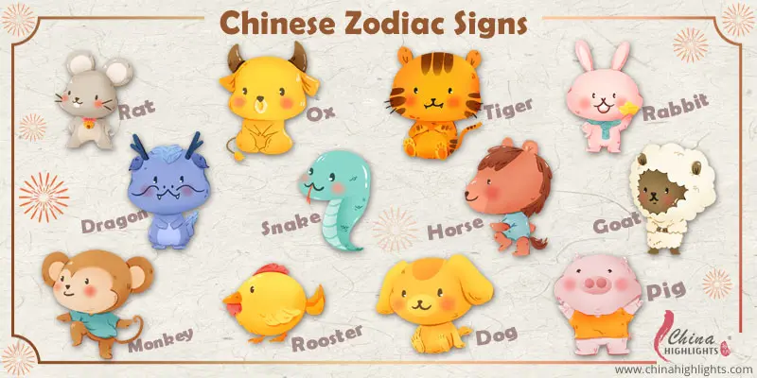
Today’s Writing Challenge!
You are going to find out which animal year you were born in and draw a picture of that animal and write a simple sentence to go with it.
If you were born in 2015 you were born in the Year of the Goat.
If you were born in 2016 you were born in the Year of the Monkey.

Slide 4
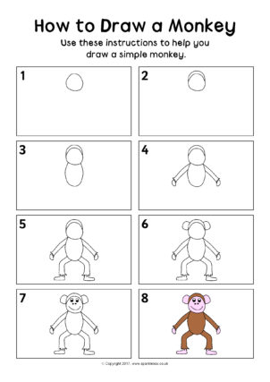
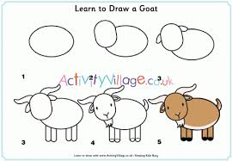
Handy hints to draw a goat or a monkey!

Slide 5
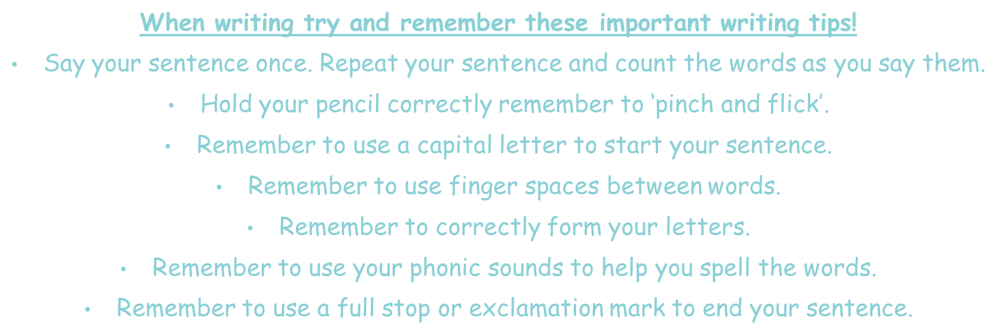
Tips for writing!

Slide 6
Writing task.
Now you have drawn your zodiac animal you can write your sentence.
I was born in the year of the
goat
monkey

Slide 7
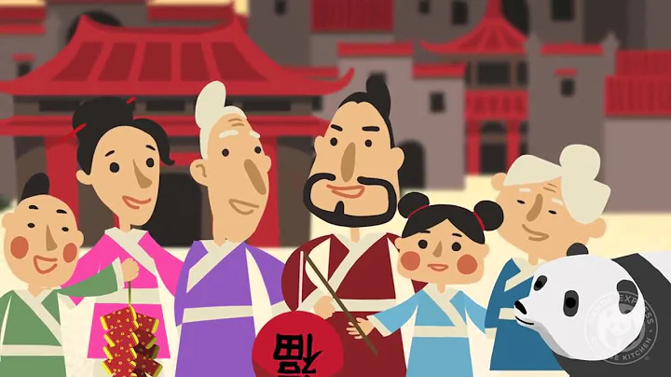
Here is another short clip that explains some more traditions of Chinese New Year.
https://www.youtube.com/watch?v=Mzq9jRFUjRA

Slide 8
The next couple of slides contain some crafty ideas to do with Chinese New Year. Please don’t feel you have to make them.

Slide 9
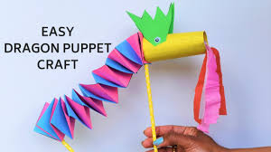
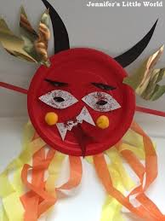
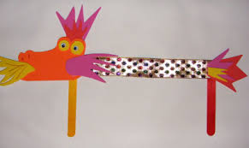
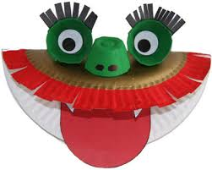
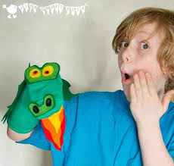
You could make your own Chinese Dragon! Here are a few ideas.

Slide 10
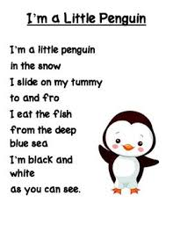
Performance!
Now you have finished your English for today, why not practise performing either the poem or song you have chosen. The links are below.
You might decide you want to learn them both!
The rhyme is called ‘I’m a little Penguin!’ click on the link below to listen to the rhyme I have also included the words just in case!
https://www.youtube.com/watch?v=qZwIZ1TsveA

Slide 11
Performance!
This dance is one of my favourites!!!
Enjoy dancing like a penguin!!
https://www.youtube.com/watch?v=uf0uKmKwnKs

Slide 12
Remote Learning Tracking
Once you have completed the PowerPoint please fill in the simple questionnaire below to let us know it’s complete.
https://forms.office.com/Pages/ResponsePage.aspx?id=eCY4lN73r0G0KV1rDWITzRhTQ2IZqpBOsW8cFVoooF9UNVlMS1dCVkdaM0k0WlhFTE9WVFBTWEg1Ti4u
Thank you.

