Slide 1
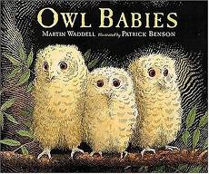
Thursday 21st January 2021 English
Owl Babies

Slide 2
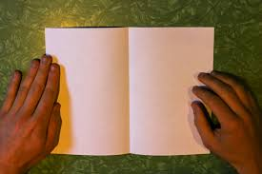
Thinking time
Today your challenge will be to start to write your own story based around the ‘Owl Babies’. You will do two pages today and two pages tomorrow. Today you will do the front cover and the beginning of your story and tomorrow you will do the middle and the end of your story.
First of all get a piece of A4 or A3 paper and fold it in half to make a book.

Slide 3
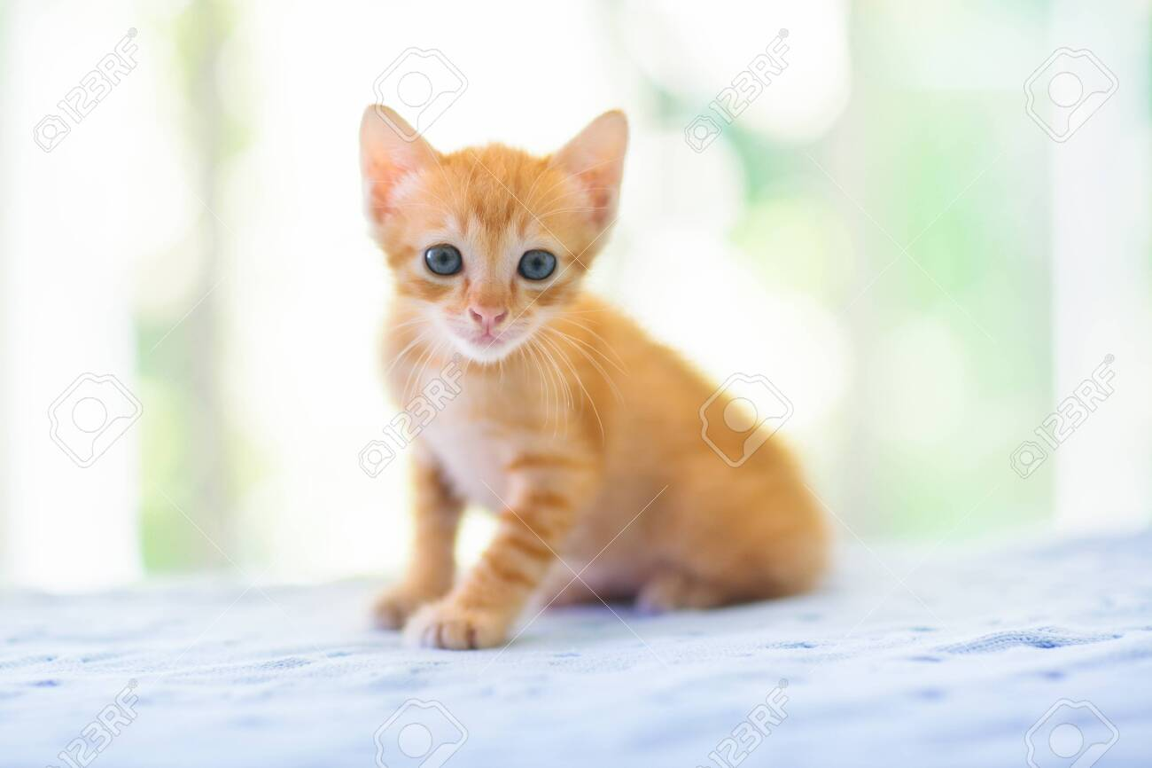
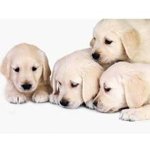
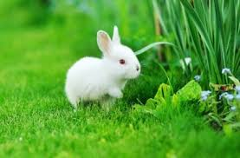
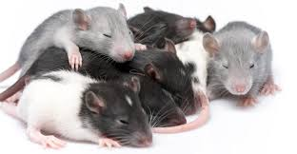
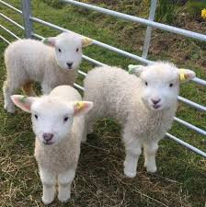
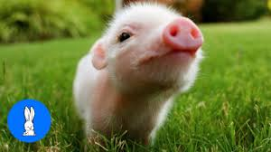
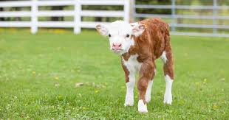
Thinking time
Your story is going to be about your favourite animal. So first of all talk to the adult you are working with to decide what animal your story is going to be about.
If you are stuck for some ideas look at the pictures below!

Slide 4
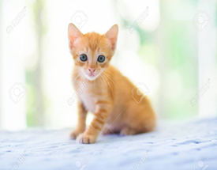
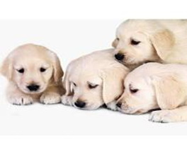
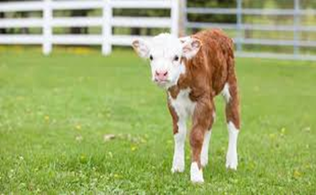
Quick Challenge!
Before you decide on what animal your story is going to be about, I have a quick challenge for you! Did you know most baby animals have a different name to adult animals? For example, a baby owl is called an owlet. Looking at the pictures again, can you find out what the baby names for these animals are?
(Cat, dog, rabbit, rat, sheep, pig, cow.)

Slide 5
Front Cover
Decide on what animal you want your story to be about and design a front cover for your book similar to the front cover of ‘Owl Babies’. Research where your animal lives and draw a picture of the 3 baby animals in their home. Give your book a title and remember to write who the author and illustrator of your book is!

Slide 6
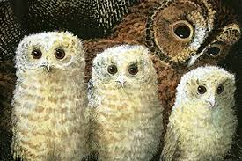
Story beginning
On your first page draw a picture and write a sentence to introduce the characters in your story. Your child can either think of their own sentence or follow my example. I will model my example on the book. The words which I have highlighted red are the words you need to change to your ideas.
Mummy Owl had three babies called Sarah, Percy and Bill.

Slide 7
Well Done!
You have worked really hard on your front cover and the beginning of your story today – WELL DONE! Tomorrow we will finish the story.

