Slide 1
Thursday 25th February 2021 English
Jack and the Beanstalk

Slide 2
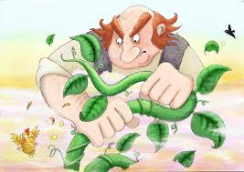
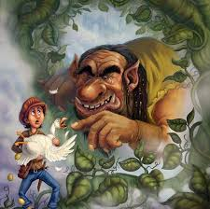
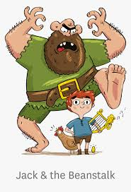
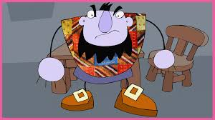
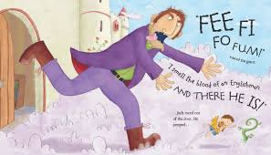
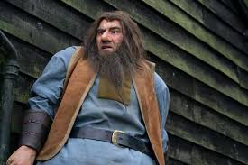
Character Description
The lesson today is going to focus on the giant. Look through the pictures on the slide and describe what the giant looks like and what he might be like!

Slide 3
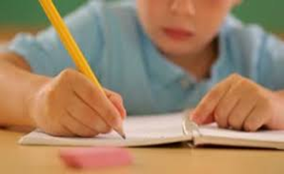
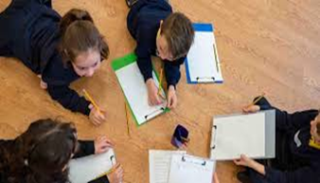
Today’s Writing Task
Today you can either paint or draw a picture of a giant and then you can write some sentences to describe him. You can use your discussion time and the pictures from the previous slide to help you. Also on the following slides will be some writing tips, sound mats and some key words to all help support you in your writing.

Slide 4
Teaching tips for writing
When writing a sentence, always encourage your child to try and sound out the word and spell it themselves. We use a sound mat at school which helps them remember and write their sounds. I will attach a sound mat on the next slide. If you are asking your child to spell a tricky word or a word that cannot be phonetically sounded out, please help them by modelling how to spell these words and by telling them that these are words they will need to learn how to spell by sight.
When writing try and remember these important writing tips!
Say your sentence once. Repeat your sentence and count the words as you say them.
Hold your pencil correctly remember to ‘pinch and flick’.
Remember to use a capital letter to start your sentence.
Remember to use finger spaces between words.
Remember to correctly form your letters.
Remember to use your phonic sounds to help you spell the words.
Remember to use a full stop or exclamation mark to end your sentence.

Slide 5
A sound mat to help with spelling words.
Phase 2 Sound Mat

Slide 6
A sound mat to help with spelling words
Phase 3 Sound Mat

Slide 7
Describing the Giant
Use some of the words below to help you write some sentences about the giant.
Examples of some sentence starters:
He was a ……..
The giant has………
I can see a ……….
angry
scary
big
enormous
smelly
grumpy

Slide 8
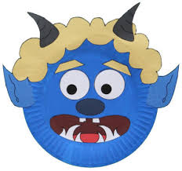
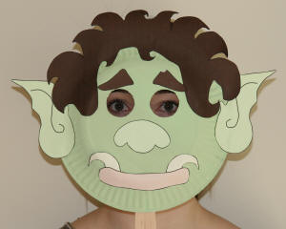
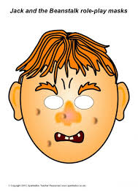
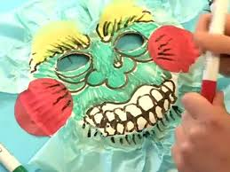
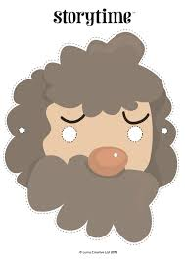
Be Creative!
Why don’t you try and act out some of the story either you or a member of your family could pretend to be the angry giant! Here are some ideas of masks you could make.

Slide 9
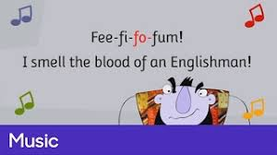
Song Time!
Remember to keep learning the song about the giant to help you remember how mean he was!
The song is called ‘Fee-fi-fo-fum’ click on the link below to listen to it.
https://www.youtube.com/watch?v=Tn-ZSizEdMI

Slide 10
Remote Learning Tracking
Once you have completed the PowerPoint please fill in the simple questionnaire below to let us know.
https://forms.office.com/Pages/ResponsePage.aspx?id=eCY4lN73r0G0KV1rDWITzRhTQ2IZqpBOsW8cFVoooF9UNVlMS1dCVkdaM0k0WlhFTE9WVFBTWEg1Ti4u
Thank you.

