Slide 1
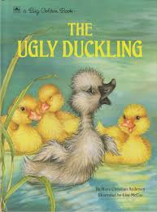
Friday 29th January English
The Ugly Duckling

Slide 2
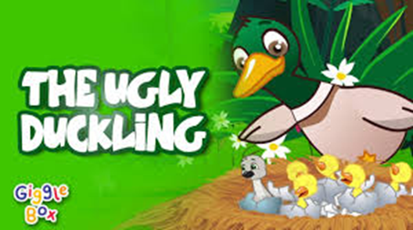
The Ugly Duckling
Yes it’s Friday!!!
Next week, you will be looking at another book with Mrs MacNeil, so I thought I would give you the chance to listen to ‘The Ugly Duckling’ one last time. Follow the link below.
https://www.youtube.com/watch?v=x4o5_8ceahs

Slide 3
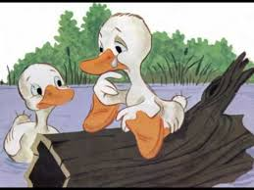
The Ugly Duckling
I have also left in the song of ‘The Ugly Duckling.’ I am sure you will all like to listen to it again. If you don’t just skip the slide!
https://www.youtube.com/watch?v=neX_E8Ozf88

Slide 4
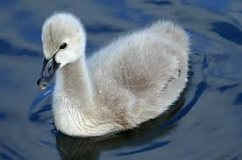
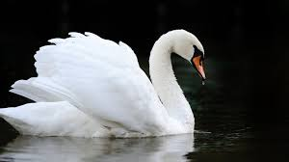
Writing task for today.
In the story of ‘The Ugly Duckling’ he is picked on by other animals for looking different and this made him really sad. By the end of the story, he had grown into a beautiful swan and animals liked him. During this week, we have been using lots of describing words which are known as adjectives! Below you will see a picture of a cygnet (a baby swan) and a picture of a swan. Your job today is to think why they are different and using the word ‘but’ write a sentence about the difference you see.
He was grey but now he is white
He had small wings but now he has big wings.
To help your child write the sentence, write the tricky words he and was on pieces of paper for them.

Slide 5
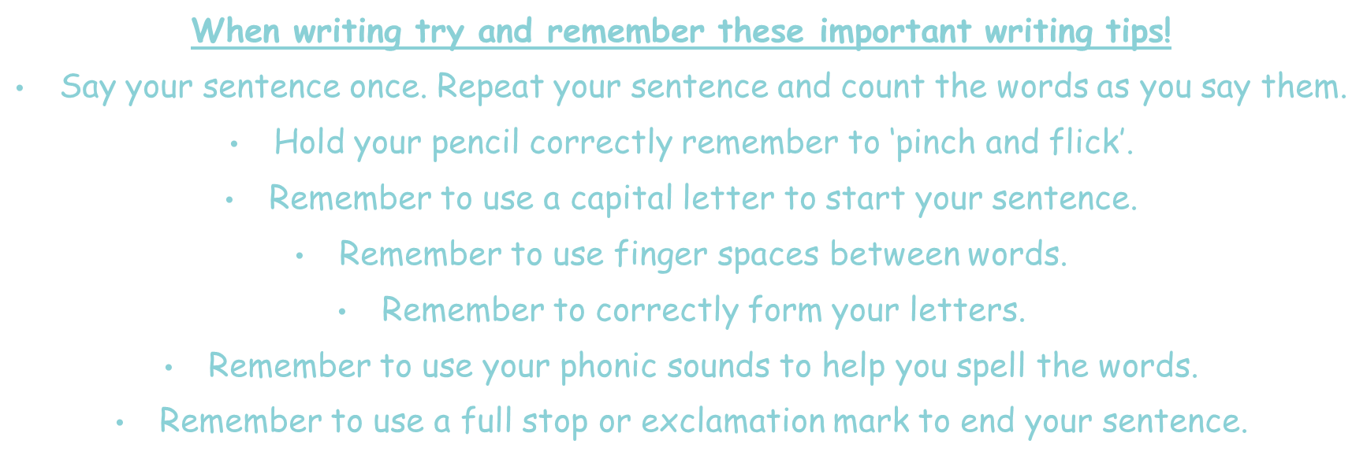
Tips for writing.

Slide 6
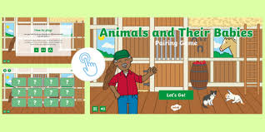
Another matching game!
https://www.twinkl.co.uk/go/resource/animals-and-their-babies-pairing-game-tg-ga-131

