Slide 1
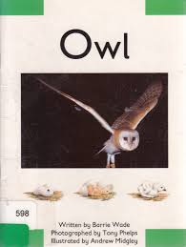

Thursday 4th February 2021
English

Slide 2

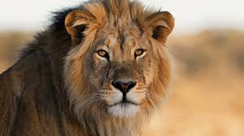
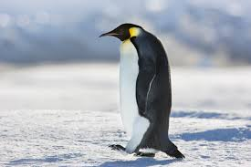
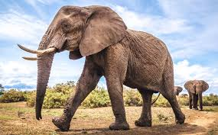
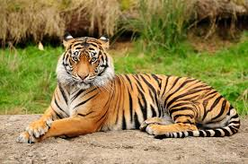
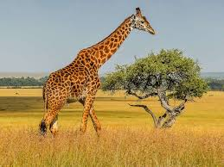
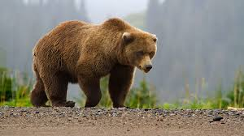
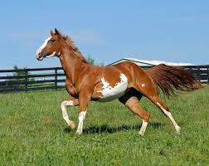
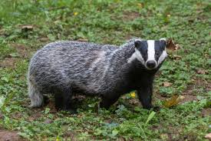
Thinking time
Today you are going to start to research about your favourite animal. First of all decide on what animal you are going to research and write about over the next few days. If you are stuck for an idea look at the pictures below.

Slide 3
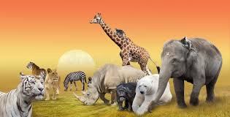
My animal
Once you have decided on the animal you are going to write about, research on the internet some facts and look at some pictures of your chosen animal.
If you are having trouble finding information, I would recommend looking at these following sites:
San Diego Zoo for Kids: Great animal photos, easy to read facts.
Smithsonian National Zoo: Facts, videos and live cams.
National Geographical for Kids: Facts and photos.
Switch Zoo: Facts, photos and games.

Slide 4
Today’s Writing Challenge
Now you have researched some interesting facts about your animal, I would like you to draw your animal and label its body parts.
Remember when writing words to sound them out and try and encourage your child to phonetically spell the words. If the word is tricky, model to them how to write it.
On the next slide are some examples of what your work could look like.

Slide 5
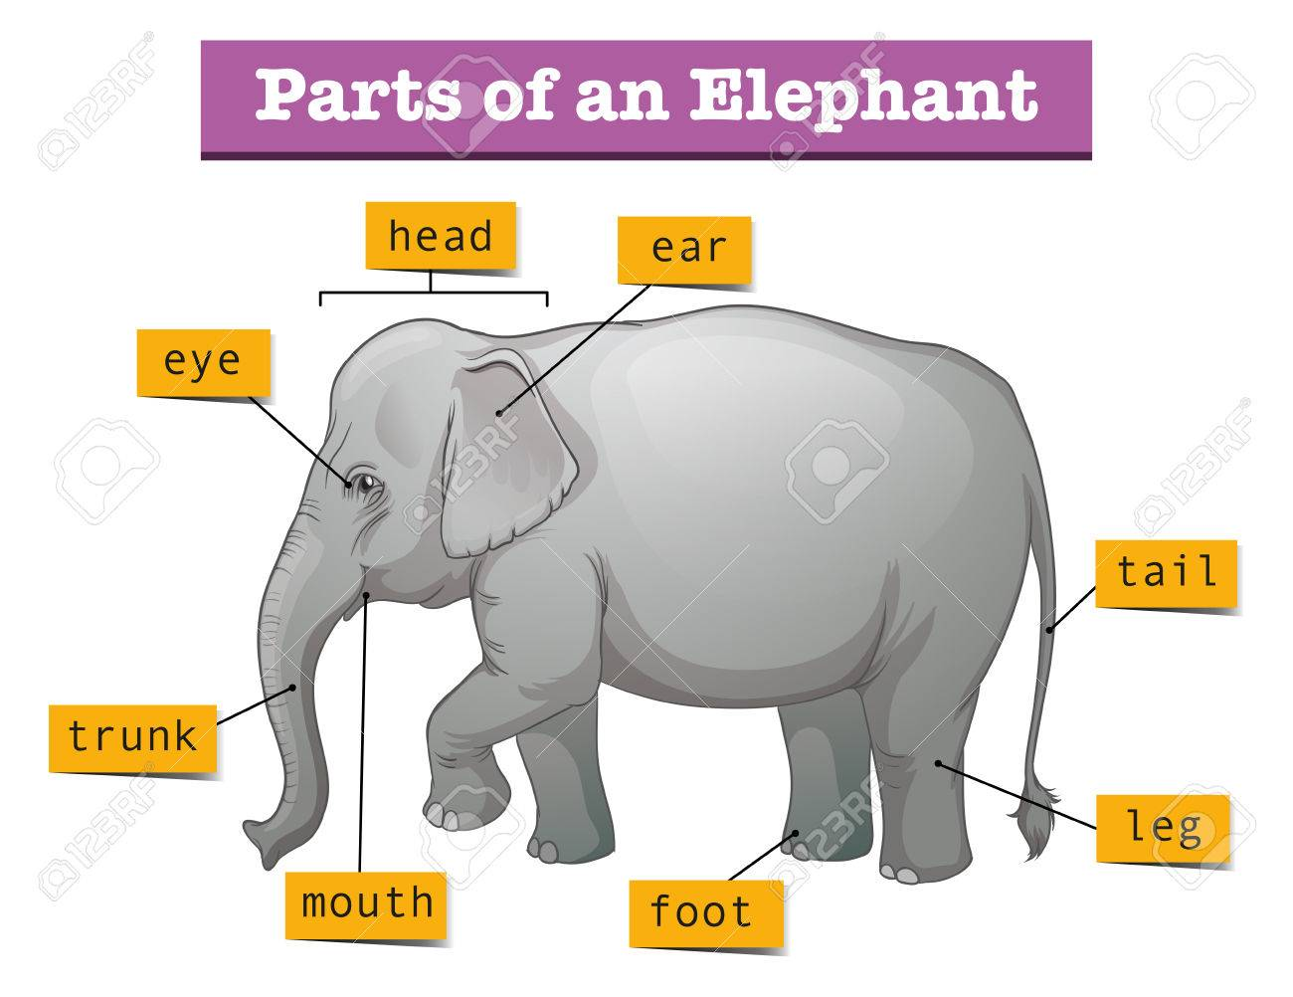
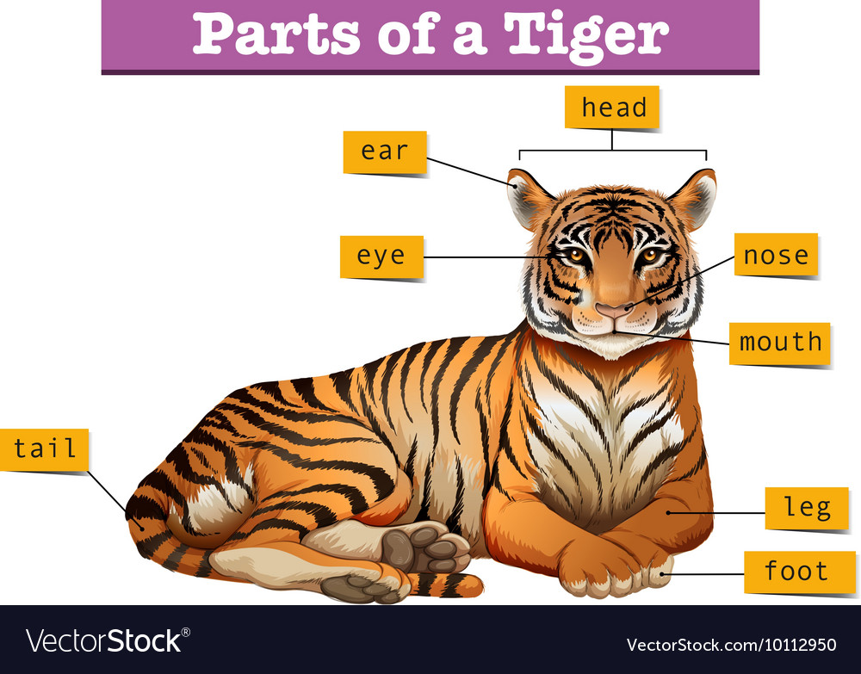
Body Parts
Example work

Slide 6
Remote Learning Tracking
Once you have completed the PowerPoint please fill in the simple questionnaire below to let us know.
https://forms.office.com/Pages/ShareFormPage.aspx?id=eCY4lN73r0G0KV1rDWITzRhTQ2IZqpBOsW8cFVoooF9UNVlMS1dCVkdaM0k0WlhFTE9WVFBTWEg1Ti4u&sharetoken=0wn6HbazNMBTOJNIa3OR
Thank you.

