Slide 1
Thursday 7th January English
Little Red Riding Hood

Slide 2
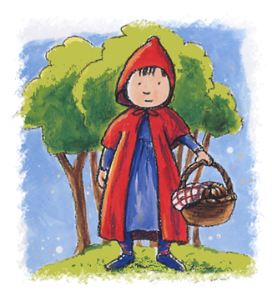
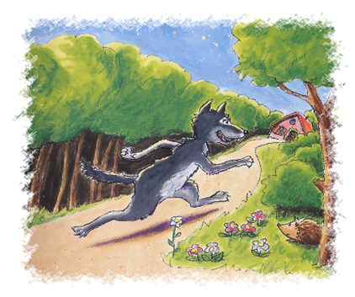
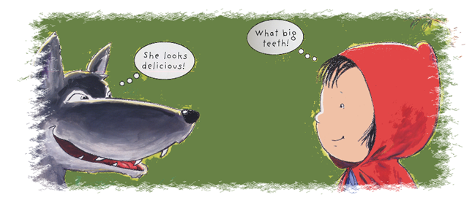
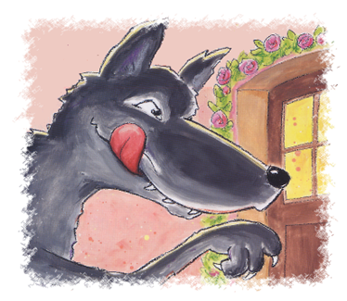
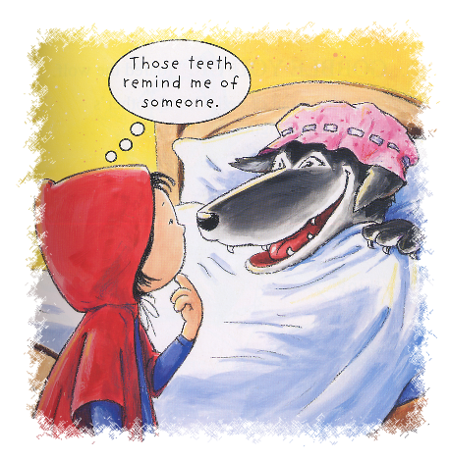
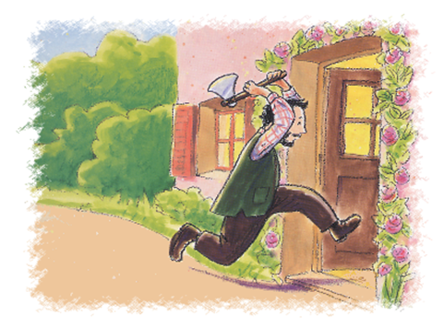
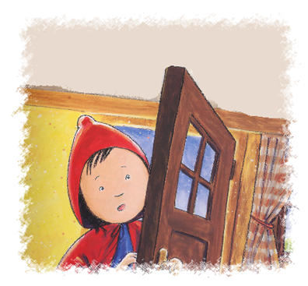
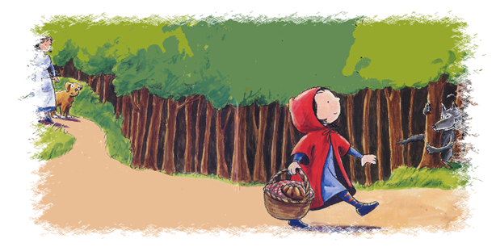
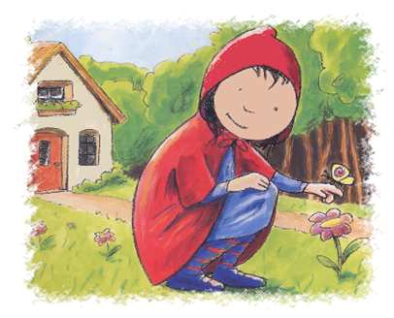
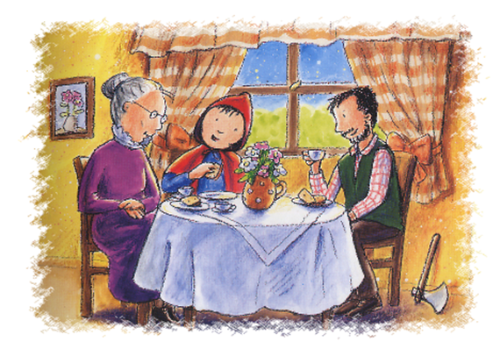
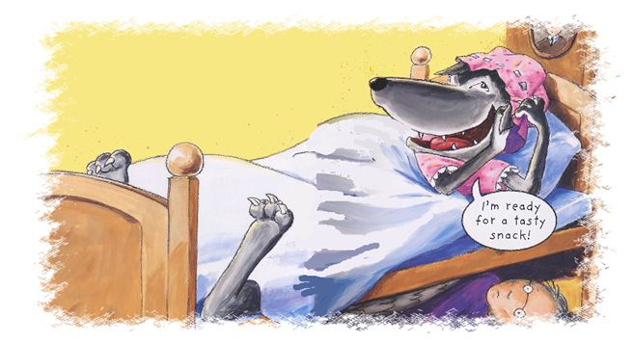
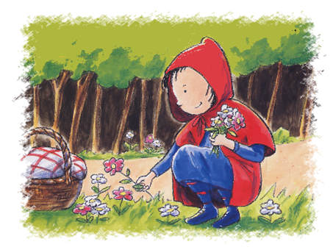
Ordering the story
Talk about each of the pictures and then put them in the right order.

Slide 3
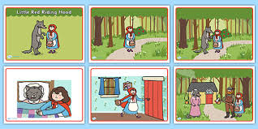
What is your favourite part of the story?
Look at the pictures again and draw a picture of your favourite part. Remember to think about details in your picture. Under your picture write a simple sentence to describe what is in your picture.
Key points to remember when you write a sentence:
Remember to use a capital letter to start your sentence.
Remember to use finger spaces between words.
Remember to correctly form your letters.
Remember to use your phonic sounds to help you spell the words.
Remember to use a full stop to end your sentence.

