Slide 1
Friday 8th January English
Little Red Riding Hood

Slide 2
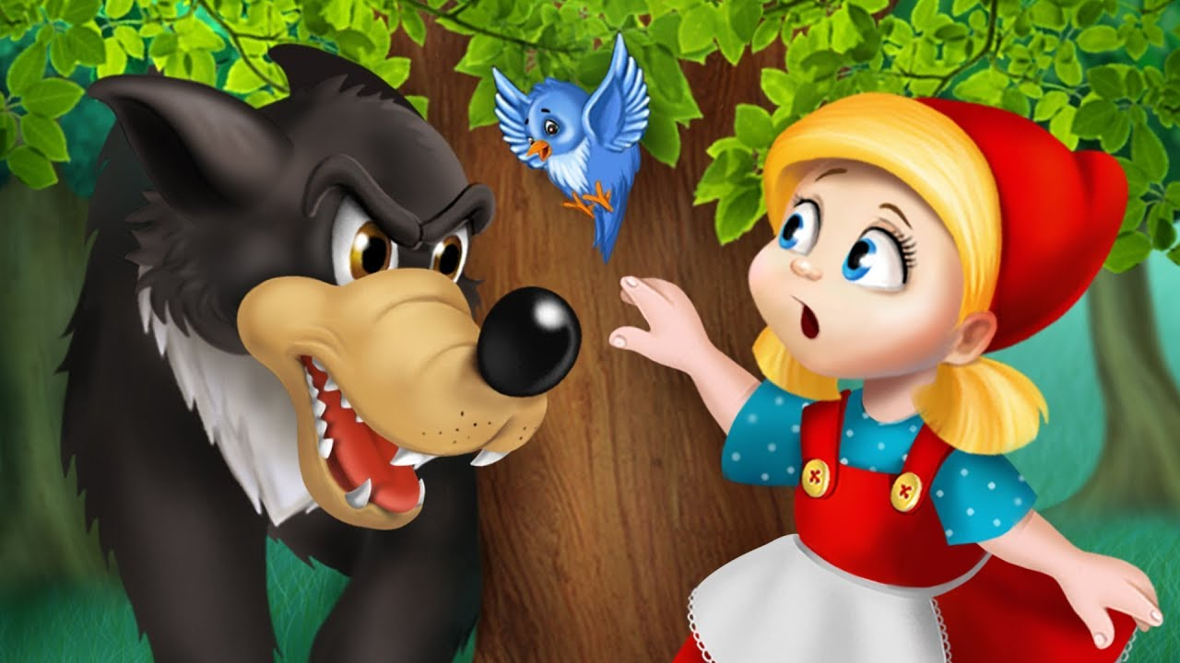
Character Description
The lesson today is going to focus on the wolf. Look through the pictures on the slides and describe what the wolf looks like and what he might be like!

Slide 3
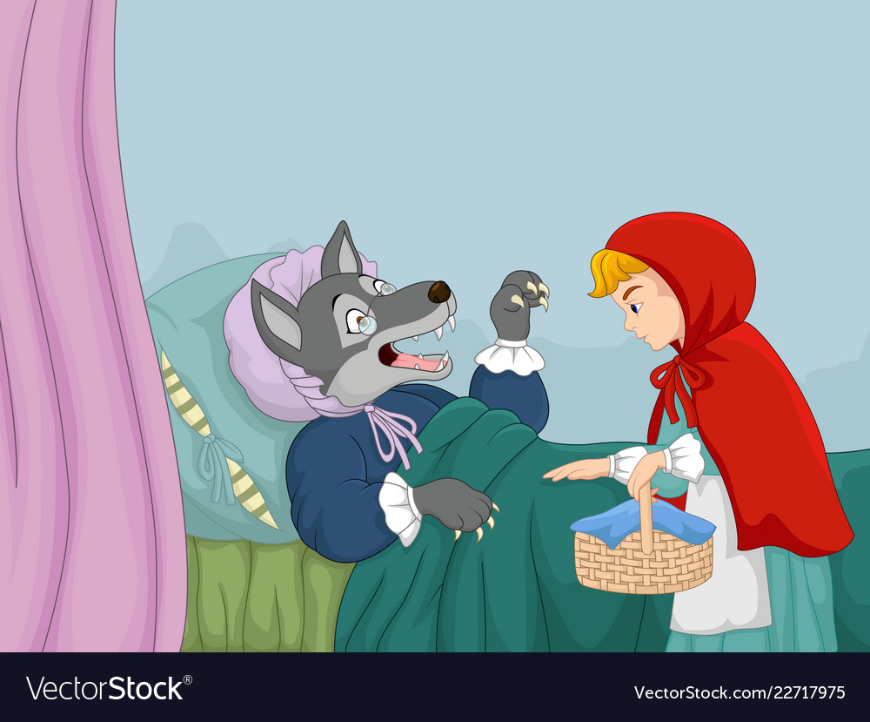
What do you think Little Red Riding Hood is thinking?

Slide 4
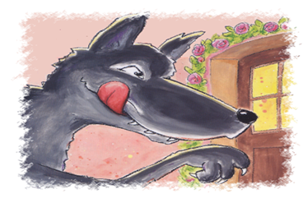
What is the wolf thinking?

Slide 5
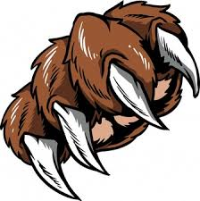
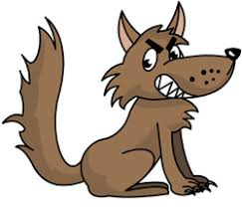
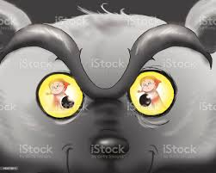
Describing the Wolf
Use some of the words below to help you write some sentences about the wolf.
sharp teeth sharp claws big bad wolf big eyes
Examples of some sentence starters.
He was a ……..
The big bad wolf has………
I can see a ……….

Slide 6
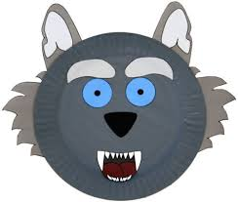
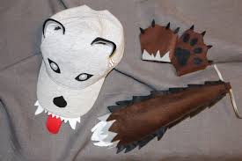
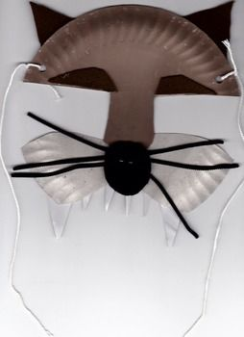
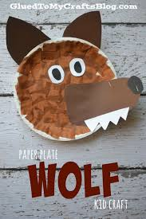
Be Creative!
Why don’t you try and act out some of the story either you or a member of your family could pretend to be the naughty Wolf! Here are some ideas of masks you could make.

