Slide 1
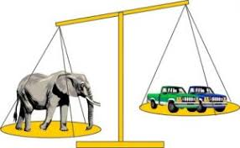

Tuesday 19th January
Maths
This week’s focus: Comparing Weight and Capacity.

Slide 2
Key Teaching Points
Key Concepts
Model, then encourage children to use the vocabulary of comparing and contrasting the weight of objects, e.g. heavy, heavier, heaviest, light, lighter and lightest.
Compare weights in different ways e.g. by lifting or using balance scales.
Children need to learn how balances/scales work, e.g. the heavier side goes down. if both sides are balanced (level), then the weight in each bucket is the same.
Order by weight, according to a rule, e.g. heaviest to lightest.
Make sure that children realise that size is not necessarily related to weight by not only giving them large heavy and small light objects to compare, but also small heavy and large light objects to compare.
Watch out for children who:
Think that larger items are always heavier. Make sure you give children experience of comparing the weights of small heavy objects with large light objects.

Slide 3
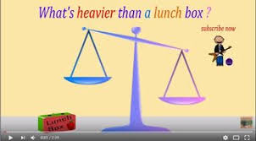
Today’s Maths Song
This week’s maths focus is comparing the weight and capacity of things. Today’s focus song is called, ‘What's heavier than a lunch box?’
https://www.youtube.com/watch?v=1QUHONch0-4

Slide 4
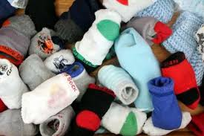
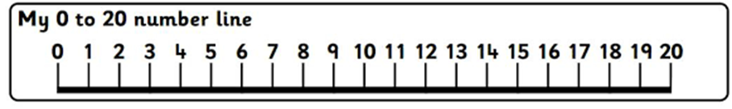
Today’s Counting Challenge
Count how many socks each of your family members have. Write down the total for each person.
Who has the most socks?
Who has the fewest socks?

Slide 5
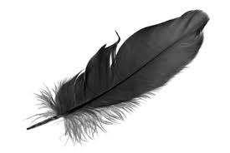
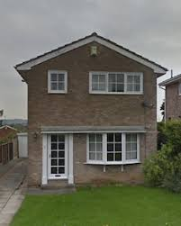
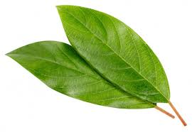
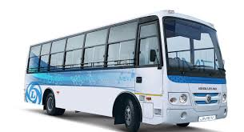
Today’s Outdoor Maths Challenge
Go on a walk and look around. Write a list of things you see that are heavier and lighter than a lunchbox like in the song you sang earlier.
Heavier than a lunchbox | Lighter than a lunchbox

Slide 6
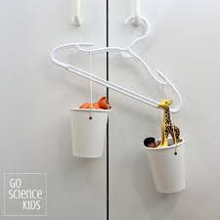
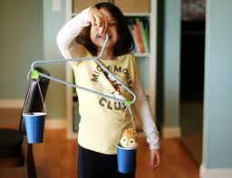
Today’s Indoor Maths Challenge
Today you are going to make a balance scale. Instructions on how to make one can be found on the link below.
https://www.youtube.com/watch?v=FRtbekqsuZ8

Slide 7
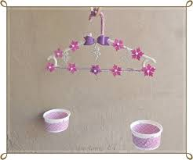
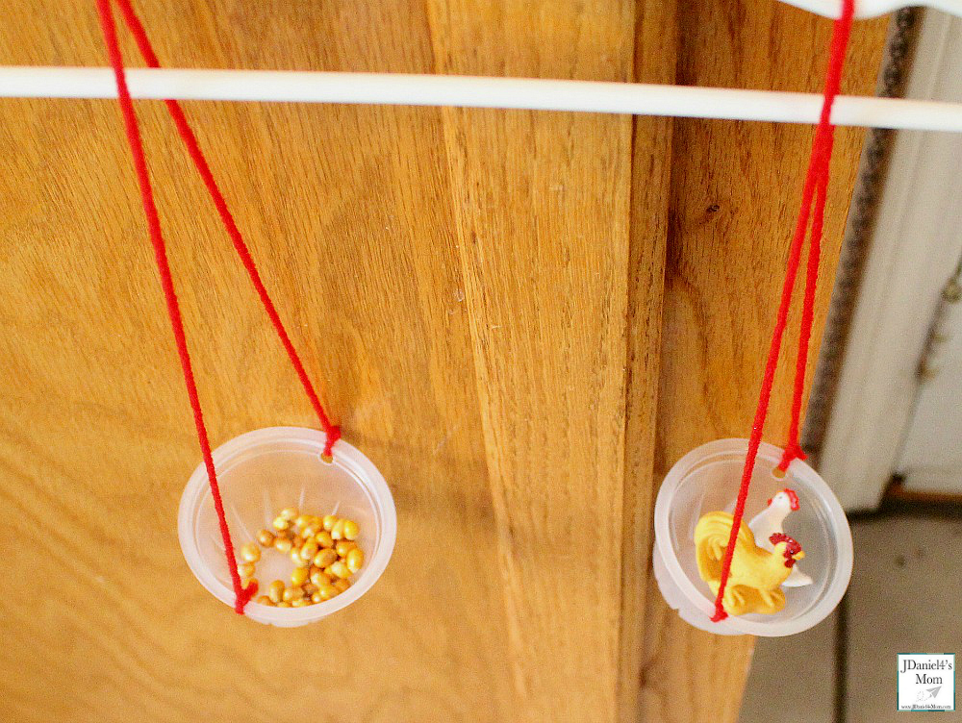
Activity
Challenge 1
Blindfold your child and give them two objects that would fit in their balance scale. Children must predict which is the heaviest and which is the lightest. Take off the blindfold so your child can now see the objects and test them in their balance scale.
Challenge 2
Try and find objects that make the balance scale ‘balanced’ or ‘the same’.

Slide 8
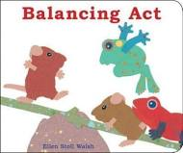
Reading Linked to Maths
‘Balancing Act’, by Ellen Stoll Walsh is a really fun book linked to our topic on weight. If you would like to listen to the story click on the link below.
https://www.youtube.com/watch?v=EkpJtf5QOsQ

