Slide 1
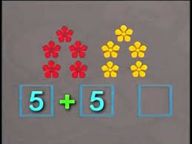
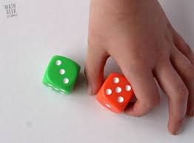

Tuesday 2nd February
Maths
This week’s focus: Combining two groups

Slide 2
Key teaching points for combining two groups
Key Concepts
Children need to learn to add by counting on, as opposed to counting all. This means saying the next few numbers rather than starting at 1, recounting the first number. E.g. working out 5 add 2, by counting on from 5, saying 6, 7, rather than counting all 7 objects starting at 1 again.
To do this, children need to be fluent in counting on from any number, i.e. not only being able to recite numbers from 1.
It is helpful to keep the numbers children count on very small – 1, 2 and 3, and keeping to counting on 1 and 2 if they regress to counting all when adding 3. Counting all can be a difficult habit to break, and becomes very inefficient when progression to adding onto larger numbers, e.g. 24 + 3.

Slide 3
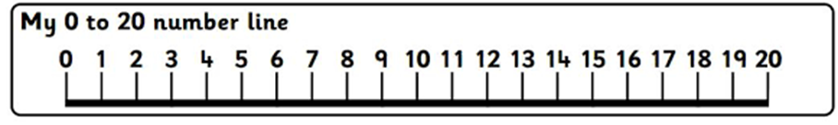
Key teaching points for combining two groups
Watch out for children who:
Struggle to count on. Give children extra practise with reciting numbers from any number up to 10, and building up number tracks, so that they look for the next number.
Persist in counting all. Support them by:
showing the first number of cubes for example, then cover whilst you count on the extra cubes.
limiting the number being counted on to 1 or 2 until they are more confident.
include the first number in the sum when counting on, e.g. for 5 + 2, saying five, six, instead of six, seven. Support them by:
placing a counter on a number track to cover the starting number before counting on one or two as appropriate.

Slide 4
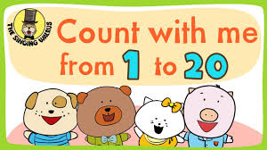
Today’s Maths Song
This week’s maths focus is combining two groups. To help your child combine two groups they have to be a confident counter. Today’s focus song is to practise their counting skills; it is called, ‘Count with me from 1 to 20’ By The Singing Walrus
https://www.youtube.com/watch?v=qi8_BWg8WDU

Slide 5
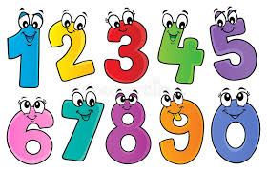

Today’s Counting Challenge
Remember your ongoing counting challenge this week!
How high can you count?
On Monday, you should have tested yourself to see what number you could count to all by yourself. You then needed, with your adult, to set yourself a target to the number you would like to be able to count to by the end of the week. E.g. If your child can count to 5 teach them to count to 10, if your child can count to 10 teach them to count to 15, if your child can count to 15 teach them to count to 20, etc. Remember keep practising!

Slide 6

Today’s Counting Challenge
Each day this week, you are going to focus on counting different coloured objects in your house. At the end of the week you can compare your results and see what colour objects you have the most of in your house!
First of all make a table like the example below.
Day | Colour | Total number of objects
Monday | Red

Slide 7
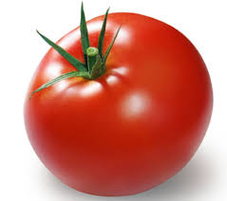
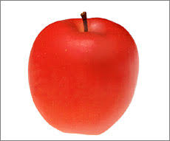

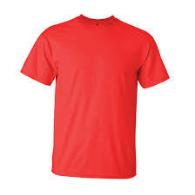
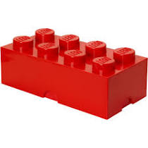
Today’s Counting Challenge Continued
Today’s colour hunt is red. Search your house for red objects, count how many things you can find and write your total in the table you have made.

Slide 8
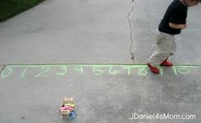
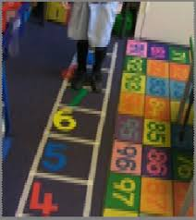
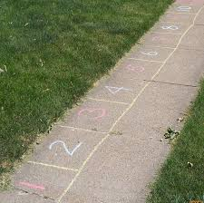
Today’s Outdoor Maths Challenge
Go outside and with your adult draw a number track with chalk on the ground like one of the examples below. Make sure you draw it big enough for you to be able to stand on each number.
Now get your adult to write a simple calculation, e.g. 2+3=, 4+3=, 6+3=, etc.
Use your number track to help you work out the calculations. Stand on the first number and then count on however many you need to add to find the total.

Slide 9
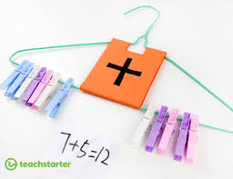
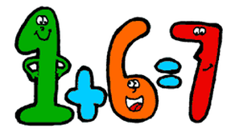
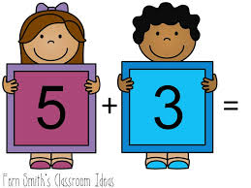
Today’s Indoor Maths Challenge
Today you are going to make an ‘addition counting hanger’ to help you work out addition calculations.
You will need: a coat hanger, pegs and stickers or pictures.
Ask your child to put the pegs onto the hanger and to explore how their pegs can be partitioned in different ways and recombined to see how many altogether.
Once your child has explored, give them simple calculations to work out using their ‘addition counting hanger’

Slide 10
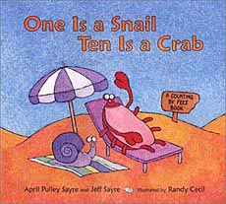
Reading Linked to Maths
‘One is a snail and ten is a crab’. This book is based on the simple, but clever idea of adding the number of feet different animals have, alone or together. If you would like to listen to the story click on the link below.
https://www.youtube.com/watch?v=WfilGMOb9rw

