Slide 1
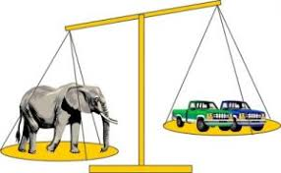

Wednesday 20th January
Maths
This week’s focus: Comparing Weight and Capacity.

Slide 2

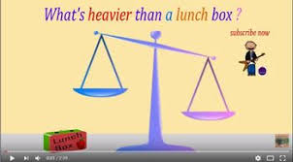
Today’s Maths Song
Today choose your favourite weight song from the ones we sang on either Monday or Tuesday. If you want to, you can sing both of the songs!
https://www.youtube.com/watch?v=qUOQrXmfwDM
https://www.youtube.com/watch?v=1QUHONch0-4

Slide 3
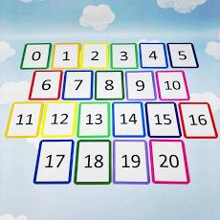
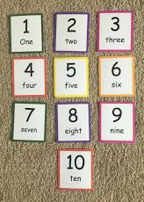
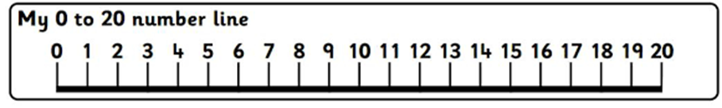
Today’s Counting Challenge
All children learn in different ways. Depending on your child’s ability choose a number range to focus on.
0-5
0-10
0-15
0-20
Write the numbers down on some flashcards and first make sure your child recognises all the numbers. Then ask them to put the numbers in the correct order.

Slide 4
Today’s Outdoor Maths Challenge
Today we are going to start to look at capacity. Children are going to experiment and explore containers and adults can play alongside their child to develop their understanding of the mathematical language linked to capacity.
Encourage your child to build on their understanding of full and empty to show half full, nearly full and nearly empty.
Provide different sized and shaped containers to investigate. Look in your recycle bin for old bottles and tubs and any other containers you can find in your kitchen.
Prompt them to use the language of tall, thin, narrow, wide and shallow when describing containers.
If you feel it is a little cold for your child to be playing with water outside, you could always move this learning inside and do it at bath time!

Slide 5
Today’s Indoor Maths Challenge
Today you are going to do some cooking with your child and the focus is to develop talk around the measuring and weighing of the ingredients. You may choose any recipe but if you would like some ideas I have two weblinks below.
https://www.nigella.com/recipes/chocolate-chip-cookies
https://www.nationaltrust.org.uk/recipes/cheese-scones
Key Vocabulary to think about when cooking
More, less, heavier, lighter, full, empty, half full, nearly full, tall, thin, narrow, wide and shallow.
Also this is a great opportunity to practise using counting skills. (e.g. when counting out ingredients and spoonfuls).
If you want to you can involve your child in the whole process, starting with writing a shopping list and maybe including the shopping trip to buy ingredients.

Slide 6
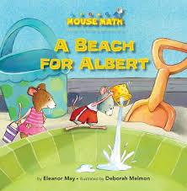
Reading Linked to Maths
‘A Beach for Albert’, by Eleanor May is a great book which, throughout the story, uses lots of vocabulary linked to capacity. If you would like to listen to the story, click on the link below:
https://www.youtube.com/watch?v=HzZdx2omt0E

