Slide 1
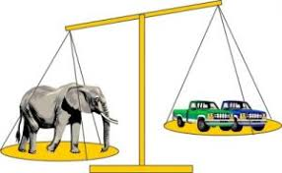

Thursday 21st January
Maths
This week’s focus: Comparing Weight and Capacity.

Slide 2
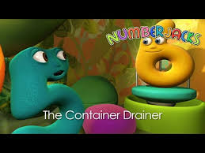
Today’s Maths Programme
Today you can watch a ‘NumberJacks’ linked to capacity. It is called ‘The Container Drainer.’
https://www.youtube.com/watch?v=4y0QvlFGxqA

Slide 3


Today’s Counting Challenge
Get a piece of paper and a pen or pencil. Ask the person who is helping you with your work to time you for 30 seconds and see how many oblongs you can draw in this time. Remember, an oblong has two long sides and two short sides. Count how many you have drawn and write the total down. Do the challenge again and see whether you draw more or less oblongs? You could have a family competition!

Slide 4
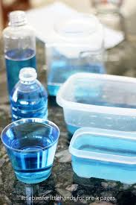
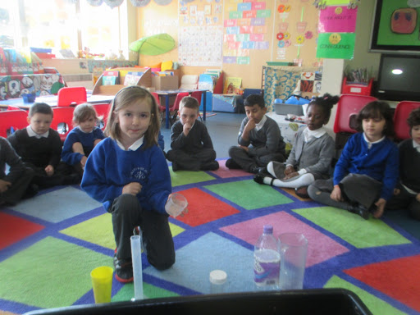
Today’s Outdoor Maths Challenge
Today we are going to continue to look at capacity. Find 5 containers of different shapes and sizes and number them 1 to 5.
Ask your child to predict (guess) which container will hold the most and which one will hold the least. Put them in order.
Fill each container with water.
Next, tip the water from each container into a jug to measure how much water each one holds. Mark on the jug how much water is from each container with a sticker or paper so you can compare the different amounts.
Remember to try and use the mathematical vocabulary: tall, thin, narrow, wide, shallow, more, less and equal to compare the different containers.
Again if it is too cold outside save the challenge until bath time!

Slide 5
Today’s Indoor Maths Challenge
Today I would like you to go on a number container hunt around the house! Explain to your child that every bottle that has a liquid in it has a number on it which tells you how much liquid is in the bottle/container.
The main focus of the lesson is for children to recognise numbers in the environment. At this stage of your child’s learning, they are not expected to recognise and read two digit numbers over 20 and 3 digit numbers. However, some children find this really exciting and so you can introduce these numbers to your child once they find them on the bottles and the important point is for them to start to realise how numbers are made.
On the next slide is an example of how I would question children about the numbers on the coke cans.

Slide 6
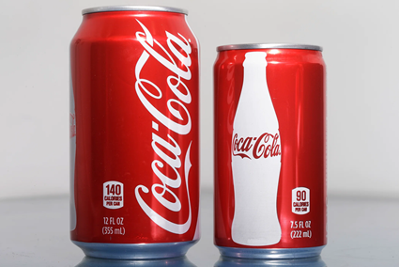
Today’s Indoor Maths Challenge Continued
An example of how you can question your child
When your child finds on their number container, hunt for the number like the ones on these coke cans and they point to the numbers for you. Ask them what numbers can they see? If they tell you they see 1, 4 and 0 explain to them when those numbers are all written together that makes a new number 140…..continue like this as children discover lots of different numbers on the containers they find.

Slide 7
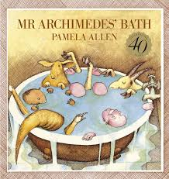
Reading Linked to Maths
‘Mr Archimedes Bath’, by Pamela Allen. This is a book about a man called Mr Archimedes and his friends who try to work out why the water always overflows when they all have a bath.
If you would like to listen to the story, click on the link below.
https://www.youtube.com/watch?v=gkA3SY68_Yk

