Slide 1
Wednesday 10th February
Phonics

Slide 2
Phonic Sounds
The link below is for the ‘Alphabet Song.’ It is important children know the name and the sound each letter makes.
https://www.youtube.com/watch?v=5PmB3SIjNdQ

Slide 3
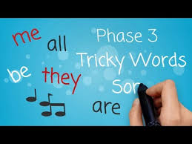
We have learnt lots of tricky words so rather than going through the slides for them all, click on the link below and your child can sing along to the tricky word song. https://www.youtube.com/watch?v=R087lYrRpgY

Slide 4
New tricky word!
there
Can you think of a sentence that includes the tricky word there?

Slide 5
Recap phase 2 sounds.
The link below will recap phase 2 sounds. Select phase 2 only and see if you can say the sounds in less than 1 minute! If you recorded your time last week see if you can beat that time!
https://www.phonicsplay.co.uk/resources/phase/3/flashcards-speed-trials

Slide 6
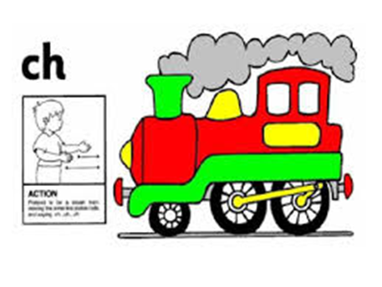
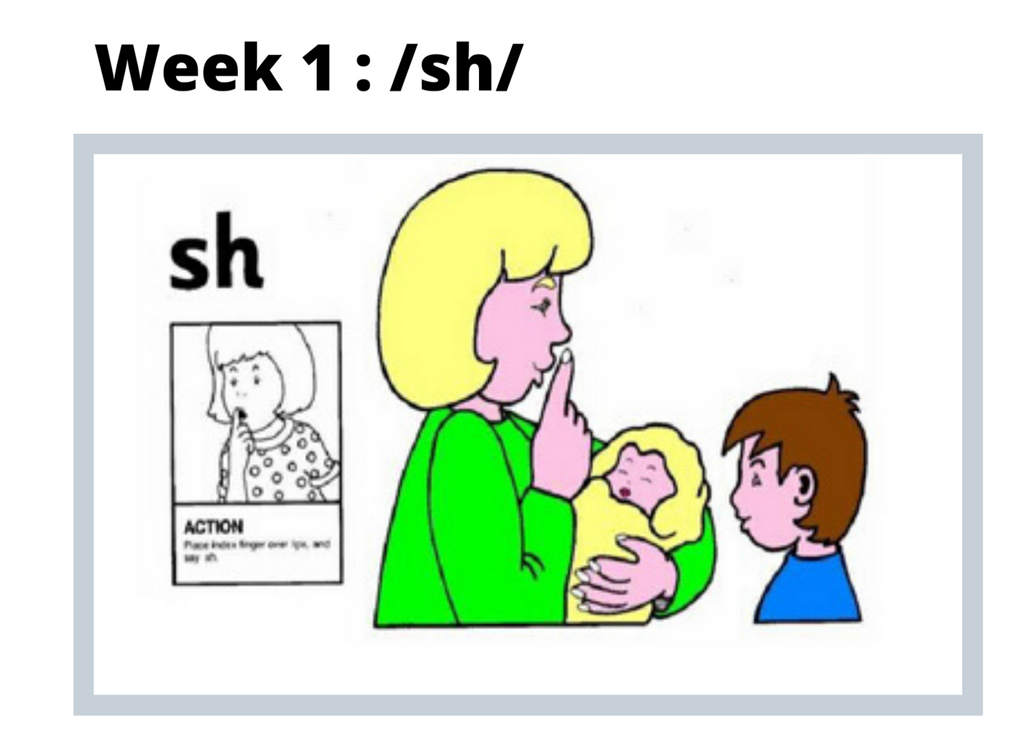
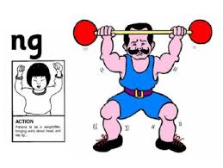
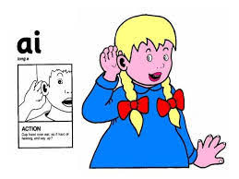
Recap new sounds
ch sh th ng ai

Slide 7
Recap new sounds

Slide 8
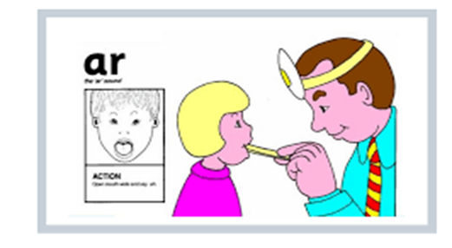
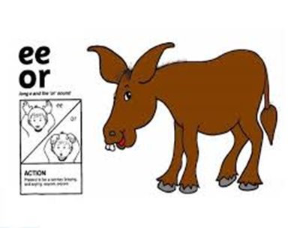
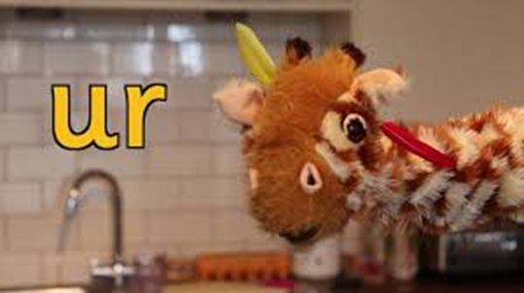
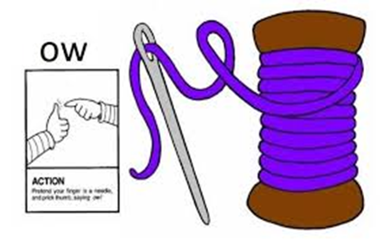
Recap new sounds
ar
or
ur
ow
ear

Slide 9
ure

Slide 10
Recapping Phase 3 sounds.
We have now learnt all the new sounds that are introduced in Phase 3 of Letters and Sounds. Over the next coming weeks, we will be using these new sounds to make longer words often using more than one digraph in each word. On the next slides will be some pictures. All the words will have the digraph ‘th’ in them. This is the focus sound for today but watch out for other digraphs that I have sneaked in!

Slide 11
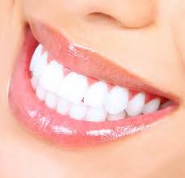
Say the word and sound the word

Slide 12
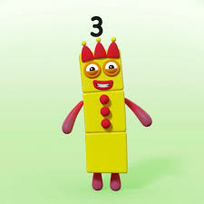
Say the word and sound the word

Slide 13
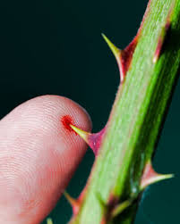
Say the word and sound the word

Slide 14
Say the word and sound the word

Slide 15
Lets make the words!
To do this you will need pieces of paper with the different sounds on
th
ee
t
r
or
n
s
l
o

Slide 16
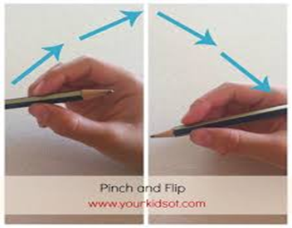
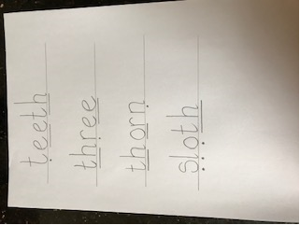
Writing the words.
Tips on the correct pencil grip: we encourage children to ‘pinch and flick’ the pencil to make sure they are holding it correctly.
Your child may want to write the words to match the pictures. Remember to encourage correct pencil grip and lower case letters.

Slide 17
Fun Phonics!.
To finish off today’s learning your child might want to play ‘Buried treasure.’ This game will help your child practice segmenting and blending using all the digraphs used so far. Click on the link below.
https://www.phonicsplay.co.uk/resources/phase/2/buried-treasure

Slide 18
Remote Learning Tracking
Once you have completed the PowerPoint please fill in the simple questionnaire below to let us know it is complete.
https://forms.office.com/Pages/ResponsePage.aspx?id=eCY4lN73r0G0KV1rDWITzRhTQ2IZqpBOsW8cFVoooF9UNVlMS1dCVkdaM0k0WlhFTE9WVFBTWEg1Ti4u

