Slide 1
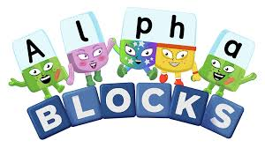
Tuesday 12th January
Phonics

Slide 2
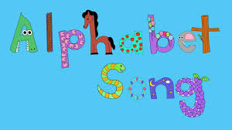
Phonic Sounds
The link below is for the ‘Alphabet Song.’ It is important children know the name and the sound each letter makes.
https://www.youtube.com/watch?v=5PmB3SIjNdQ

Slide 3
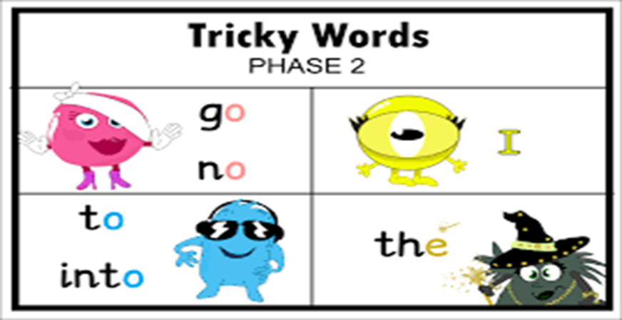
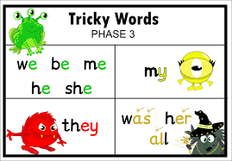
Tricky words
Tricky words are words you can not sound out. They are words your child needs to learn to recognise by sight. On the next few slides will be some tricky words, see whether your child can read them. If they struggle make little flashcards so they can practise them.

Slide 4
go

Slide 5
no

Slide 6
I

Slide 7
to

Slide 8
into

Slide 9
the

Slide 10
we

Slide 11
New tricky word!
be

Slide 12
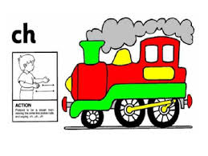
Recap yesterdays new sound
ch
https://www.youtube.com/watch?v=gLHpZyIu7ps

Slide 13
Today’s new sound
sh
https://www.youtube.com/watch?v=3uyqR3u4jtg

Slide 14
Making Words
On the next slide will be some pictures all the words will have the sound ‘sh’ at the beginning of them. This is the focus sound for today. For each picture say the word and then sound it out. I will model each word for you on the next slide.

Slide 15
Say the word and sound the word

Slide 16
Say the word and sound the word

Slide 17
Say the word and sound the word

Slide 18
Lets make the words!
To do this you will need pieces of paper with the different sounds on
sh
i
p
e
d
o

Slide 19
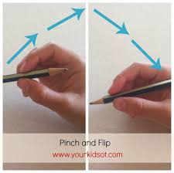
Writing the sound ‘sh’
Tips on the correct pencil grip, we encourage children to ‘pinch and flick’ the pencil to make sure they are holding it correctly.

Slide 20
Writing the sound ‘sh’
First practise writing the digraph ‘sh’. Encourage your child to try and write it on lined paper. The picture shows an example instructing you on how to correctly form the letter.

Slide 21
Writing the words starting with ‘sh’
Your child has done lots of new learning this morning!
They have learnt a new digraph and the action to go with it and they have learnt the new tricky word ‘be’.
However if you have a really enthusiastic child they may want to write the words to match the pictures. Remember to encourage correct pencil grip and lower case letters.
Your child could also play Buried Treasure which will develop your child’s segmenting and blending skills using the digraph ‘sh’
https://www.phonicsplay.co.uk/resources/phase/2/buried-treasure

