Slide 1
Friday 29th January
Phonics

Slide 2
Phonic Sounds
The link below is for the ‘Alphabet Song.’ It is important children know the name and the sound each letter makes.
https://www.youtube.com/watch?v=dLReNTmMkKA

Slide 3
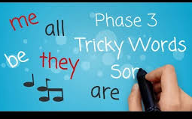
We have learnt lots of tricky words this week so rather than going through the slides for them all, click on the link below and your child can sing along to the tricky word song. https://www.youtube.com/watch?v=R087lYrRpgY

Slide 4
New tricky words we have learnt. her

Slide 5
said

Slide 6
have

Slide 7
like

Slide 8
New tricky word!
so

Slide 9
Recap phase 2 sounds.
The link below will recap phase 2 sounds. Select phase 2 only and see if you can say the sounds in less than 2 minutes! If you recorded your time yesterday, see if you can beat that time!
https://www.phonicsplay.co.uk/resources/phase/3/flashcards-speed-trials

Slide 10
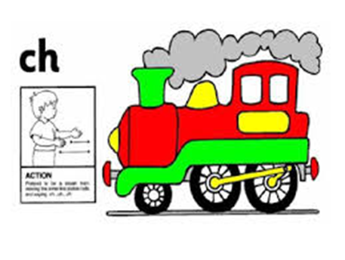
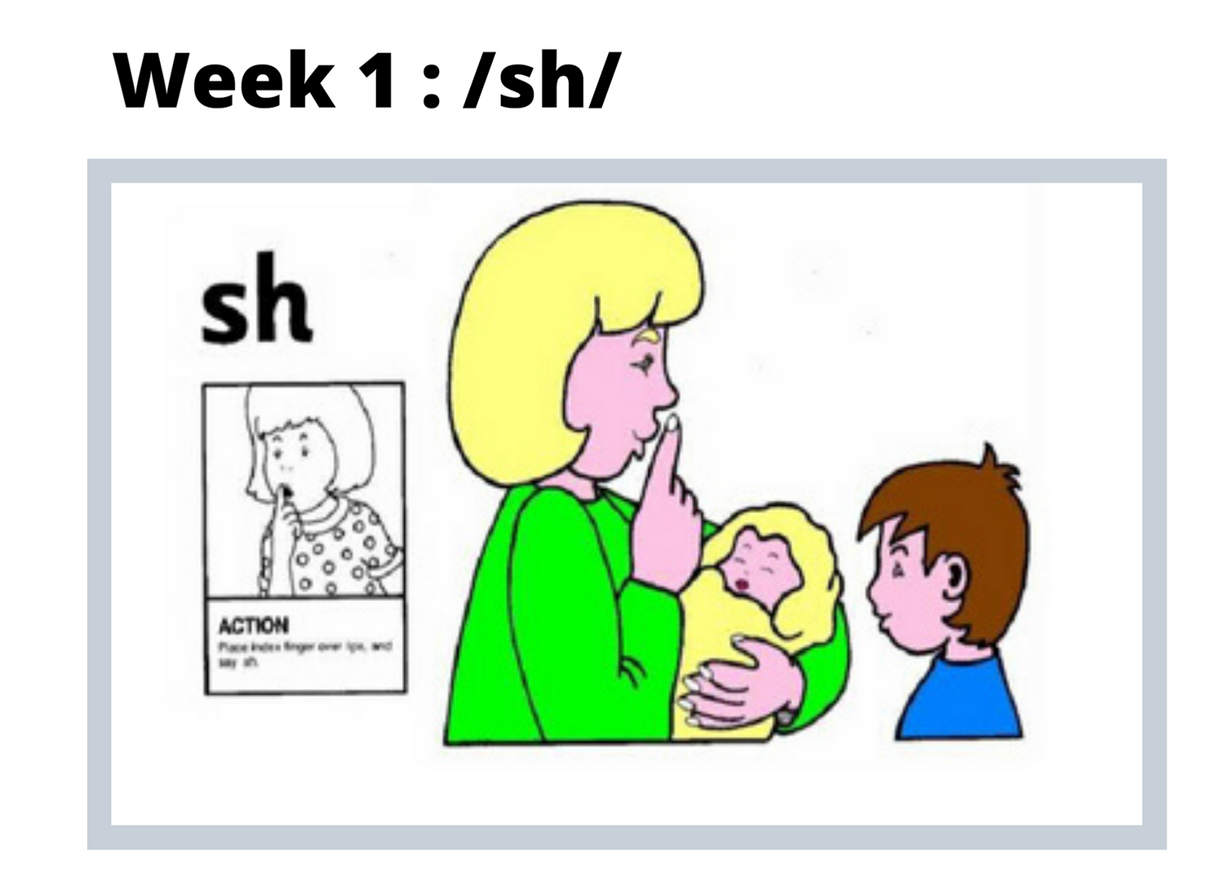
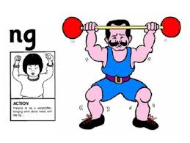
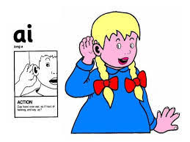
Recap new sounds
ch sh th ng ai

Slide 11
Recap new sounds

Slide 12
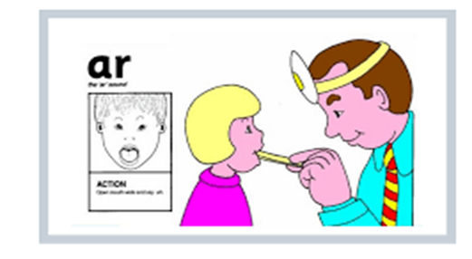
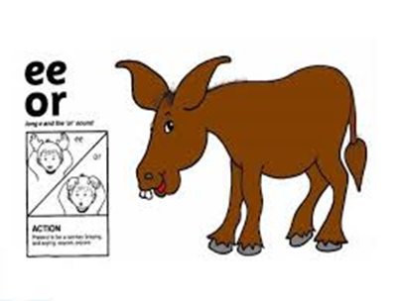
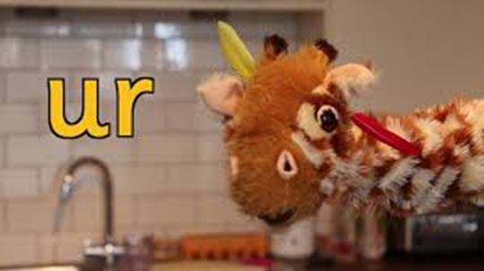
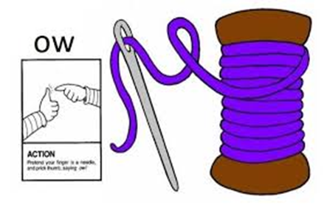
Recap new sounds
ar
or
ur
ow

Slide 13
Today’s new sound
ow
https://www.youtube.com/watch?v=9Ph6nnHrVwY

Slide 14
Making Words
On the next slide there are some pictures. All the words have the digraph ‘ow’ in the middle of them. This is the focus sound for today. For each picture say the word and then sound it out. I will model each word for you on the next slide.

Slide 15
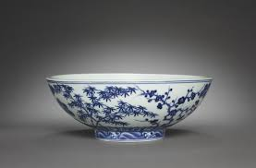
Say the word and sound the word

Slide 16
Say the word and sound the word

Slide 17
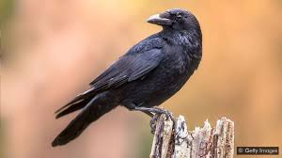
Say the word and sound the word

Slide 18
Lets make the words!
To do this you will need pieces of paper with the different sounds on
ow
r
c
b
l

Slide 19
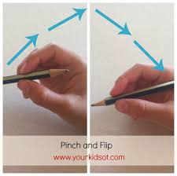
Writing the sound ‘ow’
Tips on the correct pencil grip, we encourage children to ‘pinch and flick’ the pencil to make sure they are holding it correctly.

Slide 20
Writing the sound ‘ow’
First practise writing the digraph ‘ow’. Encourage your child to try and write it on lined paper. The picture shows an example instructing you on how to correctly form the letter.
https://www.youtube.com/watch?v=lo7GoK5bc8c
https://www.youtube.com/watch?v=-14_uIQXh34
ow ow ow ow ow

Slide 21
Writing the words with ‘ow’ in the middle.
Your child has done lots of new learning this morning!
They have learnt a new digraph and the action to go with it and they have learnt the new tricky word ‘so’.
However, if you have a really enthusiastic child they may want to write the words to match the pictures. Remember to encourage correct pencil grip and lower case letters.
To finish off today’s learning your child might want to play ‘Buried Treasure.’ Click on phase 3 and then select ‘ow’ and they can practice segmenting and blending using that sound. Click on the link below.
https://www.phonicsplay.co.uk/resources/phase/3/buried-treasure

