Slide 1
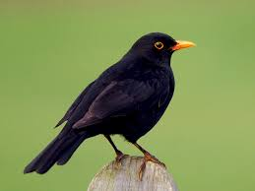
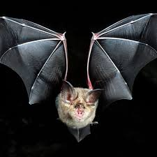
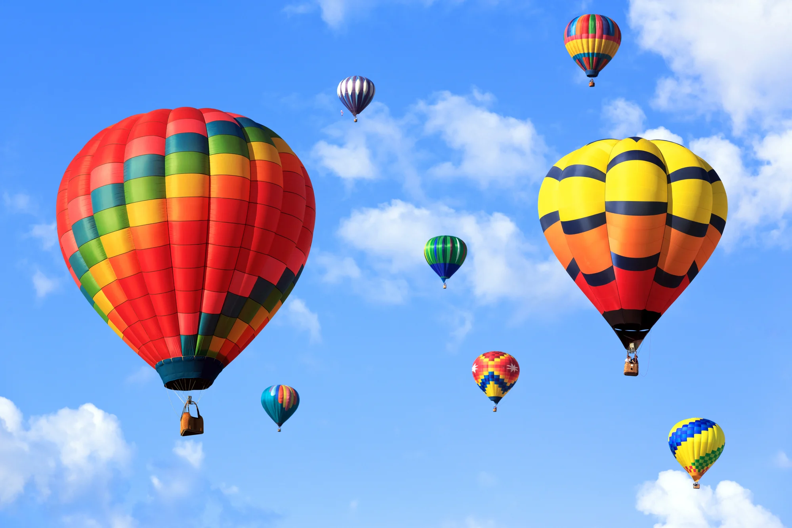
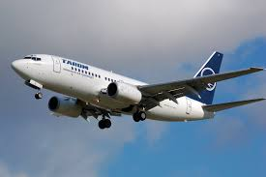
Reception topic for this half term.
Flight
Week beginning 8.2.21
Topic Challenge

Slide 2
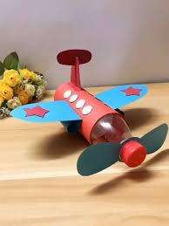
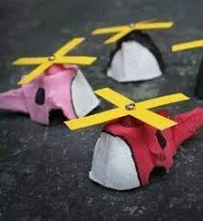
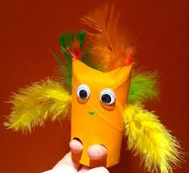
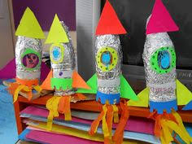
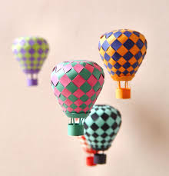
This week’s challenge…..
Over the past half term, our topic has been flight. This week’s challenge is to let your imagination go wild and create your own flying machine!!
Will it have wings like a bird that flap?
Rotor blades like a helicopter?
Boosters like on a rocket?
A balloon to make it float?

