Slide 1
Y1 Art Thursday 25th February
Objectives:
To Investigate a wide range of images and objects of sculptures.
To look at and describe what you see, think and feel when looking at images and artefacts.
To identify different art forms and suggest reasons for the artist’s intention or meaning of the work.

Slide 2
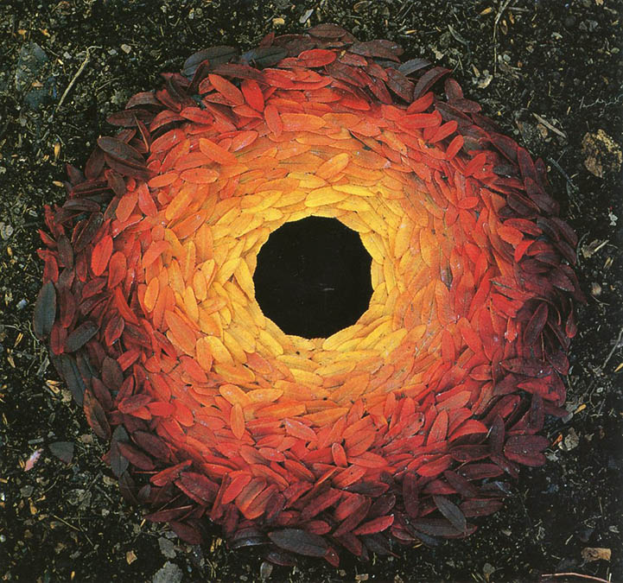
Big question: What is sculpture?
In the pictures of sculptures you will find in the powerpoint, think about:
What you see/notice.
What they have in common?
What differences there are?

Slide 3
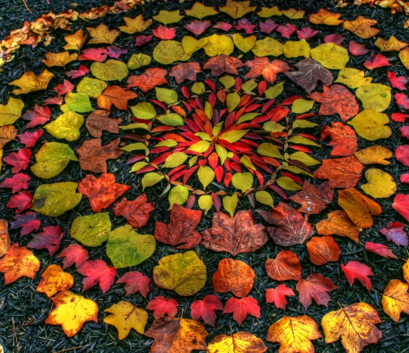
Who is Andy Goldsworthy?
Andy Goldsworthy is a British artist, known for his sculptures and photography.
He is an environmentalist, which is someone who wants to protect the environment around them.
Andy makes sculptures with natural materials on sites in the UK and around the world. He has made them in forests, cities, lakes and fields. They are known as land art.

Slide 4
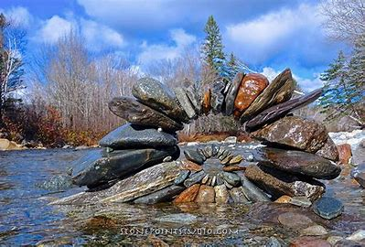
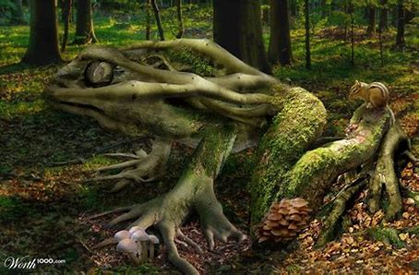
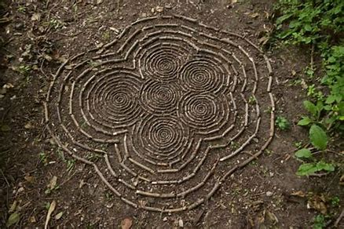
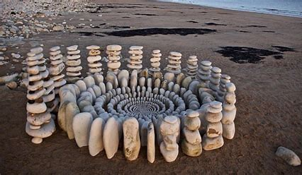
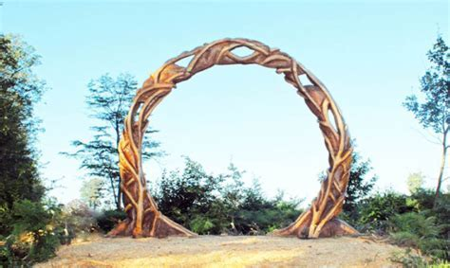
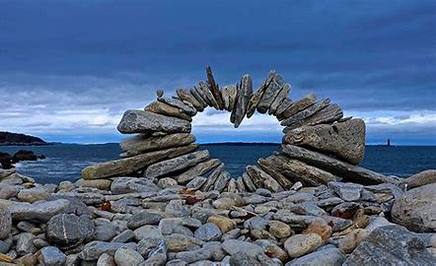
Andy Goldsworthy’s art makes us think about the world around us and how nature is art.
Can you think of a title for one or more of the sculptures on the next slides?
Choose one of the sculptures and answer the following questions.
What materials have been used?
What are the components?
How have they been joined/assembled?
What would you ask the Sculptor?
Group 2
Group 3
Group 4
Group 5
Group 6

Slide 5
“We often forget that we are nature” Andy Goldsworthy

Slide 6
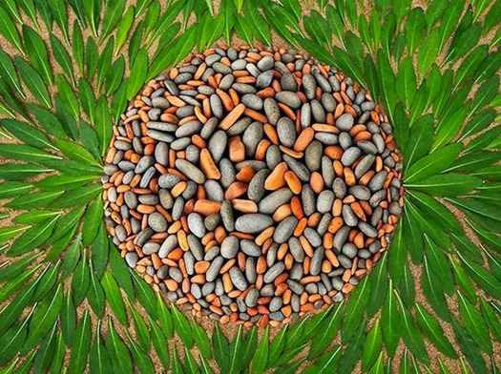
What do these sculptures make you think of?

Slide 7
Andy Goldsworthy Sculptures- 1

Slide 8
Andy Goldsworthy Sculptures- 2

Slide 9
Andy Goldsworthy Sculptures- 3

Slide 10
Andy Goldsworthy Sculptures- 4

Slide 11
What is a sculpture? Write a definition.
A sculpture is… ________________________________________________________________________________________________________________________________________________________________________________________________________________________________________________________________________________________________________________________

Slide 12
Your task is to use natural materials to recreate some designs on paper. Take pictures of your work for a class gallery. Give each piece a title.

Slide 13
Please follow the link below and fill in the online form to show that you have completed the lesson.
https://forms.office.com/Pages/ResponsePage.aspx?id=eCY4lN73r0G0KV1rDWITzRhTQ2IZqpBOsW8cFVoooF9UNVlMS1dCVkdaM0k0WlhFTE9WVFBTWEg1Ti4u

