Slide 1
Y1 English Wednesday 24th February

Slide 2
Objectives:
To explore familiar and unfamiliar rhymes and stories
To think about the themes and issues of stories, making connections with our own lives .
To write in role as a story character.

Slide 4
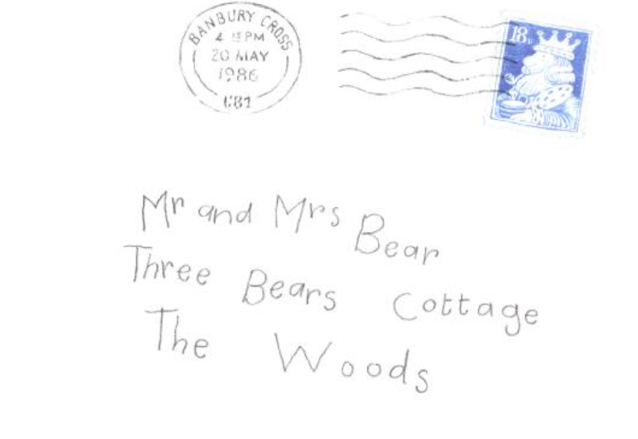
Who are the Three Bears?
Who might write to them and why?
You might like to remind yourself of the story of Goldilocks before you continue. Here is an example on You Tube.
Goldilocks and the Three Bears by Oxbridge Baby

Slide 5
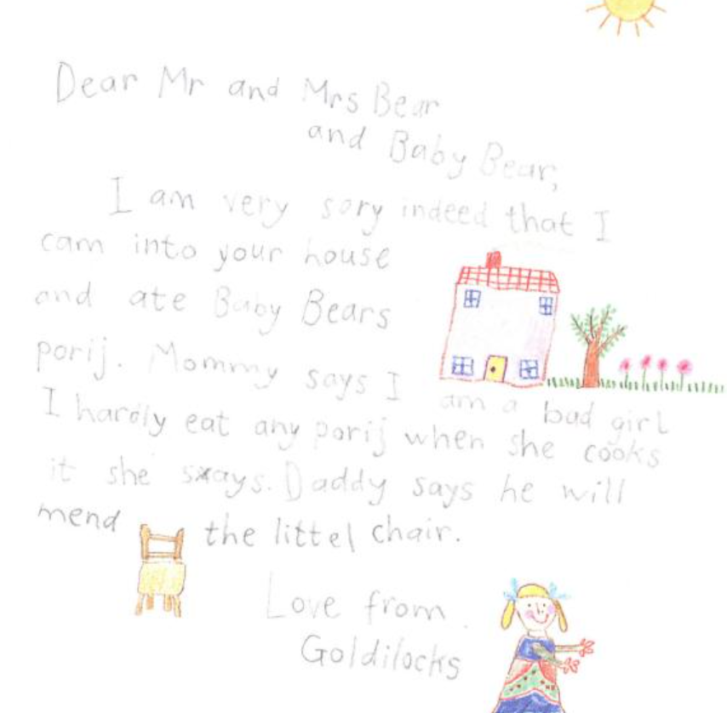
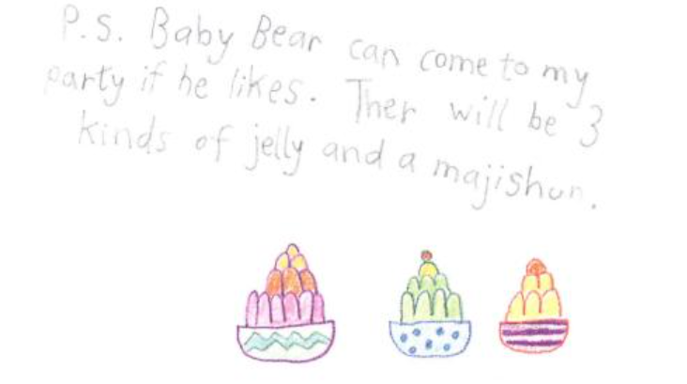
Why do you think Goldilocks writes this letter?
What does she want the Bears to think?
How do you think the Bears feel about Goldilocks?
How do you feel about Goldilocks?

Slide 6
Do you think Baby Bear should forgive Goldilocks?
Reasons for:
_____________________________________________________________________________________________________________________________________________________________________________________________________________________________________________________________________________________________________________________________________________
Reasons against:
_____________________________________________________________________________________________________________________________________________________________________________________________________________________________________________________________________________________________________________________________________________

Slide 7
She doesn’t set out to do any damage.
The chair might be very expensive to replace.
She wanted to be friends.
The Bears should have remembered to lock the door.
It might have been raining.
She should think of other people’s feelings.
The Bears might not have any other food.
She invited him to her party.
The chair might have been very valuable.
The chair might have been a present from Baby’s grandbearmother.
She was hungry and tired.
She wrote a kind and thoughtful letter.
She shouldn’t have gone into a stranger’s house.
There might have been a wolf chasing her.
He was scared when he saw there was a person in his bed.
She should have gone straight home and had her dinner if she was hungry.
Baby has nowhere to sit.
She might have been lost.

Slide 8
Imagine you are Baby Bear.
Are going to forgive Goldilocks?
Write and illustrate your own letter to Goldilocks to explain how you feel.

Slide 9
Here are some ideas for setting out your letter.

Slide 10
Please follow the link below and fill in the online form to show that you have completed the lesson.
https://forms.office.com/Pages/ResponsePage.aspx?id=eCY4lN73r0G0KV1rDWITzRhTQ2IZqpBOsW8cFVoooF9UNVlMS1dCVkdaM0k0WlhFTE9WVFBTWEg1Ti4u

