Slide 1
English
tuesday 26th JAnuary

Slide 2
Recounts: Diaries First person and past tense
Outcomes:
To be able to identify 'doing words', or verbs, in sentences and use them in their own writing

Slide 3
Today’s Learning
Remember…
that a diary is a personal record of experiences and feelings that have happened. It is written in the first person and the past.
We change the form of verbs to refer to when something happens, i.e. past and present.

Slide 4
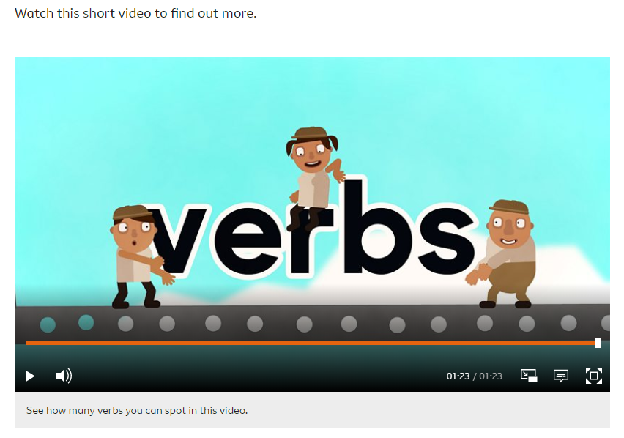
What is a verb?
Watch the first video link about what a verb is.
Click on the link below.
https://www.bbc.co.uk/bitesize/articles/z3y9vwx

Slide 5
Verbs
Verbs can be used to describe an action - that’s doing something. For example, the word jumping:
The rabbit was jumping in the field.
They can also be used to describe what something ‘feels’ like. For example, the word likes here:
The monster likes rollercoasters.
Or a verb can be used to describe something that’s happening. For example, the word became here:
The caterpillar became a butterfly.
When writing, make sure every sentence includes a verb.

Slide 6
Listen for the verbs
https://www.bbc.co.uk/bitesize/articles/z3y9vwx
Write the verbs down as you hear them.
Play the video as many times as you need.

Slide 7
Spot the verb
https://www.bbc.co.uk/bitesize/articles/z3y9vwx

Slide 8
Your turn!

Slide 9
Still learning to read?

Slide 10
Now its your turn
Have fun!

