Slide 1
Year One
Maths
Wednesday 20th January

Slide 2
Money and Time
Identify coins to 10p
Exchange for 1p coins
Objectives
Day 3
Use combinations of 1p, 2p, 5p and 10p coins to pay for items.

Slide 3
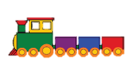
Day 3: Use combinations of 1p, 2p, 5p and 10p coins to pay for items.
9p
7p
4p
10p
12p
Which coins could be used to pay for the train?

Slide 4
Day 3: Use combinations of 1p, 2p, 5p and 10p coins to pay for items.
Talk to your partner.
Which coins could we use to pay 4p?
4p
Notes:
Which way uses fewest coins?

Slide 5
Day 3: Use combinations of 1p, 2p, 5p and 10p coins to pay for items.
How else could we make 4p?
4p

Slide 6
Day 3: Use combinations of 1p, 2p, 5p and 10p coins to pay for items.
Which way uses the fewest coins?
4p

Slide 7
Day 3: Use combinations of 1p, 2p, 5p and 10p coins to pay for items.
Talk to your partner.
How could we make 7p?
7p

Slide 8
Day 3: Use combinations of 1p, 2p, 5p and 10p coins to pay for items.
7p
Which way uses the fewest coins?

Slide 9
Day 3: Use combinations of 1p, 2p, 5p and 10p coins to pay for items.
How could I pay?
10p
Notes:
Explain that now you want to buy a pencil for 10p but you have not got a 10p coin.
Ask how else you could pay.
Ask children if you could pay with 2 coins rather than using all the pennies.

Slide 10
Day 3: Use combinations of 1p, 2p, 5p and 10p coins to pay for items.
How else could I pay?
10p
or

Slide 11
Day 3: Use combinations of 1p, 2p, 5p and 10p coins to pay for items.
Can I pay with just two coins?
10p
Notes:
Children can now go on to do differentiated GROUP ACTIVITIES. You can find Hamilton’s group activities in this unit’s TEACHING AND GROUP ACTIVITIES download.
WT/ARE: Find different combinations to make money amounts.
GD: Find different combinations to make money amounts.

Slide 12
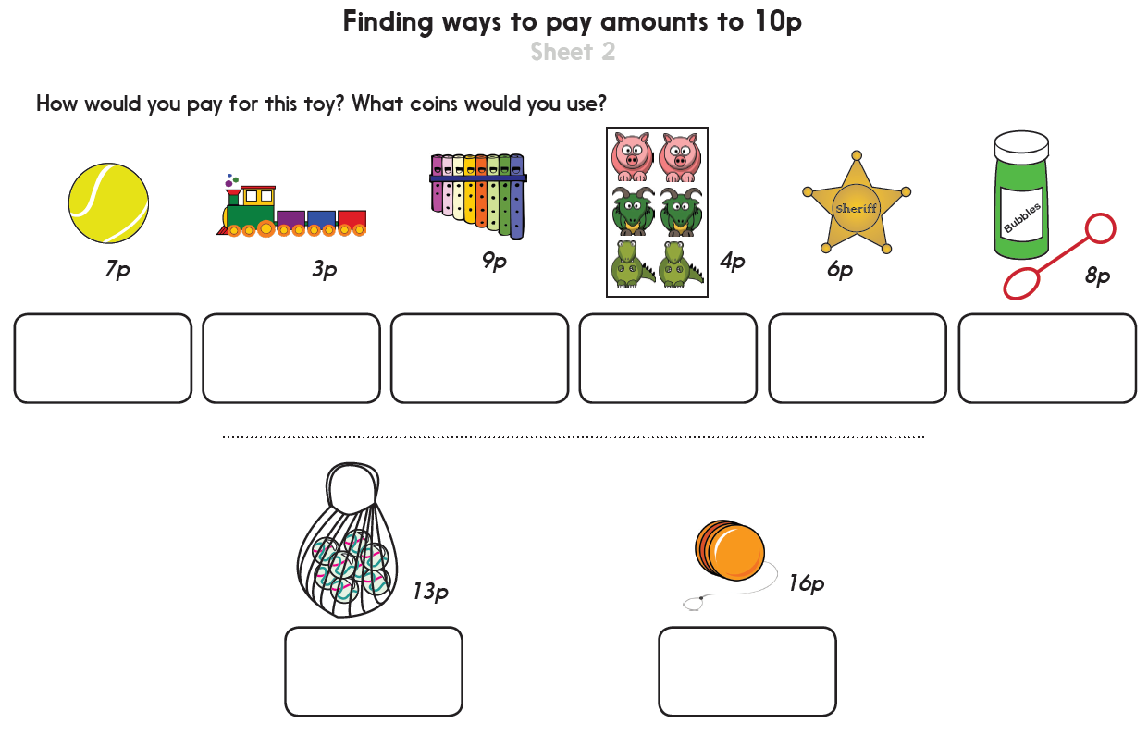
Notes:
The Practice Sheet on this slide is suitable for most children.
Differentiated PRACTICE WORKSHEETS are available on Hamilton’s website in this unit’s PROCEDURAL FLUENCY box.
WT: Finding ways to pay amounts to 6p Sheet 1
ARE/GD: Finding ways to pay amounts to 10p Sheet 2

Slide 13
Money and Time
Identify coins to 10p
Exchange for 1p coins
Well Done! You’ve completed this unit.
Objectives
Day 1
Know how much each coin to 10p is worth.
Day 2
Find totals of two coins from 1p, 2p, 5p and 10p.
Day 3
Use combinations of 1p, 2p, 5p and 10p coins to pay for items.
Notes:
You can now use the Mastery: Reasoning and Problem-Solving questions to assess children’s success across this unit. Go to the next slide.

Slide 14
Problem solving and reasoning questions
Find a coin which is…
less than 2p
5p more than 5p
(c) in between 2p and 10p
Draw the number of 1p coins each coin is worth.
5p
2p
10p
Challenge
Try to put at least one coin in each place on the table.
Is this possible?
 | silver | brown
round
not round

Slide 15
Problem solving and reasoning: Answers
Find a coin which is…
(a) less than 2p 1p
(b) 5p more than 5p 10p
(c) in between 2p and 10p 5p
Draw the number of 1p coins each coin is worth.
(i) 5p 5 x 1p
(ii) 2p 2 x 1p
(iii) 10p 10 x 1p
Challenge
Try to put at least one coin in each place on the table.
Is this possible? No. There are no coins that are both brown and not round.
 | silver | brown
round | 5p, 10p | 1p, 2p
not round | 20p, 50p | none

