Slide 1
Year One
Maths
Monday 25th January

Slide 2
Money and Time
Make amounts using 1p, 2p, 5p and 10p coins
Find all possibilities
Starters
Day 3
Pairs to 6 and 7 (simmering skills)

Slide 3
Money and Time
Make amounts using 1p, 2p, 5p and 10p coins
Find all possibilities
Starter
Pairs to 6 and 7

Slide 4
Money and Time
Make amounts using 1p, 2p, 5p and 10p coins
Find all possibilities
Objectives
Day 3
Begin to find all possibilities by making an ordered list.

Slide 5
Day 3: Begin to find all possibilities by making an ordered list.
Is there a 7p coin?
7p
Talk to your partner.
How could you make 7p?
Draw your ideas on your whiteboard.
Notes:
Explain that you want to buy something costing 7p.

Slide 6
Day 3: Begin to find all possibilities by making an ordered list.
What’s the biggest (greatest value) coin we can use?
7p
Notes:
Ask children to share their ideas.
Show 5p and 2p, and 5p and two pennies.

Slide 7
Day 3: Begin to find all possibilities by making an ordered list.
What is the next ‘biggest’ coin we could use to start with?
7p
Notes:
Ask children to share their ideas.
Show three 2p coins and one 1p coin.

Slide 8
Day 3: Begin to find all possibilities by making an ordered list.
What is the next biggest coin we could use?
7p
Notes:
Note that this is the least amount of coins we can use with a 2p coin.
Then show how we could swap one of the 2p coins with two pennies to find another way.

Slide 9
Day 3: Begin to find all possibilities by making an ordered list.
7p
Notes:
Keep swapping the 2p coins for pennies until you are left with seven pennies.

Slide 10
Day 3: Begin to find all possibilities by making an ordered list.
7p
Notes:
Keep swapping the 2p coins for pennies until you are left with seven pennies.

Slide 11
Day 3: Begin to find all possibilities by making an ordered list.
5p + 2p = 7p
5p + 1p + 1p = 7p
2p + 2p + 2p + 1p = 7p
2p + 2p + 1p + 1p + 1p = 7p
2p + 1p + 1p + 1p + 1p + 1p = 7p
1p + 1p + 1p + 1p + 1p + 1p + 1p = 7p
Notes:
Investigation into how many ways children can make 6p and 8p.

Slide 12
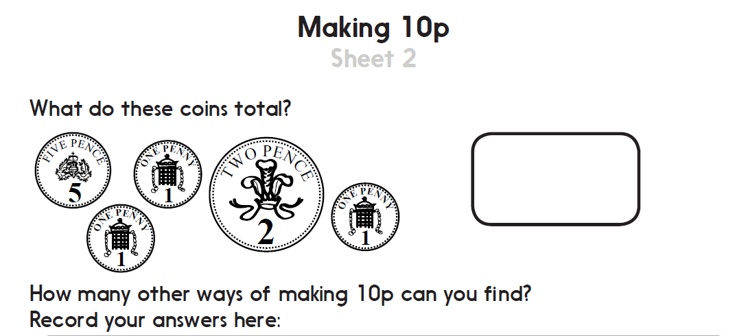
Ways of making 10p

Slide 13
Problem solving and reasoning questions
Write three different amounts that can be made using three identical coins
True or false
• 2p and 1p are the only brown coins
• A 10p coin is smaller than a 2p
• 5p is the smallest coin
Start with 1p. Add 2p five times. What is your answer?
Start with 10p. How many times can you subtract 2p?
How many different ways are there of giving me 5p?

Slide 14
Problem solving and reasoning: Answers
Write three different amounts that can be made using three identical coins.
3p (3 x 1p) 6p (3 x 2p) 15p (3 x 5p) 30p (3 x 10p)
True or false
• 2p and 1p are the only brown coins True
• A 10p coin is smaller than a 2p It is smaller in size, but not in value.
• 5p is the smallest coin It is smallest in size, but not in value (that’s the 1p).
Start with 1p. Add 2p five times. What is your answer? 11p
Start with 10p. How many times can you subtract 2p? Five times
How many different ways are there of giving me 5p? 4 ways:
A 5p Two 2ps and a 1p A 2p and three 1ps Five 1ps

Slide 15
Money and Time
Make amounts using 1p, 2p, 5p and 10p coins
Find all possibilities
Well Done! You’ve completed this unit.

