Slide 1
Y1 Maths
Friday 26th February

Slide 2
Money and Fractions
Find half and quarter of amounts
Objectives
Day 2 Find a quarter of quantities.

Slide 3
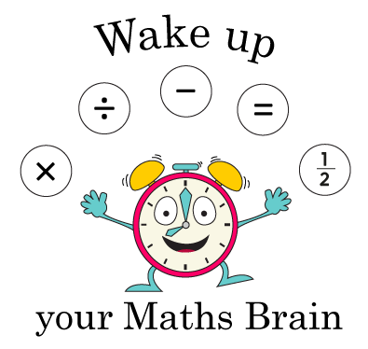
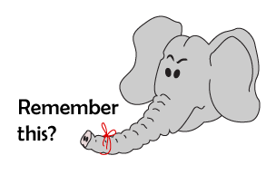
Money and Fractions
Find half and quarter of quantities
Starters
Day 2 Finding doubles

Slide 4
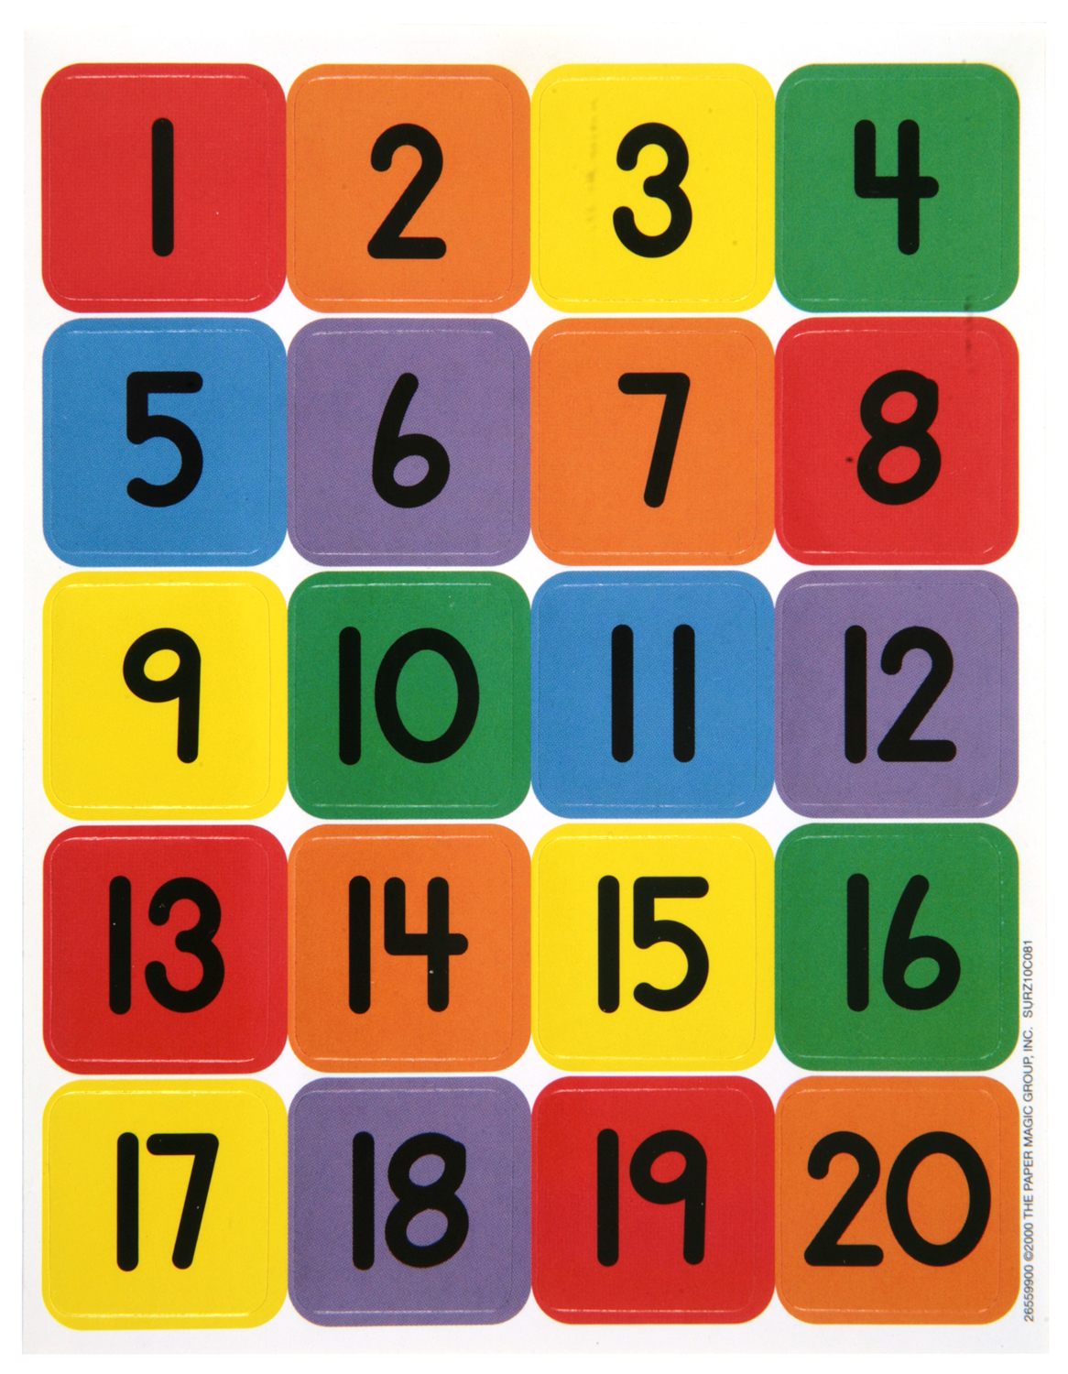
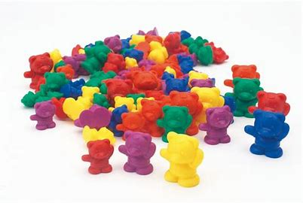
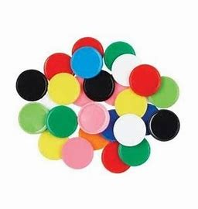
Money and Fractions
Find half and quarter of quantities
Starter
Find doubles
Make a list of the doubles that you find.
For example:
double 3 is 6
How many doubles can you make?
Notes:
You will need 20 objects for counting. Which numbers from 1-20 can you find the double for with your counters? That means you need to make two equal groups.

Slide 5
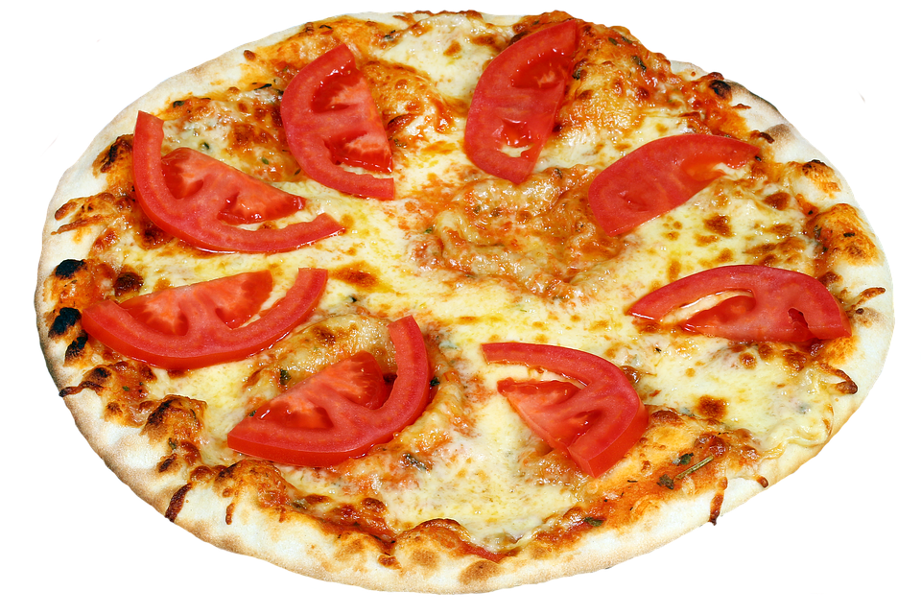
Day 2: Find a quarter of quantities.
Where would we need to cut to divide the pizza in half?

Slide 6
Day 2: Find a quarter of quantities.
How many pieces of tomato are on each half?
4
So half of 8 is 4

Slide 7
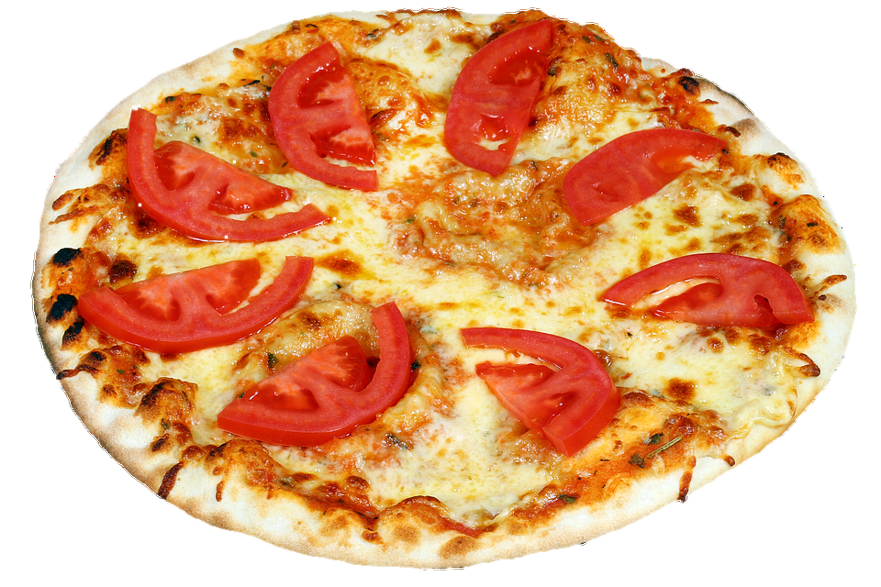
Day 2: Find a quarter of quantities.
How could we cut the pizza into quarters?

Slide 8
Day 2: Find a quarter of quantities.
How many pieces of tomato are on each quarter?
2
So one quarter of 8 is 2

Slide 9
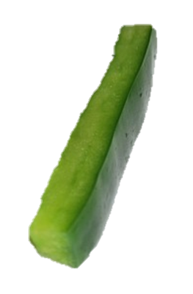
Day 2: Find a quarter of quantities.
How many pieces of pepper are on each quarter?

Slide 10
Day 2: Find a quarter of quantities.
One quarter of 12 is 3

Slide 11
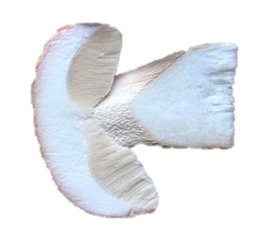
Day 2: Find a quarter of quantities.
How many pieces of mushroom are on each quarter?

Slide 12
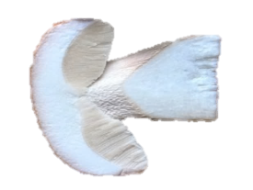
Day 2: Find a quarter of quantities.
One quarter of 16 is 4

Slide 13
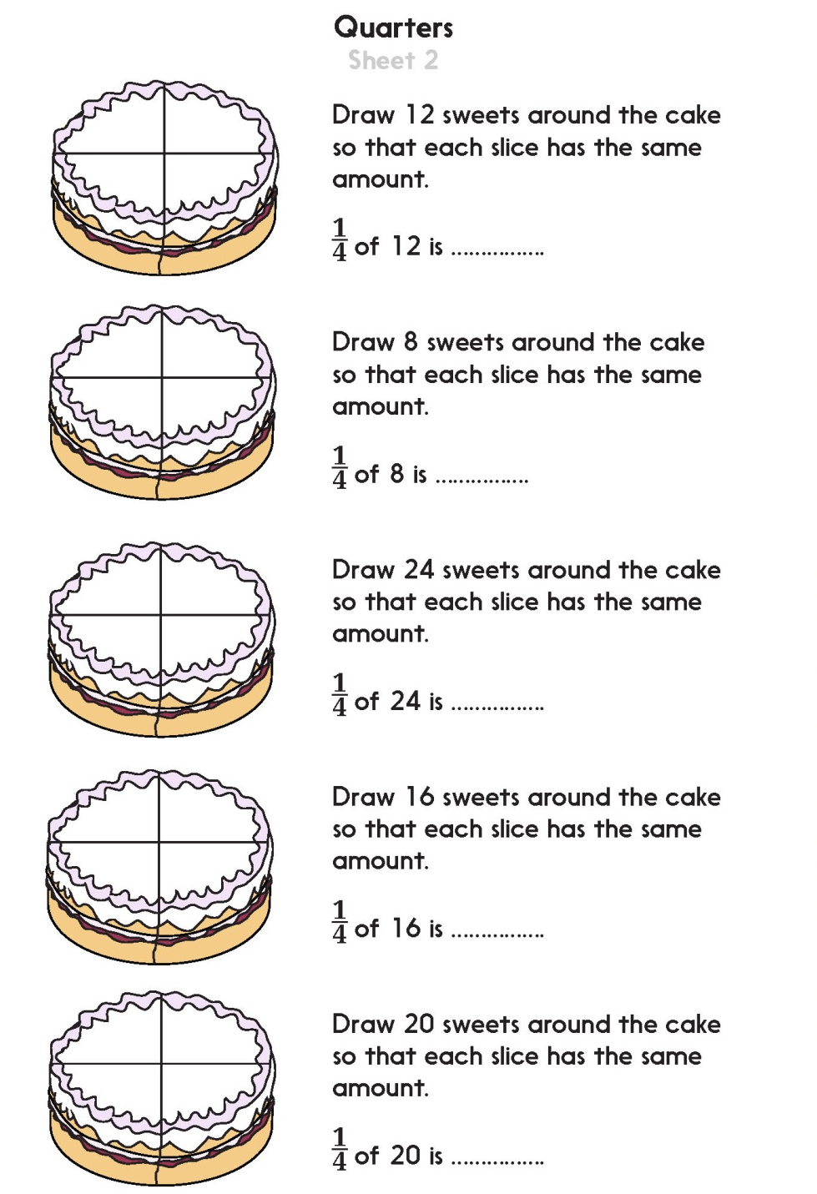

Slide 14
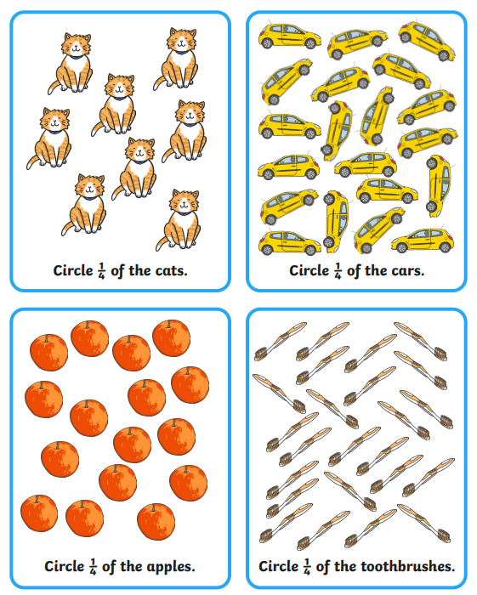
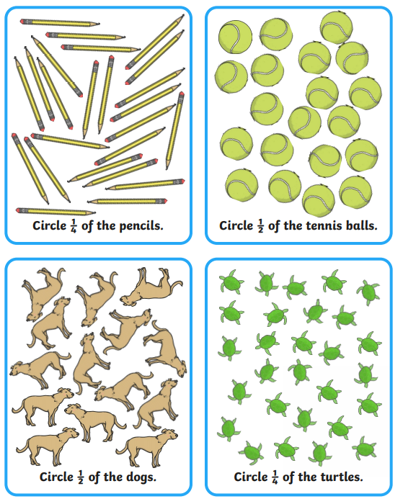

Slide 15
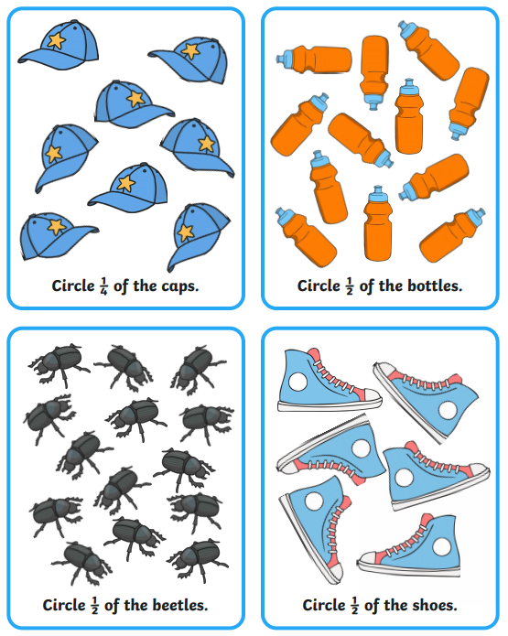
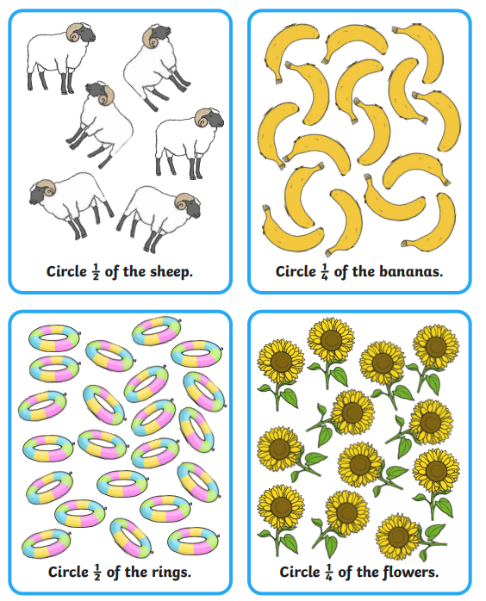

Slide 16
Money and Fractions
Find half and quarter of amounts
Objectives
Day 1
Find half of quantities.
Day 2 Find a quarter of quantities.

Slide 17
Problem solving and reasoning questions
True or false
• There are two quarters in each half.
• Sometimes one quarter is larger than another.
• Half of 8 is 4.
• A quarter of 8 is 4.
Make a line of 20 cubes.
Break it into quarters.
How many in each quarter?
Here is a line of 12 cubes.
Is ¹/₄ of them shaded?

Slide 18
Problem solving and reasoning questions answers
True or false
• There are two quarters in each half. True – can be demonstrated by folding a piece of paper in half, then half again.
• Sometimes one quarter is larger than another. True – it depends on the whole – a quarter of a larger cake is more cake than a quarter of a small cake and a quarter of £20 is more than a quarter of £8. However, each quarter of one particular cake or set of objects will be the same.
• Half of 8 is 4. True.
• A quarter of 8 is 4. False, a quarter of 8 is 2.
Make a line of 20 cubes. Break it into quarters. How many in each quarter?
5 in each.
Here is a line of 12 cubes.
Is ¹/₄ of them shaded?
No. ¼ of 12 is 3 so 3 should be shaded to show a quarter.

Slide 19
https://forms.office.com/Pages/ResponsePage.aspx?id=eCY4lN73r0G0KV1rDWITzRhTQ2IZqpBOsW8cFVoooF9UNVlMS1dCVkdaM0k0WlhFTE9WVFBTWEg1Ti4u

