Slide 1
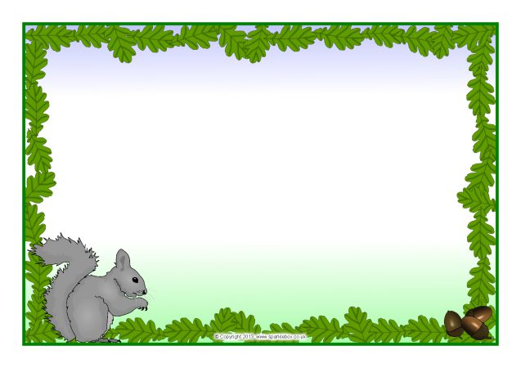
Y1 Science Monday 25th January
Objective: Name and compare types of mammals that live in different habitats.

Slide 2
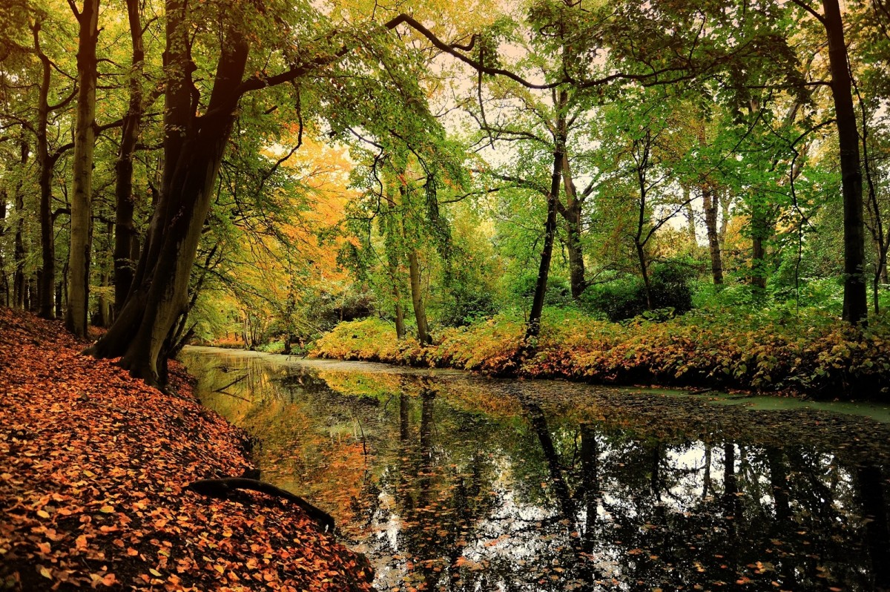
Woodland Habitat
Which animals would you expect to find living in this woodland habitat?
Why do you think they might live here?

Slide 3
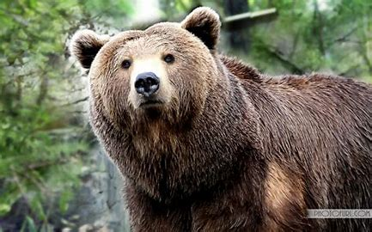
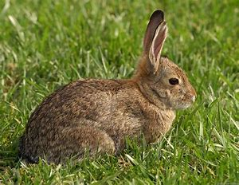
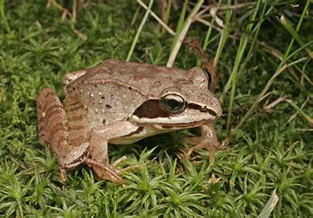
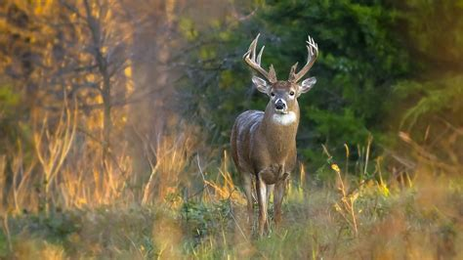
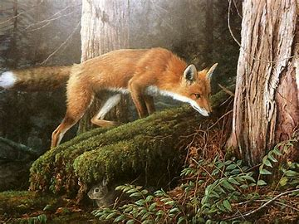
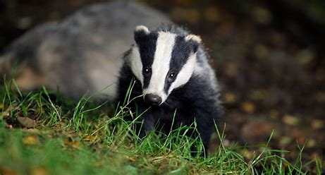
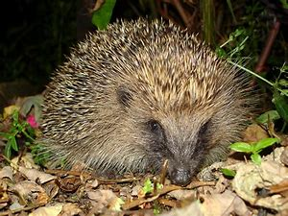
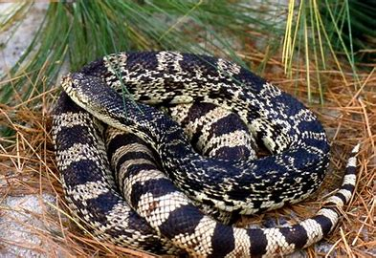
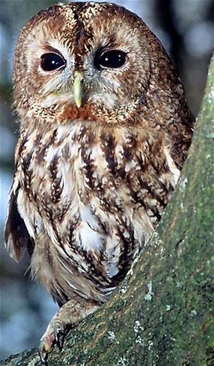
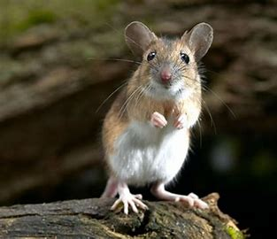
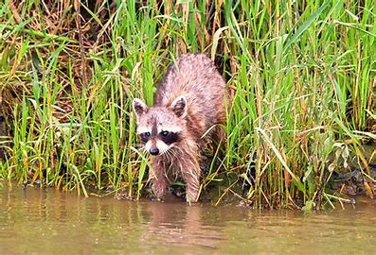
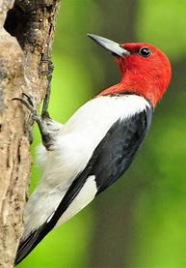
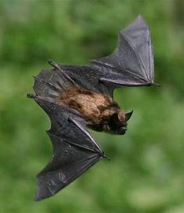

Slide 4
Animals who live in woodland habitats rely on the trees to give them what they need – shelter, food, and protection from other creatures.
They also use the streams and ponds to get water and (if they’re the sort of animal that eats them) fish.

Slide 5
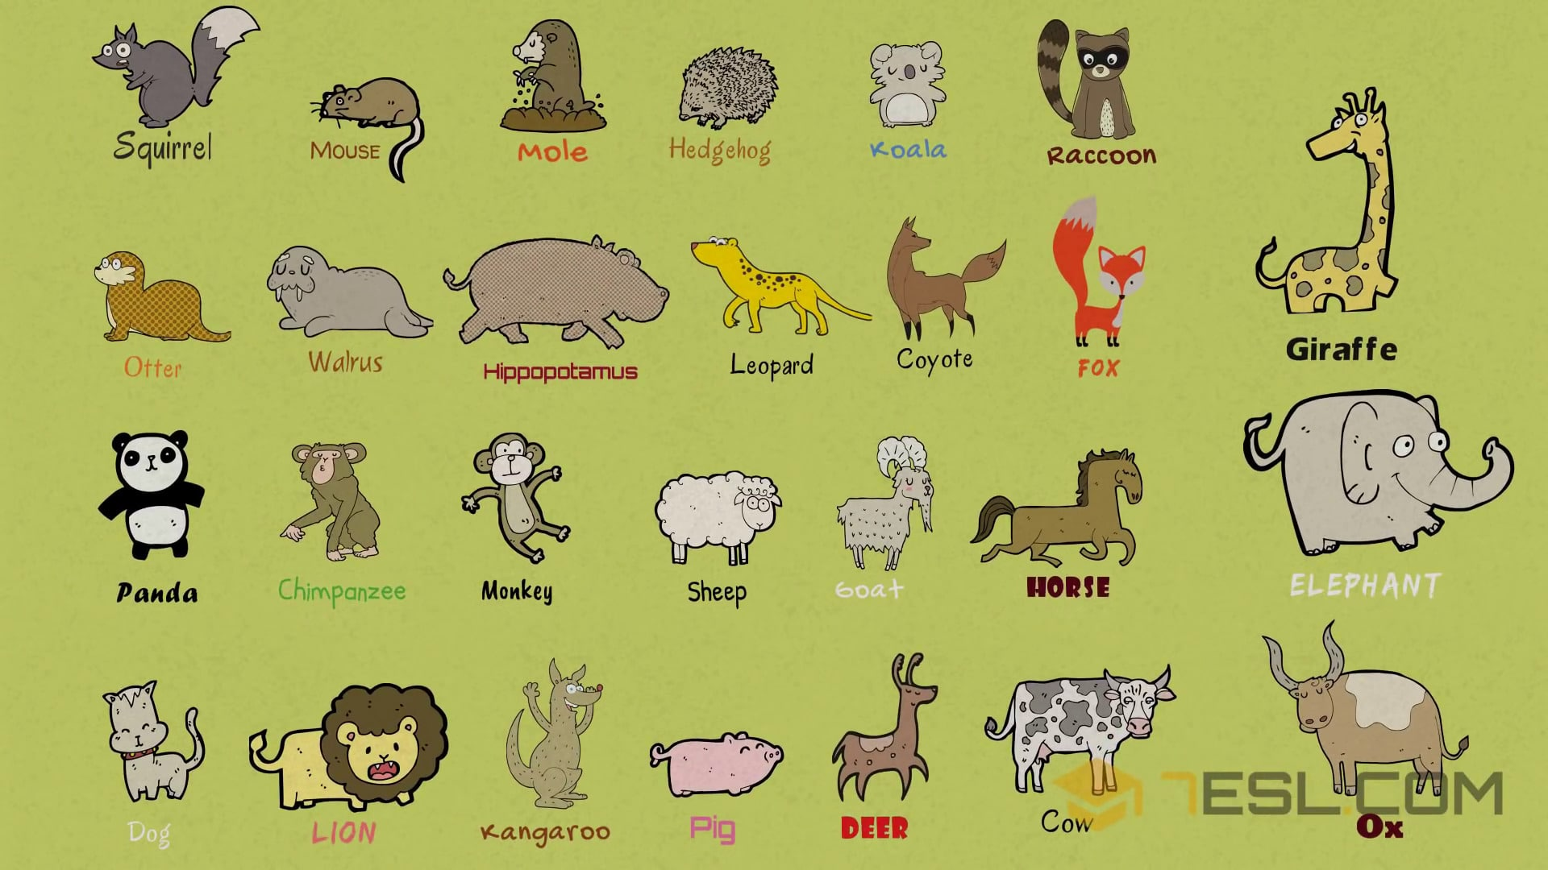
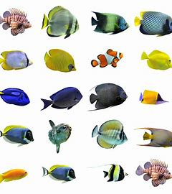
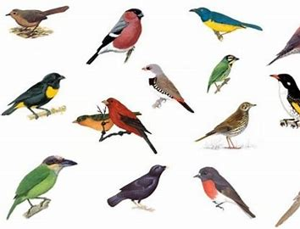
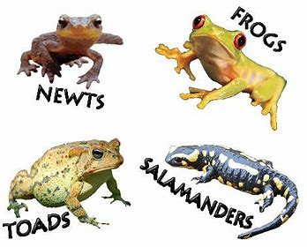
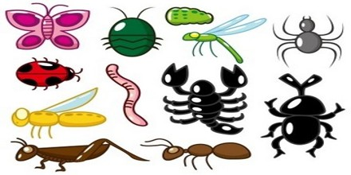
Some animals are called mammals.
Mammals are different from fish and birds
and amphibians and invertebrates
because:
They have a backbone (also called a vertebra or spine).
They give birth to live babies who can breathe and move.
c) They make milk to feed their babies when they are born.
d) They have hair or fur.

Slide 6
fox
hummingbird

Slide 7
rabbit
snake

Slide 8
badger
frog

Slide 9
bat
owl

Slide 10
My name is _______________________________
My favourite mammal is a/an
_______________________________
It is my favourite because ____________________________________________________________________________________________________________________________________________
Appearance
____________________________________________________________________________________________________________________________________________
Habitat
____________________________________________________________________________________________________________________________________________
Did you know?
________________________________________________________ ____________________________________________________________________________________

