Slide 1
Maths 24.02.2021
L.O: Create patterns using 2D shapes.

Slide 2
SHAPE GAME
When the shape comes up, name the shape and say how many sides and vertices the shape has got.

Slide 3
SHAPE GAME
How many did you get right?
Rectangle
4 sides
4 vertices
Triangle
3 sides
3 vertices
Square
4 sides
4 vertices
Circle
1 side
0 vertices
Pentagon
5 sides
5 vertices

Slide 4
Shape Patterns
Today we are going to be making patterns using different shapes.
Patterns are something that repeats.
?
What colour goes next in the pattern?

Slide 5
Our turn: Shape Patterns
?
?

Slide 6
Your turn: What goes next in the pattern?
?
?
?

Slide 7
Our turn: Different shape patterns
?
?

Slide 8
Your turn: What goes next in the pattern?
?
?
?

Slide 9
Activity
Draw the next 3 shapes in each pattern.
Think about the colour of the shape that goes next in the pattern.
When you have finished, create 5 of your own shape patterns.

Slide 10
Challenge 1

Slide 11
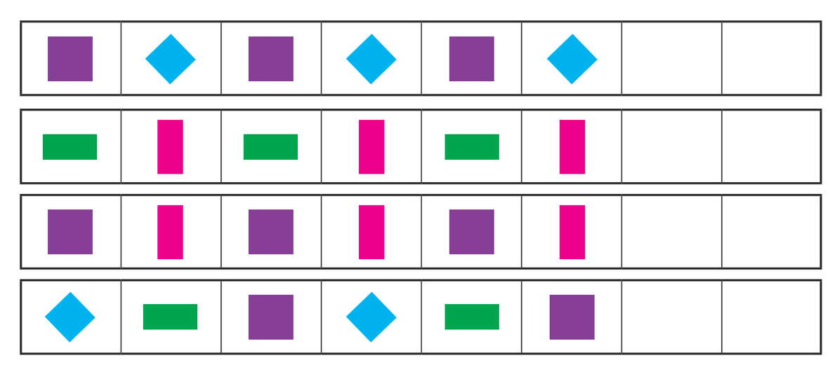
Challenge 2

Slide 12
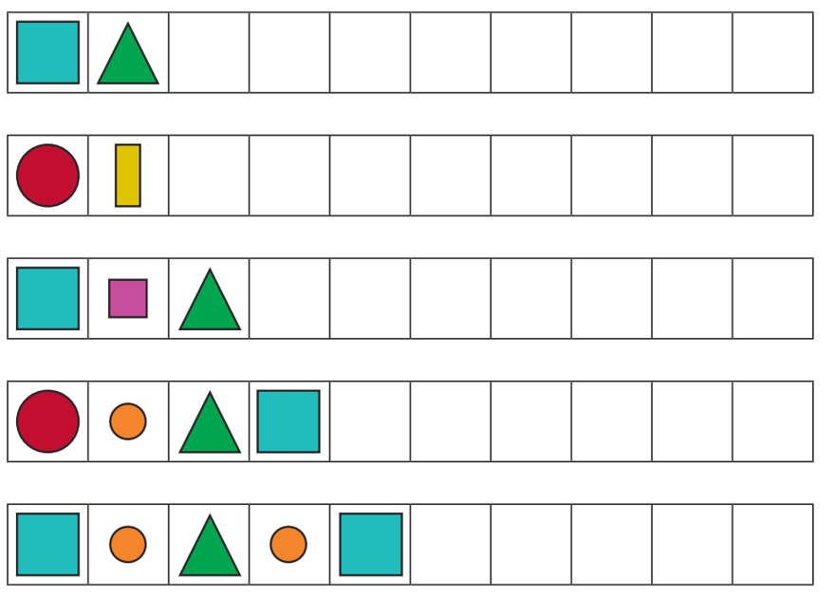
Challenge 3

Slide 13
Challenge 1 Answers

Slide 14
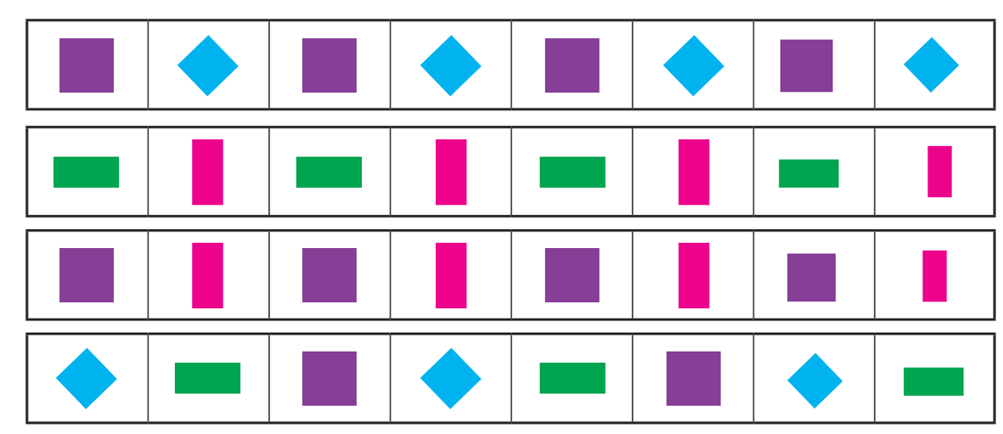
Challenge 2 - Answers

Slide 15
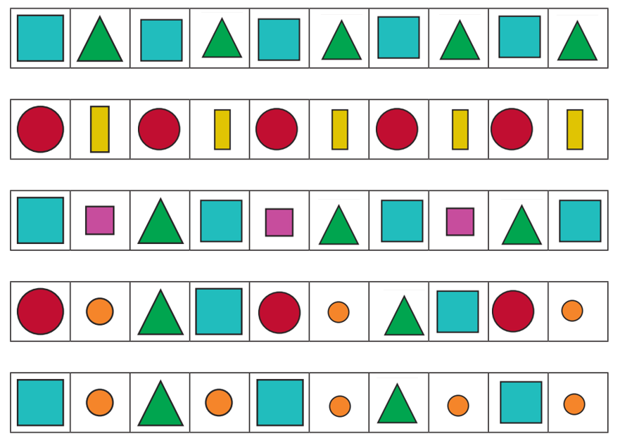
Challenge 3 Answers

Slide 16
Plenary
What is the difference between a square and a rectangle?

Slide 17
Remote Learning Tracking
https://forms.office.com/Pages/ResponsePage.aspx?id=eCY4lN73r0G0KV1rDWITzRhTQ2IZqpBOsW8cFVoooF9UNVlMS1dCVkdaM0k0WlhFTE9WVFBTWEg1Ti4u

