Slide 2
Modelling dividing numbers by 10.

Slide 5
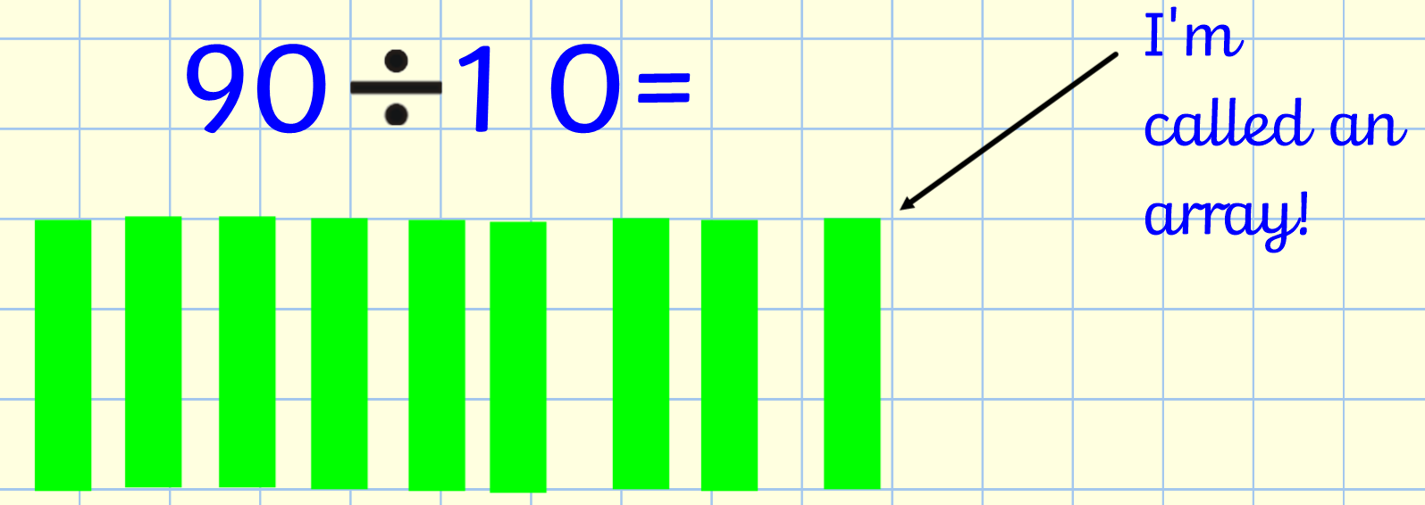

Slide 6
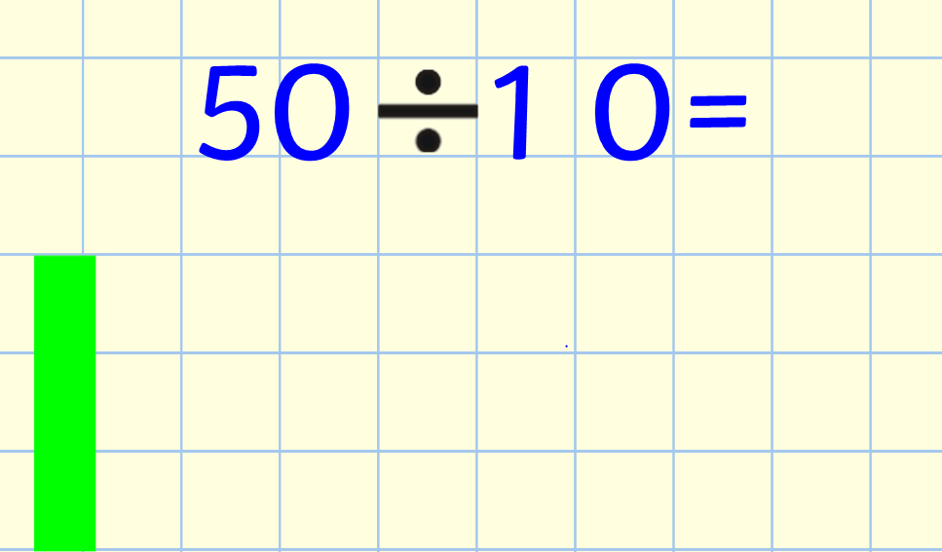

Slide 7
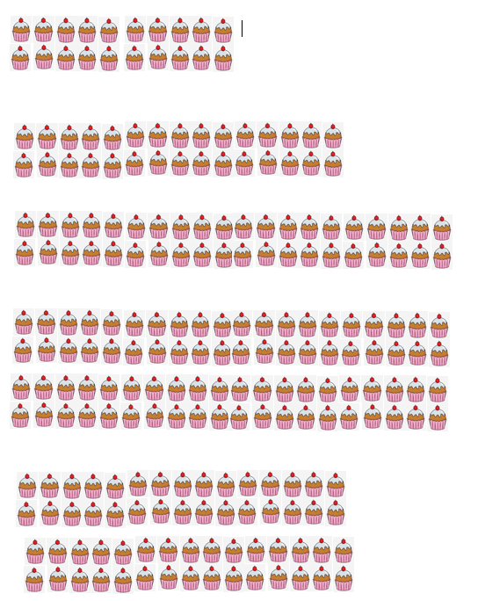
Activity
Challenge 1
Challenge 2
Challenge 3
Star Challenge:
Emma has 10 groups of 5 bananas and Barry has 7 groups of 10 bananas. Who has more bananas?
Why?

Slide 8
Answers
Challenge 1 | Challenge 2 | Challenge 3
20 ÷ 10 = 2 | 20 ÷ 10 = 2 | 20 ÷ 10 = 2
30 ÷ 10 = 3 | 30 ÷ 10 = 3 | 30 ÷ 10 = 3
40 ÷ 10 = 4 | 120 ÷ 10 = 12 | 120 ÷ 10 = 12
80 ÷ 10 = 8 | 60 ÷ 10 = 6 | 60 ÷ 10 = 6
60 ÷ 10 = 6 | 3 tens (30) ÷ 10 = 3 | 3 tens (30) ÷ 10 = 3
 | 70 ÷ 10 = 7 | 70 ÷ 10 = 7
 | 50 ÷ 10 = 5 | 50 ÷ 10 = 5
 | 10 ÷ 10 = 1 | 1 ten (10) ÷ 10 = 1
 | 90 ÷ 10 = 9 | 9 tens (90) ÷ 10 = 9
 | 40 ÷ 10 = 4 | 40 ÷ 10 = 4
 | 100 ÷ 10 = 10 | 10 tens (100) ÷ 10 = 10
 | 110 ÷ 10 = 11 | 110 ÷ 10 = 11

Slide 9
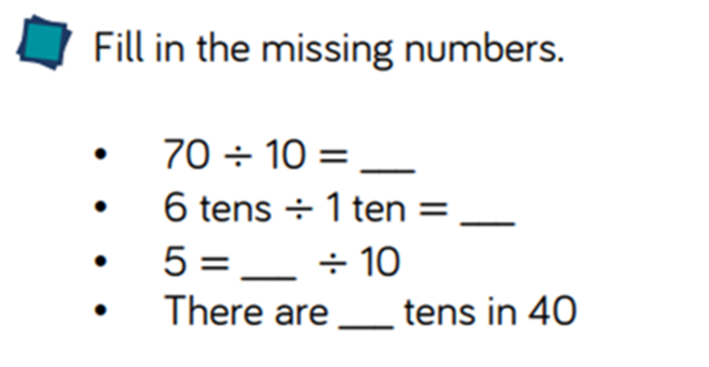
Plenary

