Slide 1
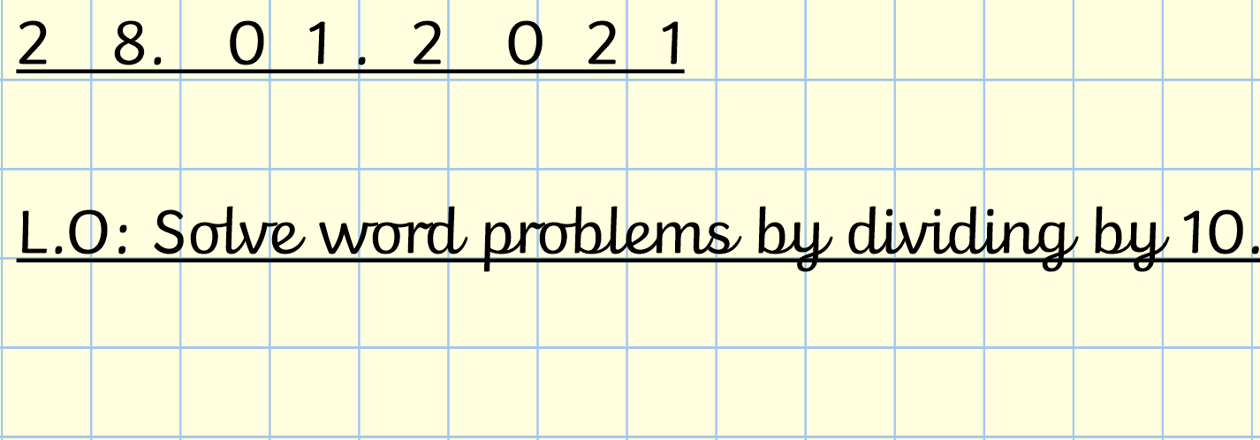

Slide 2
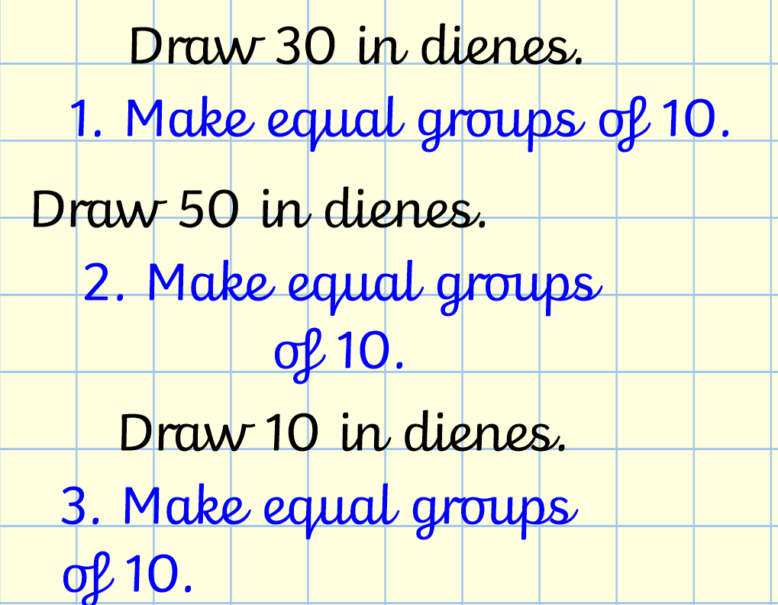

Slide 6
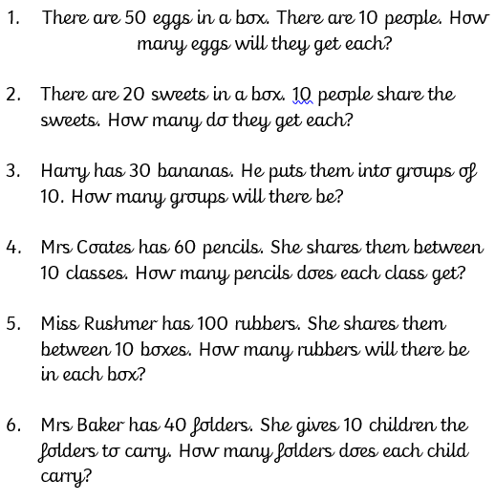
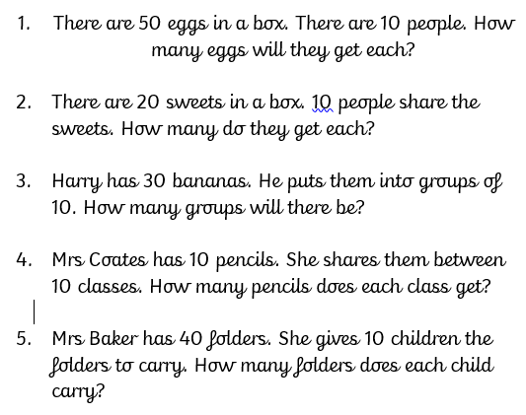
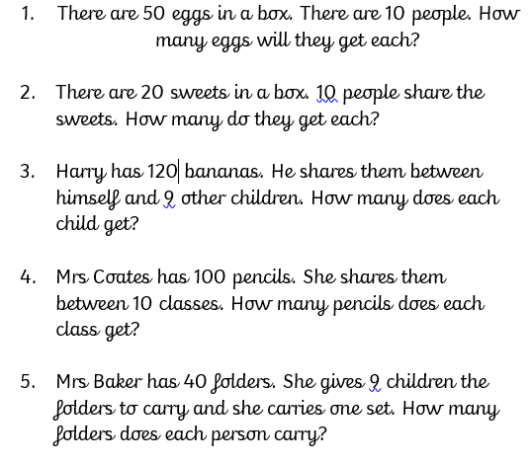
Activity
Challenge 2
Challenge 3
Challenge 1

Slide 7
Answers
Challenge 1 | Challenge 2 | Challenge 3
50 ÷ 10 = 5 | 50 ÷ 10 = 5 | 50 ÷ 10 = 5
20 ÷ 10 = 2 | 20 ÷ 10 = 2 | 20 ÷ 10 = 2
30 ÷ 10 = 3 | 30 ÷ 10 = 3 | 12 ÷ 10 = 12
10 ÷ 10 = 1 | 60 ÷ 10 = 6 | 100 ÷ 10 = 10
40 ÷ 10 = 4 | 100 ÷ 10 = 10 | 40 ÷ 10 = 4
 | 40 ÷ 10 = 4

Slide 8
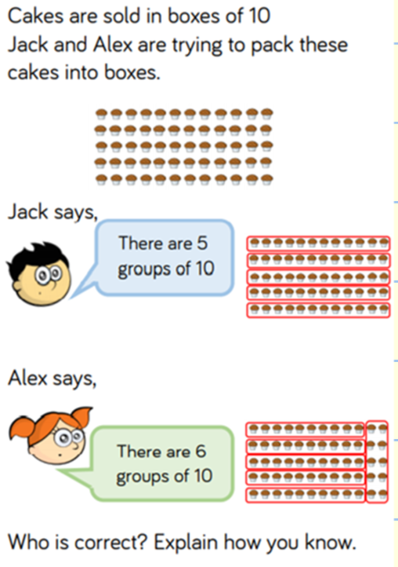
Plenary

