Slide 1
R.E Thursday 21st January 2021 L.O: Retell a religious story using a religious feature.

Slide 2
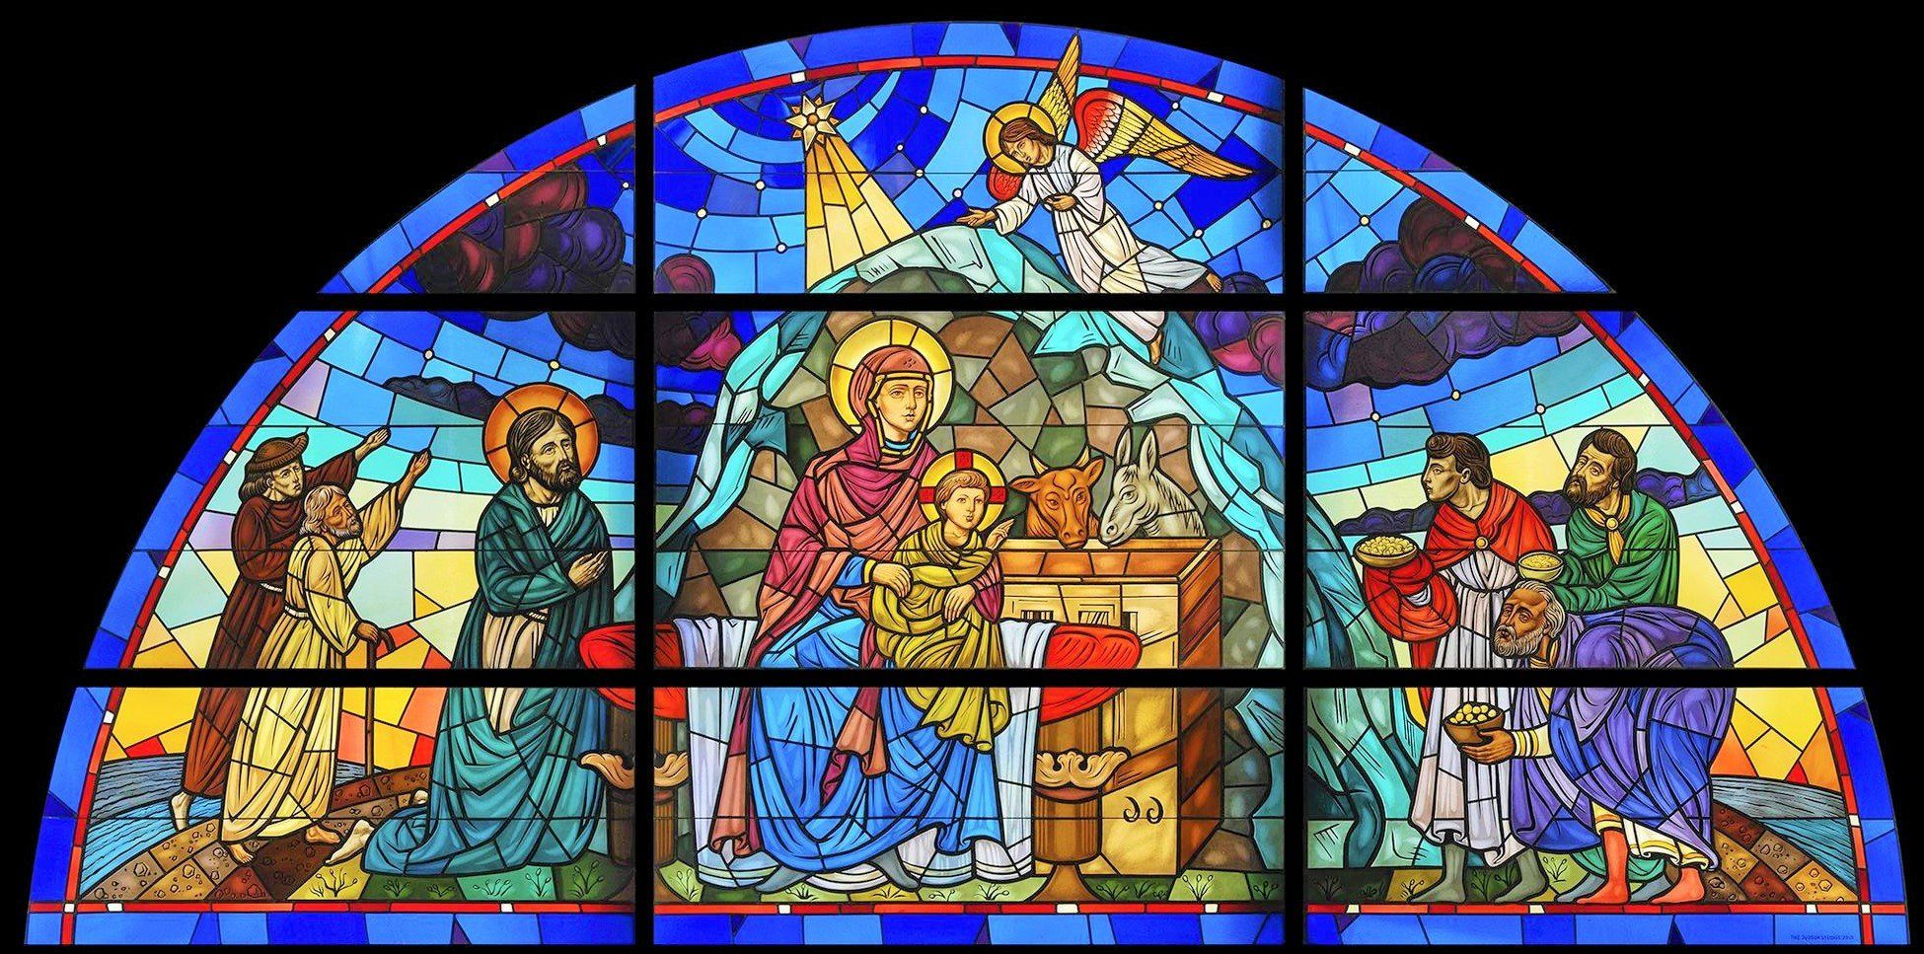
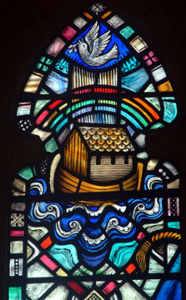
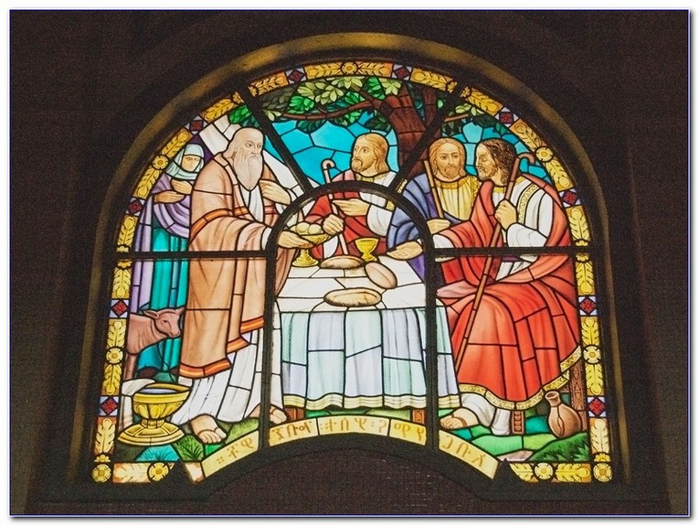
Nativity
Noah’s
Ark
Last
supper

Slide 3
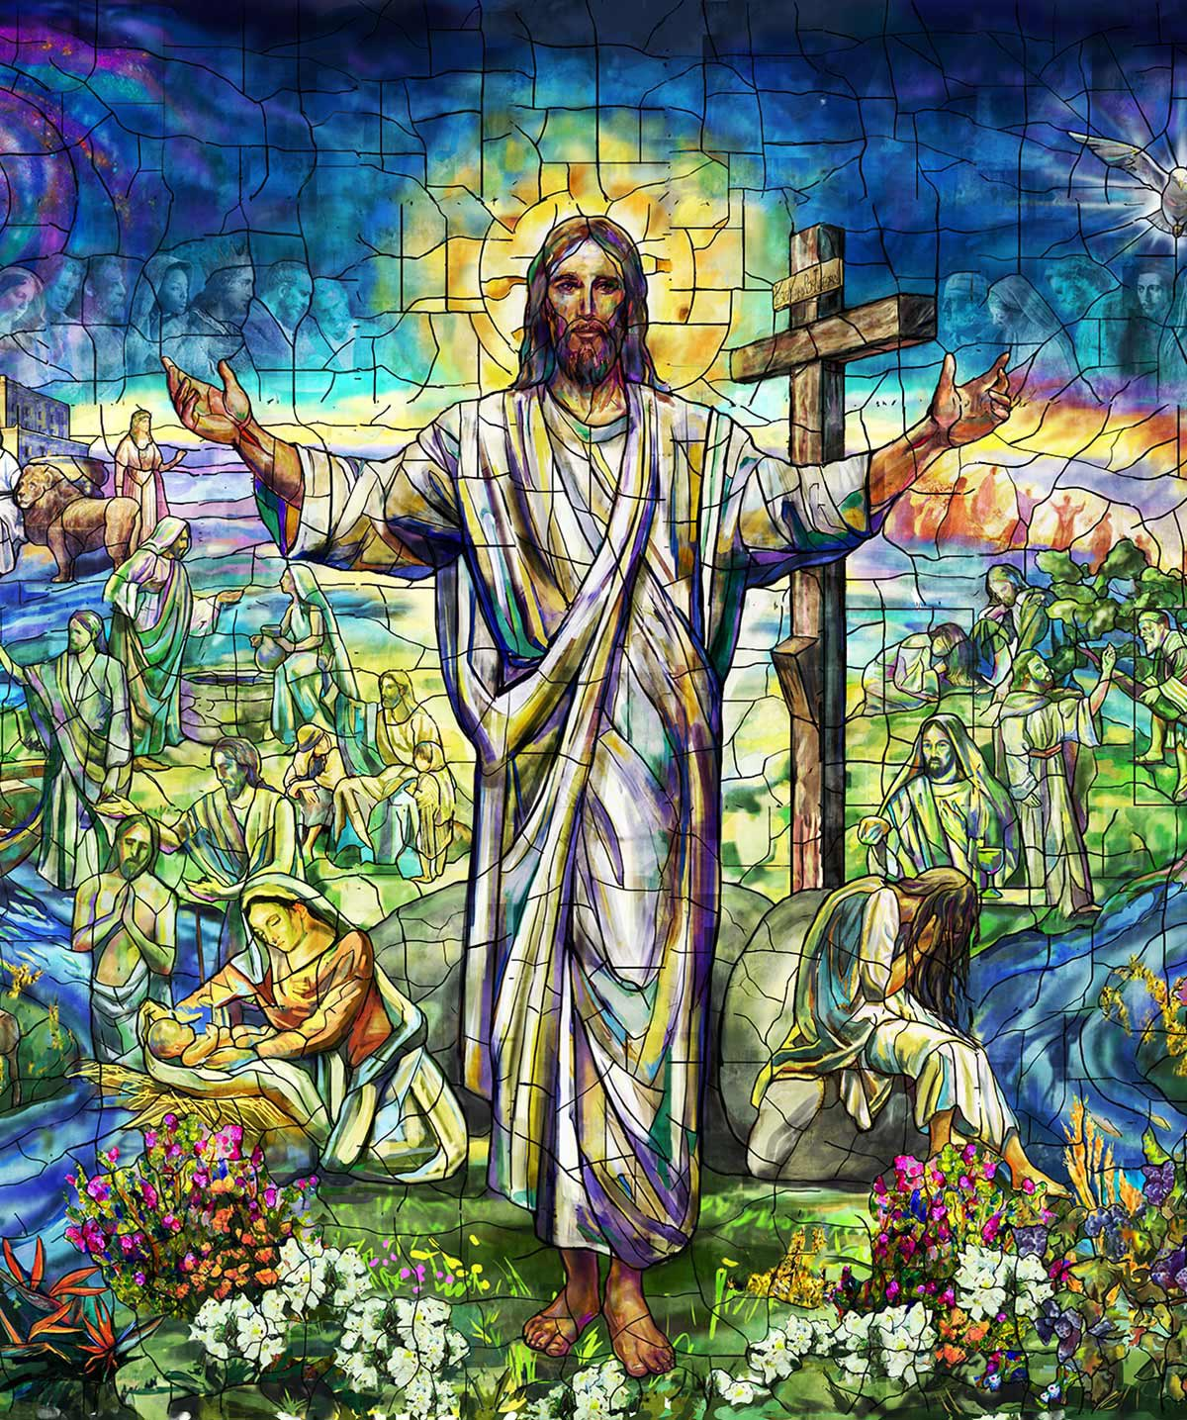

Slide 4
What do the colours mean?
Red – Colour of Jesus’ blood
Blue – Colour of the sky – represents Heaven
Green - colour of the grass and represents growth
White – being pure
Black – represents Jesus dying on the cross
Yellow – the halo on angels and saints
Purple – Jesus wore this when he was crucified – represents suffering
Rainbow – when Jesus was reunited with the world.

Slide 5
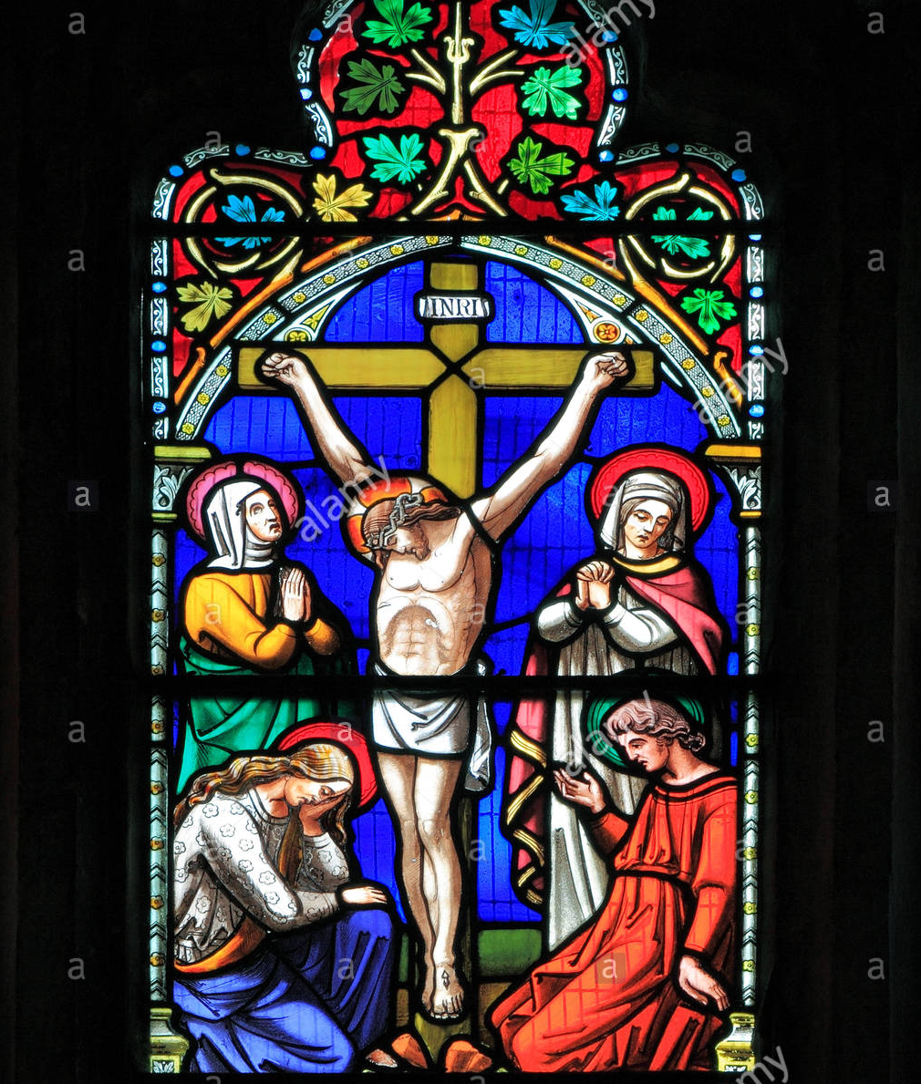
Which Christian story from the Bible do you think this stained glass window is retelling?

Slide 6
Watch the clip below:
The Story of Easter for Kids and Childrens (Jesus Sacrifice) - YouTube

Slide 7
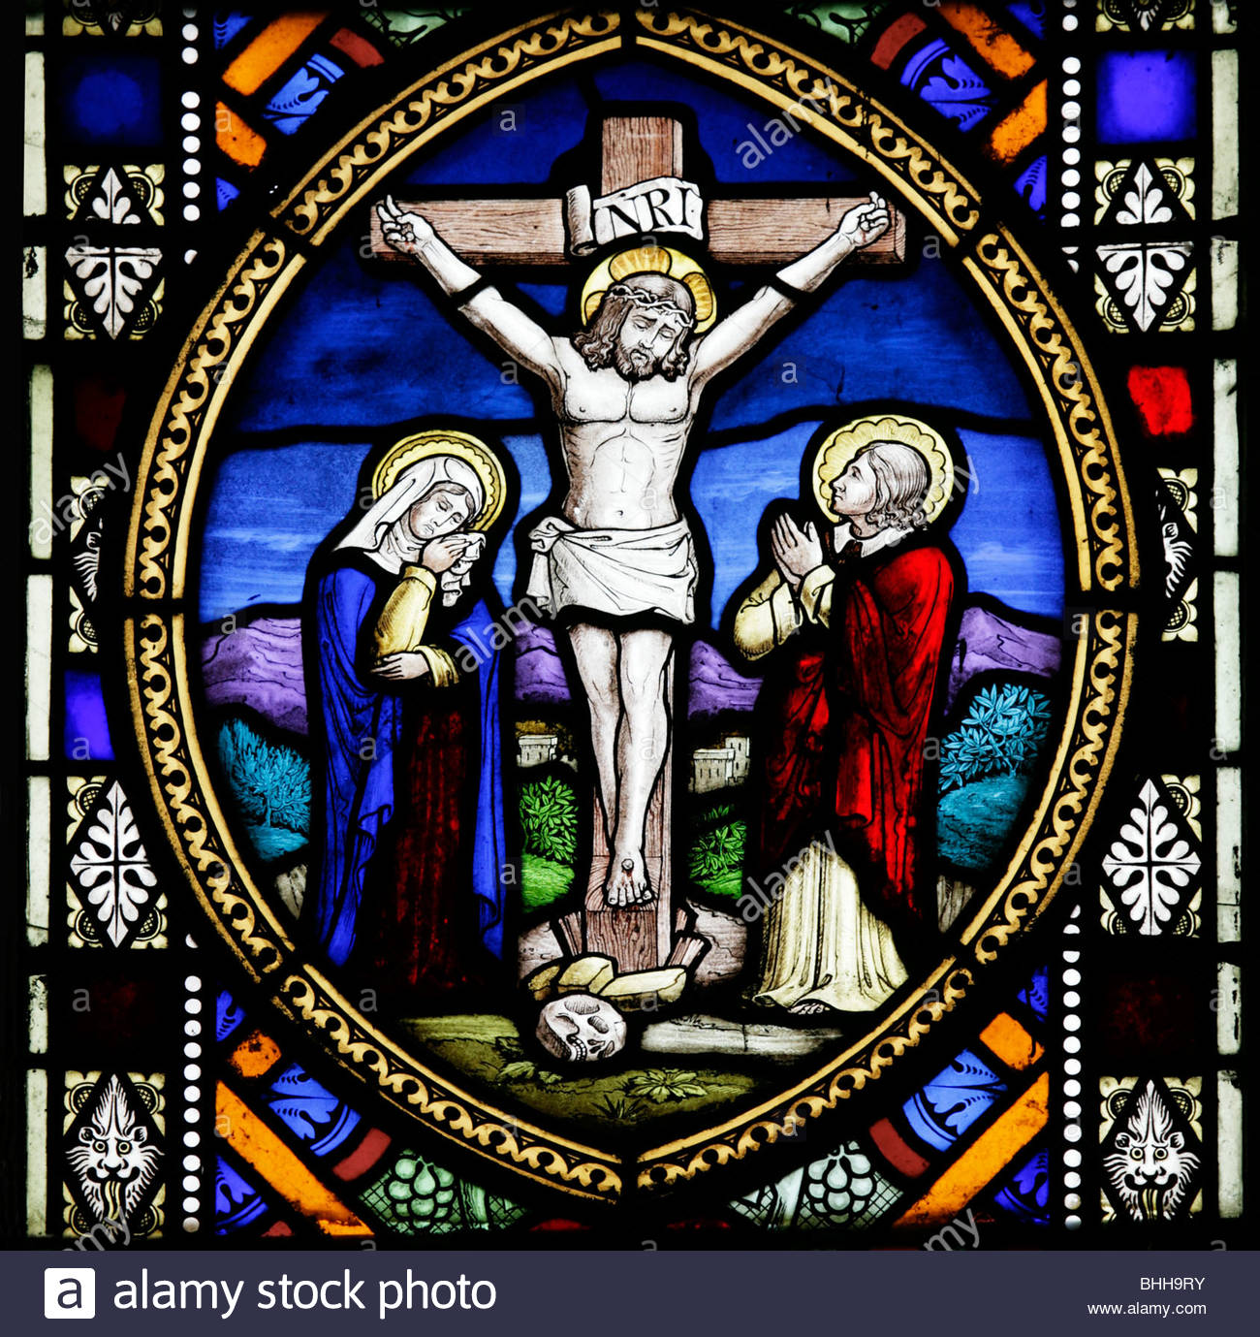
Activity
Retell the story of Jesus being crucified.
You can do this by writing or drawing pictures.
Challenge: Add the emotions that Jesus felt throughout the event.
Remember to send your amazing retellings to your teacher for them to look at and read.

