Slide 1
Year 3 Computing
Thursday 28th January 2021

Slide 2
Thursday 28th January 2021
LO: Solve an investigation and present results in a graph
• Collect data
• Set up a graph with a given number of fields.
• Enter data for the graph.
• Add a title
• Which is the most appropriate style of graph for your data? Why?
• What does the graph tell you? What are your results? Write this up in the
Investigation 2Do

Slide 3
Favourite Colours Graph
Choose your title or question
Conduct a survey to find out your answers. Remember social distancing. You could ring or message people to ask their answer
Which graph would be best? Why?
Enter your data onto your graph
Check you have labelled the title

Slide 4
Collecting data
I decided to collect data about the pets that the Kingsfield staff have:
Cat/s 15
Dog/s 12
Hamster/s 5
Rabbit/s 3
Guinea Pig/s 6
Snake/s 1
Rat/s 1
None 10

Slide 5
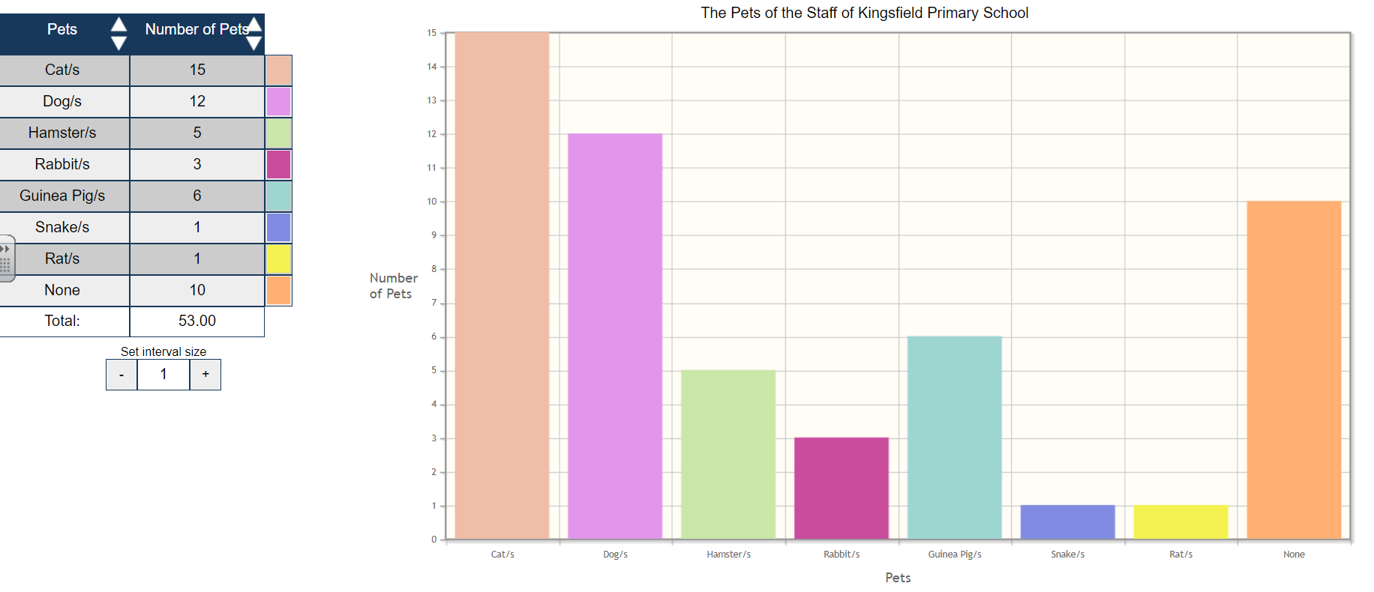
Creating a graph

Slide 6
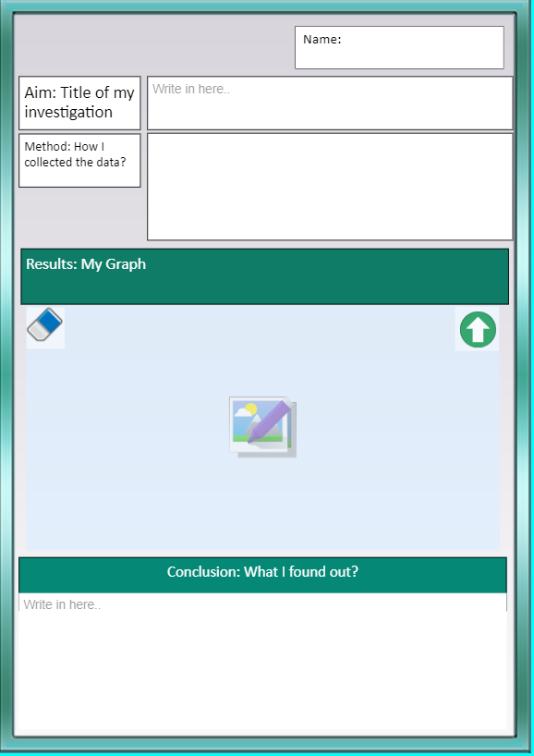
Writing up

Slide 7
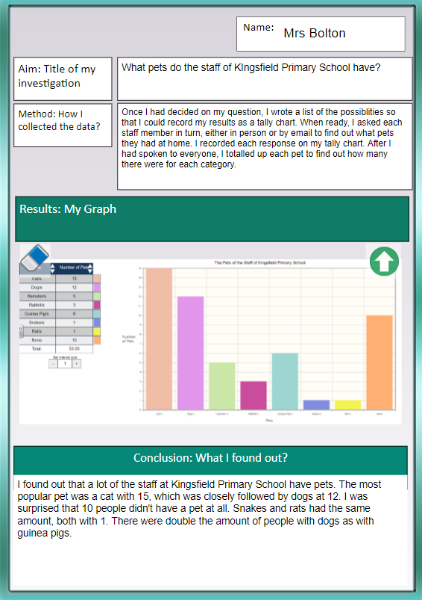
Writing up

Slide 8
Thursday 28th January 2021
LO: Solve an investigation and present results in a graph
• Collect data
• Set up a graph with a given number of fields.
• Enter data for the graph.
• Add a title
• Which is the most appropriate style of graph for your data? Why?
• What does the graph tell you? What are your results? Write this up in the
Investigation 2Do

