Slide 1
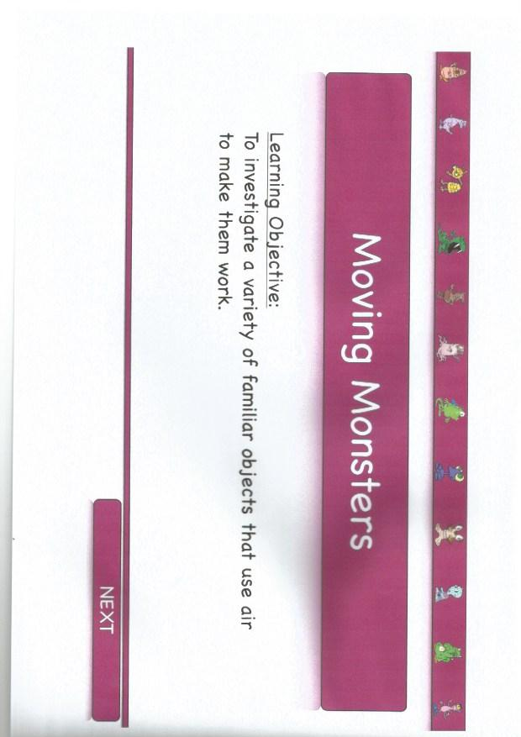

Slide 2
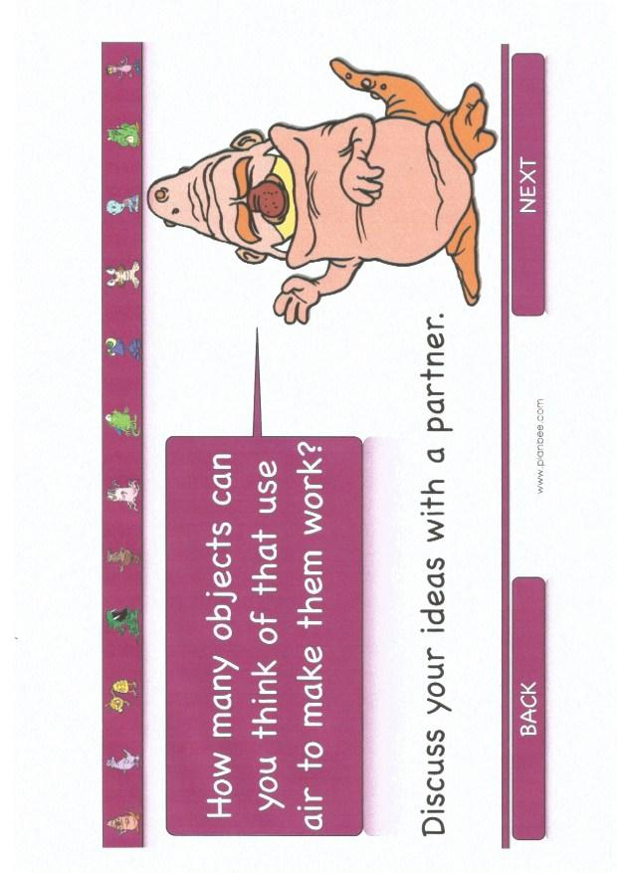
L.O: Investigate a variety of objects that use air to make them work

Slide 3
L.O: Investigate a variety of objects that use air to make them work
Beach ball
Tyres
Whistle
Pump
Balloon
Air pump
Air tank diving
Trumpet

Slide 4
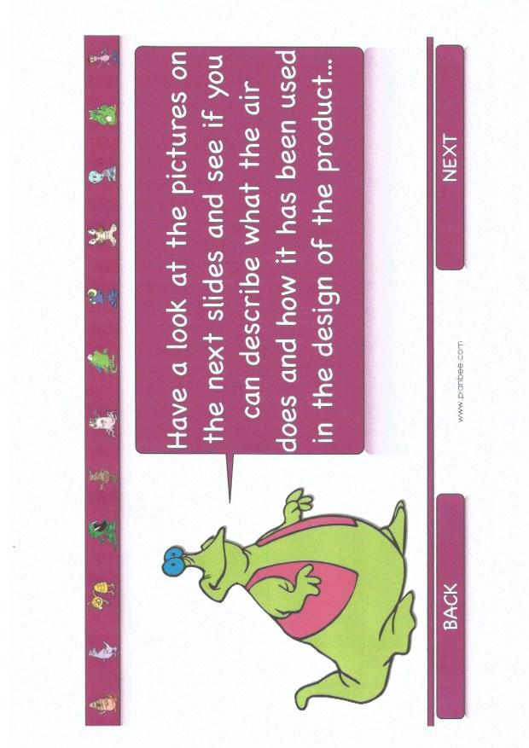
L.O: Investigate a variety of objects that use air to make them work

Slide 5
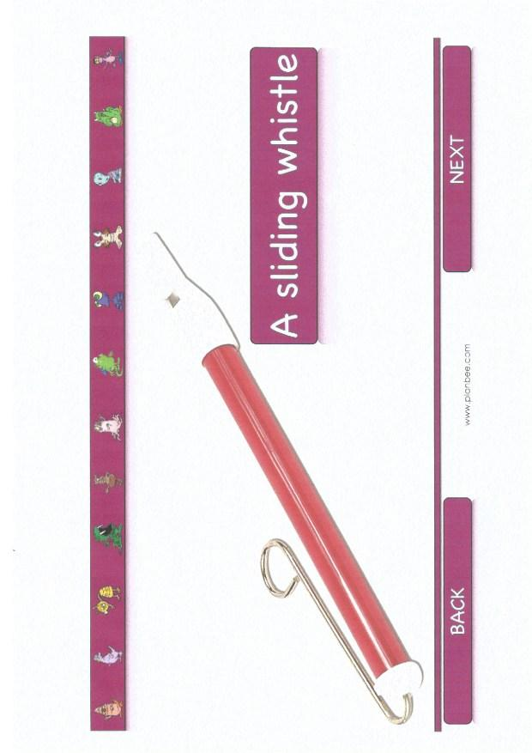
L.O: Investigate a variety of objects that use air to make them work

Slide 6
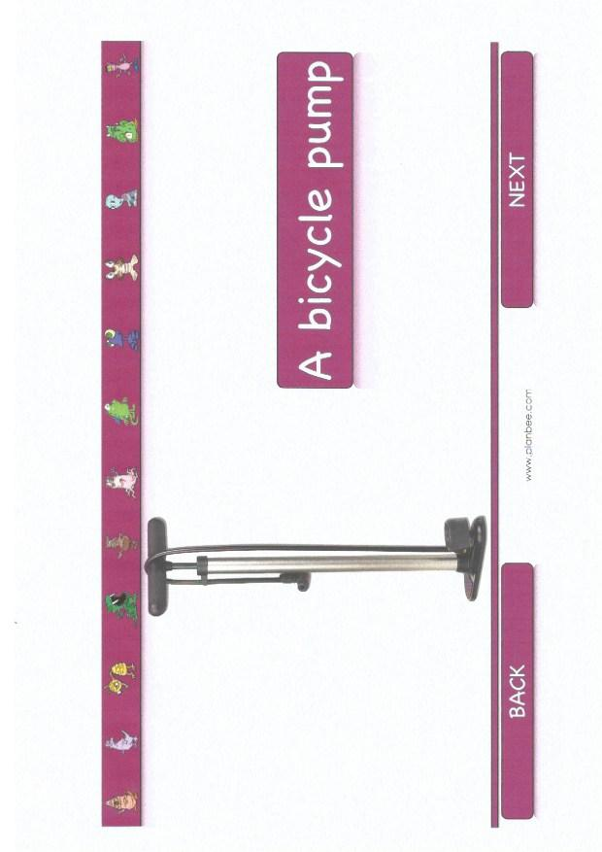
L.O: Investigate a variety of objects that use air to make them work

Slide 7
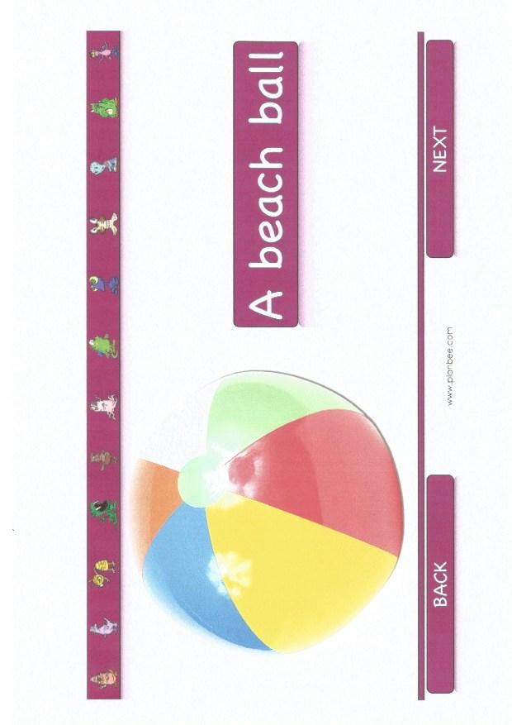
L.O: Investigate a variety of objects that use air to make them work

Slide 8
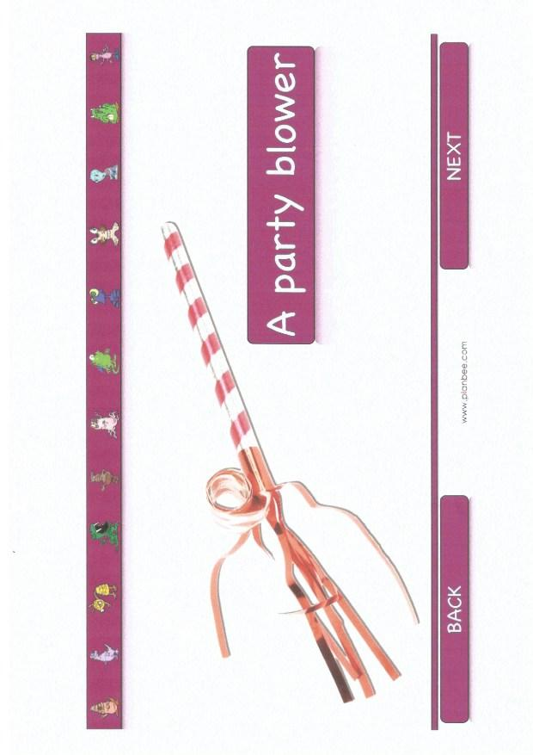
L.O: Investigate a variety of objects that use air to make them work

Slide 9
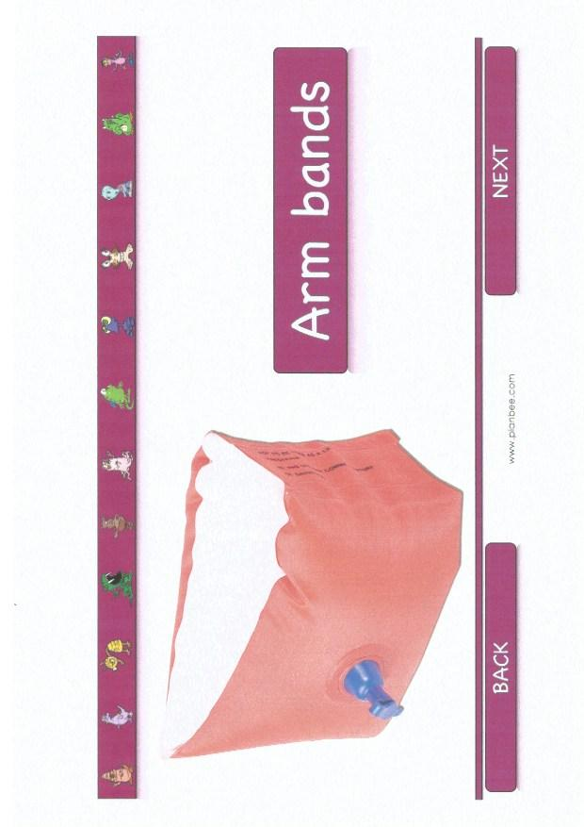
L.O: to investigate a variety of objects that use air to make them work

Slide 10
L.O: Investigate a variety of familiar objects that use air to make them work.

Slide 11
L.O: Investigate a variety of familiar objects that use air to make them work.
On the following slide you will find 3 different activities.
Chose the one that you think is suitable for you and when complete, send a photo of it back to your teacher.

Slide 12
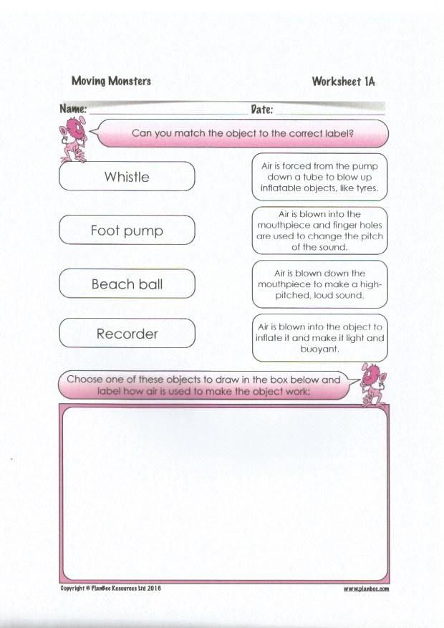
L.O: Investigate a variety of objects that use air to make them work
Work 1
Copy this onto a piece of paper
Can you match the object to the correct
label?
Chose one of these objects to draw and
label how air is used to make it work.

Slide 13
L.O: Investigate a variety of objects that use air to make them work
Work 2:
On a piece of paper can you describe how each of these objects uses air to make it work?
Whistle, foot pump, beach ball and recorder.
Chose one of these objects to draw and label how air is used to make the object work.

Slide 14
L.O: Investigate a variety of objects that use air to make them work
Work 3 - on a piece of paper.
Describe how a whistle, a foot pump, a beach ball and a recorder use air to make them work.
Draw a simple diagram to go with each description.

