Slide 1
Year 3
English
Wednesday 10th February
by Miss Taylor

Slide 2
Today we are going to start our story.
We are going to write the first 2 paragraphs.

Slide 3
L.O. Draft a story using a story planner.
Success Criteria
Check previous work.
Use planning to record ideas.
Write correctly structured sentences.
Organise paragraphs.

Slide 4
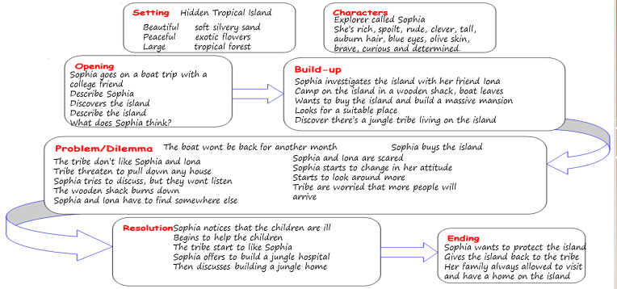
I need to read my plan to check what I need to include.

Slide 5
My first and second paragraph
Sophia is an extremely rich, clever and spoilt young lady. She has long auburn hair, sparkling blue eyes and olive skin. Sophia enjoys spending money and sailing on her own personal yacht. When Sophia is sailing she always invites a friend from college to go with her. It’s surprising that she has any friends, as she can be so rude to people and doesn’t seem to care. One of Sophia’s positive traits is that she is an extremely curious, brave and determined young lady. I think this is why her friends like her. One of her best friends is Iona, who went to college with Sophia. Iona often says to Sophia, “Why are you so rude, as you are such an intelligent and brave person?” Sophia thinks that this is funny. Sophia invited Iona to join her on a mystery sailing tour around some small islands. They discover a hidden island and ask for the sailing crew to take them onto the island. Of course the crew have to do as they are told, so they did! The girls’ first impression of the island is of amazement, it is so beautiful. There’s soft silvery sand, exotic flowers, a tropical forest and it is so peaceful. Sophia turns to the crew and says, “You can go, leave our camping equipment and come back in a month.”
The girls couldn’t wait to explore the island. Now where should they set up their camp? They set off to start their investigation of the island. Iona usually did anything that Sophia asked her to do; but this time she wasn’t sure, “Do you know where to go Sophia?” whispered Iona. After walking for about an hour the girls discover a good sized wooden .shack. It was in surprisingly good condition and just needed a little bit of cleaning. After cleaning the place up they unpack their belongings and make it a comfy home for the next month. Sophia has already fallen in love with this beautiful island and wants to find a place where she can build a massive mansion looking over the sea. Sophia is a very determined young lady and although she is spoilt, she is more than able to look after herself and do anything that needs doing to get what she wants. Iona and Sophia find an ideal place halfway up the side of the mountain. They start to clear some of the area to take a better look. All of a sudden there is a scream of anger from the forest. A fierce man, followed by other men run towards the girls waving his hands. “WHAT ARE YOU DOING?” screeches the man. Sophia tells him that she is clearing the area to see if a mansion can be built. The man shakes his head and tells her that she can’t do that. Sophia rudely shouts “I can and I will, there’s nothing you can do!” Iona doesn’t look so sure, she thinks that the small tribe could be a problem!

Slide 6
You need to read your plan, paying attention to the setting and characters to write about in the opening paragraph.
Then read your notes for your second paragraph.
Work 1 this will be your main event.
Work 2 this will be your problem.
Work 3 – this will be your build up.

Slide 7
Look at the work on the next few slides and make sure you use the work that is the appropriate level for you.

Slide 8
Work 1
Use the grid to help you write your sentences for your opening and second paragraph.
Where there is a line you need to write your own word.
My The | setting | a is | big a | hot cold | __________ | .
I You | can | see | lots a | of big | fish | .
The It | is __________ | a is | muddy green | and | nice smelly | .
The My | character | is | a | big small | boy girl | .
He She | is has | black brown |  | short long | hair | .
Paragraph 1
I | go went | to get | the see | the | __________ | .
I We | can | see get | lots a | of big | food forest | .
I We | went swam | to in | the get | a blue | sea boat | .
We I | went | to go | to see | the | _________ | .
It The | sea is | is a | warm good | and cool | Salty day | .
Character Description
Boy, girl, short hair, long hair, big, small, nasty, nice, kind
Paragraph 2

Slide 9
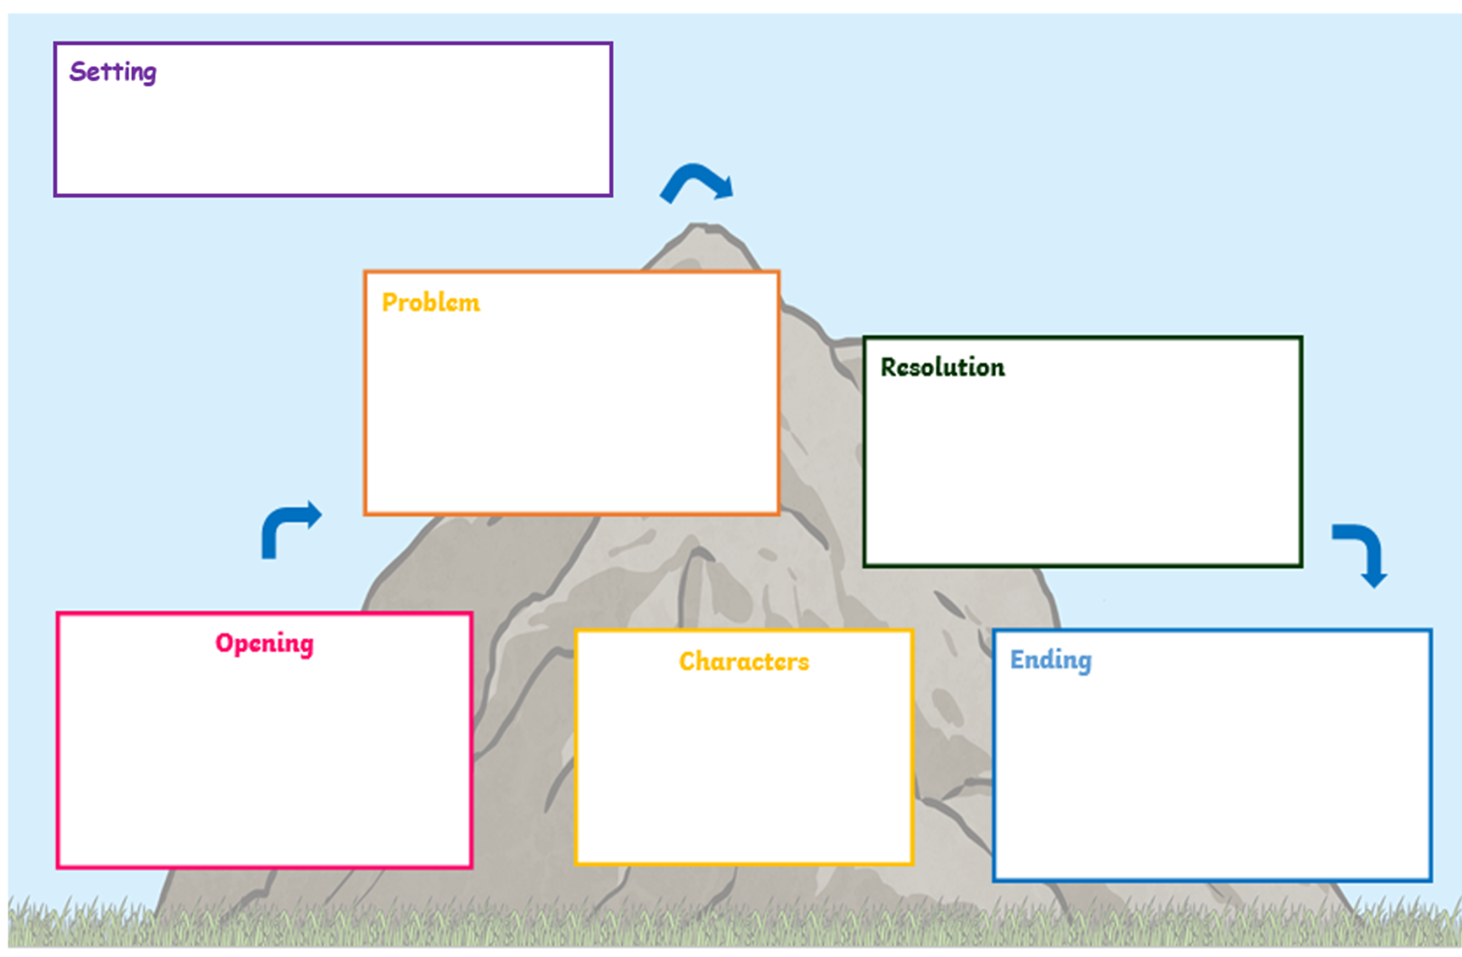
Work 2
Paragraph 1 – Your opening (Introducing your setting and characters)
Paragraph 2 – Problem (read your notes)
Where is your setting?
What can you see?
What can you hear?
What can you smell?
What can you touch?
Where is your setting?
What can you see?
What can you hear?
What can you smell?
What can you touch?
What happened?
Was there a problem?
What did your character do?
How did your character feel?
Describe your setting
Introduce your character
Where do they go?
What do they do?
Describe your setting
Introduce your character
Where do they go?
What do they do?
What do they look like?
How do they behave?
What do they wear?
What do they look like?
How do they behave?
What do they wear?

Slide 10
Work 3
Paragraph 1 – Your opening paragraph (introducing your setting and characters)
Paragraph 2 – Build up (read your notes)
Where is your setting?
What can you see?
What can you hear?
What can you smell?
What can you touch?
Where is your setting?
What can you see?
What can you hear?
What can you smell?
What can you touch?
What do they look like?
How do they behave?
What do they wear?
What do they look like?
How do they behave?
What do they wear?
Describe your setting
Introduce your character
Where do they go?
What do they do?
How do they feel and why?
Describe your setting
Introduce your character
Where do they go?
What do they do?
How do they feel and why?
Begin to write about what is happening at the start of your story. Don’t forget to use the
characters you introduced at the beginning of your story.

Slide 11
Remote Learning Tracking
Please click on the link below
https://forms.office.com/Pages/ResponsePage.aspx?id=eCY4lN73r0G0KV1rDWITzRhTQ2IZqpBOsW8cFVoooF9UNVlMS1dCVkdaM0k0WlhFTE9WVFBTWEg1Ti4u

