Slide 1
Year 3
English
Thursday 11th February
by Miss Taylor

Slide 2
Today we are going to finish our story.
But first you need to read through what you’ve already written.

Slide 3
L.O. Draft a story using a story planner.
Success Criteria
Read through the previous work.
Follow planning notes.
Write correctly structured sentences.
Organise paragraphs.

Slide 4
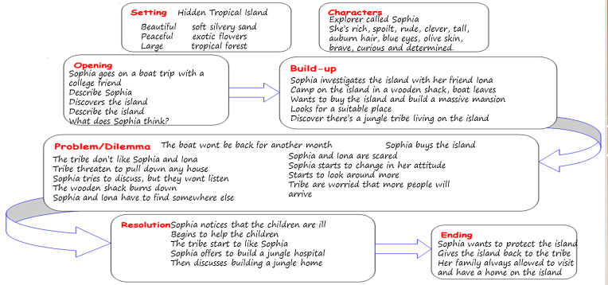
I need to read my plan to check what I need to include.

Slide 5
My first and second paragraph
Sophia is an extremely rich, clever and spoilt young lady. She has long auburn hair, sparkling blue eyes and olive skin. Sophia enjoys spending money and sailing on her own personal yacht. When Sophia is sailing she always invites a friend from college to go with her. It’s surprising that she has any friends, as she can be so rude to people and doesn’t seem to care. One of Sophia’s positive traits, is that she is an extremely curious, brave and determined young lady. I think this is why her friends like her. One of her best friends is Iona, who went to college with Sophia. Iona often says to Sophia, “Why are you so rude, as you are such an intelligent and brave person?” Sophia thinks that this is funny. Sophia invited Iona to join her on a mystery sailing tour around some small islands. They discover a hidden island and ask for the sailing crew to take them onto the island. Of course the crew have to do as they are told, so they did! The girls’ first impression of the island is of amazement, it is so beautiful. There’s soft silvery sand, exotic flowers, a tropical forest and it is so peaceful. Sophia turns to the crew and says, “You can go, leave our camping equipment and come back in a month.”
The girls couldn’t wait to explore the island. Now where should they set up their camp? They set off to start their investigation of the island. Iona usually did anything that Sophia asked her to do; but this time she wasn’t sure, “Do you know where to go Sophia?” whispered Iona. After walking for about an hour the girls discover a good sized wooden .shack. It was in surprisingly good condition and just needed a little bit of cleaning. After cleaning the place up they unpack their belongings and make it a comfy home for the next month. Sophia has already fallen in love with this beautiful island and wants to find a place where she can build a massive mansion looking over the sea. Sophia is a very determined young lady and although she is spoilt, she is more than able to look after herself and do anything that needs doing to get what she wants. Iona and Sophia find an ideal place halfway up the side of the mountain. They start to clear some of the area to take a better look. All of a sudden there is a scream of anger from the forest. A fierce man, followed by other men run towards the girls waving his hands. “WHAT ARE YOU DOING?” screeches the man. Sophia tells him that she is clearing the area to see if a mansion can be built. The man shakes his head and tells her that she can’t do that. Sophia rudely shouts “I can and I will, there’s nothing you can do!” Iona doesn’t looks so sure, she thinks that the small tribe could be a problem!

Slide 6
Continuing my story
As the tribe rush back into the forest Iona looks at Sophia and shakily says, “We need to leave this place, I’m scared!” Sophia looks back at Iona, shakes her head and angrily shouts, “No way!” The girls trek back to their make do home, unaware that the tribe are following, and think about what they are going to have for dinner. It looks as if Sophia might be worried about the tribe! In the morning Sophia asks Iona’s advice about if she should go and speak to the tribe and try to sort things out. Iona is amazed that Sophia is asking her advice and says, “So are you worried about them?” Sophia slowly nods and replies, “I think that they could be nasty, so we should at least try and talk to them.” As they leave the hut, the tribe suddenly appear as if by magic. The tribe still look fierce and unhappy. Sophia bravely walks forward and speaks to the man at the front of the tribe, “I’d like to explain why I’d like to build a wonderful house here.” The head tribesman shakes his head and rudely shouts, “You can’t build one of your fancy homes on this island, it isn’t right!” Sophia looks a bit confused. Why can’t she build a home here? Sophia again tries to talk to the man, “Will you please listen to me?” But unfortunately Sophia sounds as if she’s annoyed and this makes the tribe become even more agitated. The tribe start to jump up and down shaking their fists and then vanish into the forest. Sophia isn’t used to people being rude to her and angrily stomps off in the other direction, closely followed by Iona. They head back to the clearing and Sophia asks Iona what she thinks about the island. Iona stares at Sophia and then quietly says, “I think it’s a beautiful place, so peaceful and so many different birds and flowers to look at.” Sophia slowly turns looking around the small clearing and then nods her head and says, “I agree, I feel differently since coming to this island.” Suddenly the girls look up and see smoke coming through the forest. “RUN!” shouts Sophia, and both girls start to run. But not away from the smoke, but towards it. What is going on? The girls have realised that the smoke is coming from the area where they are camping. As they reach the blazing wooden shack they see their camping equipment thrown all over the grass. They also see tribesmen running away whooping with glee. What are they going to do now? Unknown to Iona, Sophia’s Dad has already bought the island as a gift for his daughter. Sophia found a note in her backpack from her Dad, telling her that the island is hers.
Sophia and Iona walk back to the clearing with all their camping equipment. This time they will have to use their tents and camp properly. The girls quickly put both tents up and soon start to make them comfy. Just as they finish their tents they see a small child crying at the edge of the clearing. Sophia walks over to the child and asks why he is crying. The boy starts to cough and holds his throat. Sophia caringly says, “Is your throat hurting?” The boy nods his head. Fortunately Sophia is always very organised and has a huge first aid kit. She gives the boy a throat sweet and explains for him to slowly suck the sweet. Iona thinks that they should let the boy’s parents know what they have given him. So they bravely walk with the boy to the tribe’s settlement. The girls are surprised to see a very well organised village with proper homes made out of wood. They notice that the children seem really quiet and wonder why. The boy has run ahead of the girls and drags a man out of one of the bigger homes. Sophia and Iona look dismayed as they see the head tribesman. They can see him patiently listening to the boy and then he starts smiling.
My story isn’t finished, but you can see how I have used my planning and developed the notes into detailed descriptive writing.

Slide 7
You need to read through your work from yesterday
then read your notes to see what needs writing next.
Work 1 – paragraph 3 (ending)
Work 2 – paragraph 3 (resolution)
Paragraph 4 (ending)
Work 3 – paragraph 3 (problem)
Paragraph 4 (resolution and ending)

Slide 8
Look at the work on the next few slides and make sure you use the work that is the appropriate level for you.

Slide 9
Work 1
Use the grid to help you write your sentences for the story ending
then read your story and say if you liked it and what you liked.
I We | went had | a to | get look | for a | flower flowers | .
Then | I we | had | lots a | of big | Fish picnic | .
We I | had got | ready to | get to | go my | bag home | .
I We | saw had | lots a | good of | big new | things adventure | .
______________ | went | back home | and | short fell | asleep | .
Paragraph 3
I liked _______________________________________________ in my story.
It was _______________________________________________________________ .

Slide 10
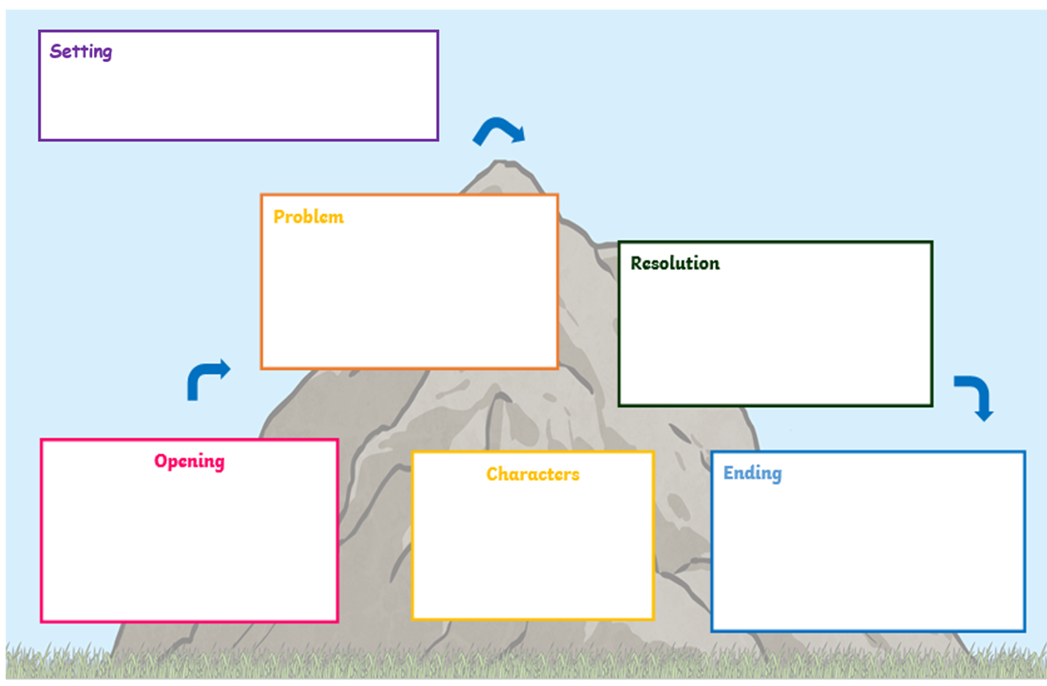
Work 2
Paragraph 3 – resolution
Paragraph 4 – ending
Where is your setting?
What can you see?
What can you hear?
What can you smell?
What can you touch?
Where is your setting?
What can you see?
What can you hear?
What can you smell?
What can you touch?
What happened?
Was there a problem?
What did your character do?
How did your character feel?
How can you fix what happened?
Will your character solve the problem?
Describe your setting
Introduce your character
Where do they go?
What do they do?
Is it going to be an exciting ending?
A cliffhanger – what will happen next?
Or a happy ending?
Describe your setting
Introduce your character
Where do they go?
What do they do?
What do they look like?
How do they behave?
What do they wear?
What do they look like?
How do they behave?
What do they wear?

Slide 11
Work 3
Paragraph 3 – problem
Paragraph 4– resolution and ending
Where is your setting?
What can you see?
What can you hear?
What can you smell?
What can you touch?
Where is your setting?
What can you see?
What can you hear?
What can you smell?
What can you touch?
What do they look like?
How do they behave?
What do they wear?
What do they look like?
How do they behave?
What do they wear?
Describe your setting
Introduce your character
Where do they go?
What do they do?
How do they feel and why?
Describe your setting
Introduce your character
Where do they go?
What do they do?
How do they feel and why?
Begin to write about what is happening at the start of your story. Don’t forget to use the
characters you introduced at the beginning of your story.
Write about a problem that is happening in your story. What
is it that has gone wrong?
What happened?
Was there a problem?
What did your character do?
How did your character feel?
Write about how the problem will be fixed. Think about how the characters might work
together to solve whatever has
gone wrong.
How can you fix what happened?
Will your character solve the problem?
Is it going to be an exciting ending?
A cliffhanger – what will happen next?
Or a happy ending?

Slide 12
Remote Learning Tracking
Please click on the link below
https://forms.office.com/Pages/ResponsePage.aspx?id=eCY4lN73r0G0KV1rDWITzRhTQ2IZqpBOsW8cFVoooF9UNVlMS1dCVkdaM0k0WlhFTE9WVFBTWEg1Ti4u

